Slide 1
Plenary session II (Open Spaces and Marine Resources)
Andrea Hershberger
Biologist II/Coral Reef Initiative Coordinator
Bureau of Statistics and Plans
Jose Garrido
Historic Preservation Specialist
Department of Parks and Recreation

Slide 2
Plenary session II (Open Spaces and Marine Resources)
Andrea Hershberger
Biologist II/Coral Reef Initiative Coordinator
Bureau of Statistics and Plans

Slide 3
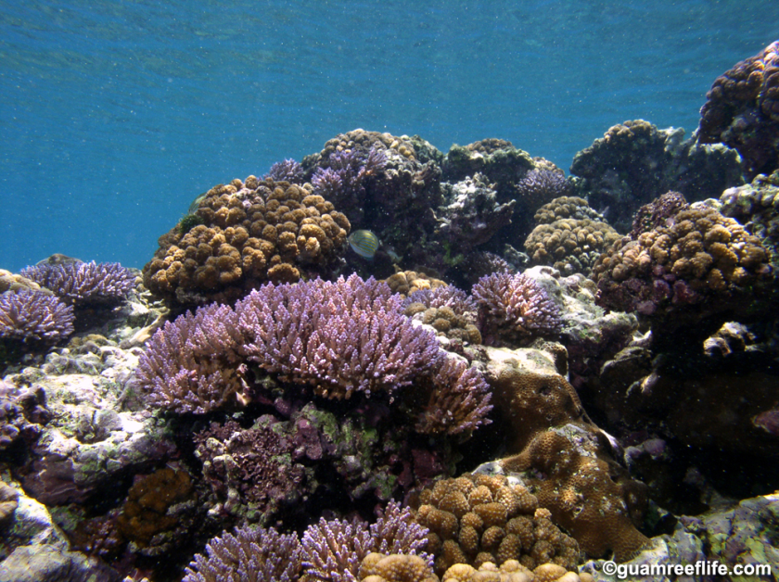
Guam’s Coral Reef Initiative
Assembly of Planners March 8, 2016
Working to Preserve our Reefs…
Andrea Hershberger, Coral Reef initiative coordinator, Bsp

Slide 4


Bureau of Statistics and Plans
“The Mission of the Bureau of Statistics and Plans is to ensure Guam’s resources are effectively used for the benefit of present and future generations by appraising, coordinating, preparing and assisting in the development of a wide range of plans, policies, studies and statistics that further economic, social, land use, environmental and infrastructure goals, priorities and planning activities as per Public Law 12-200 as amended by Public Law 20-147 and Public Law 26-76.”

Slide 5
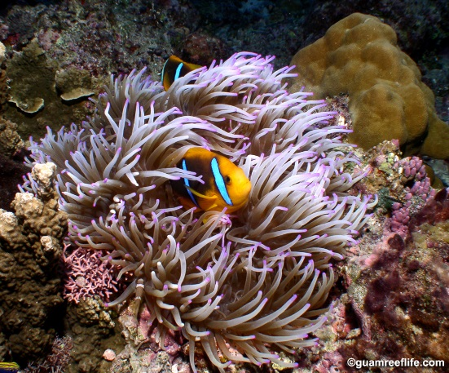
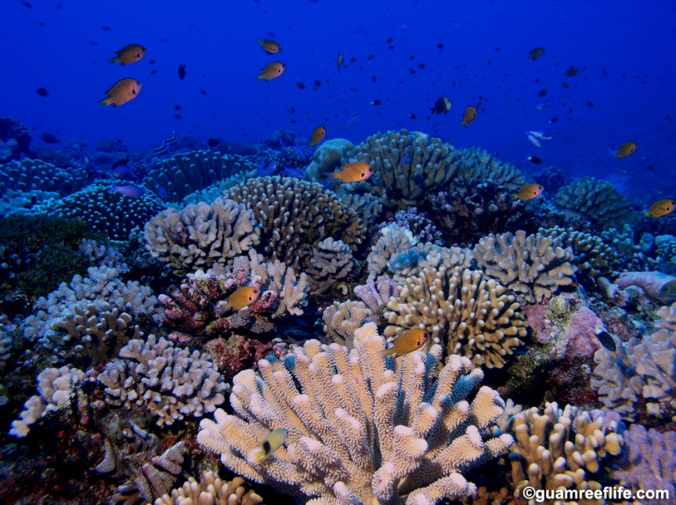
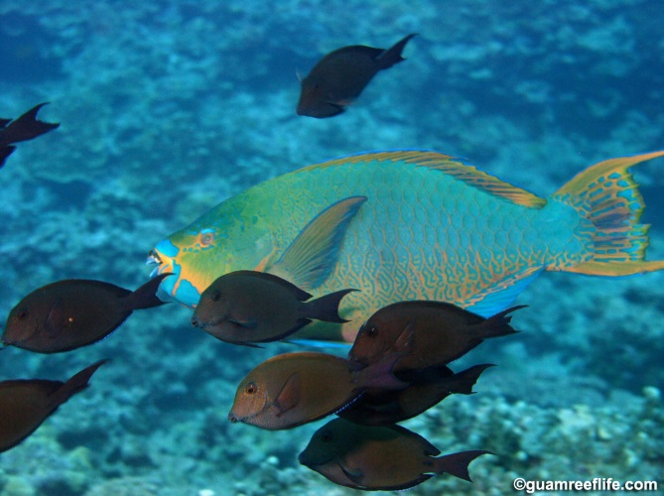
Coral Reef Initiative (CRI)
In1997, GovGuam established the Coral Reef Initiative to address threats to the reefs
The CRI provides funding for management and protection of coral reef ecosystems in the insular areas (CFDA 15.875)
BSP, DoAG, DAWR and GEPA lead most of the efforts of the CRI

Slide 6

NOAA PARtnership: Coral reef conservation program
CRCP MISSION: The CRCP supports effective management and sound science to preserve, sustain and restore valuable coral reef ecosystems for future generations.
Guam: Provides matching grants of financial assistance in support of coral reef conservation programs and projects that preserve, sustain and restore Guam’s coral reef ecosystems. (CFDA 11.482)

Slide 7
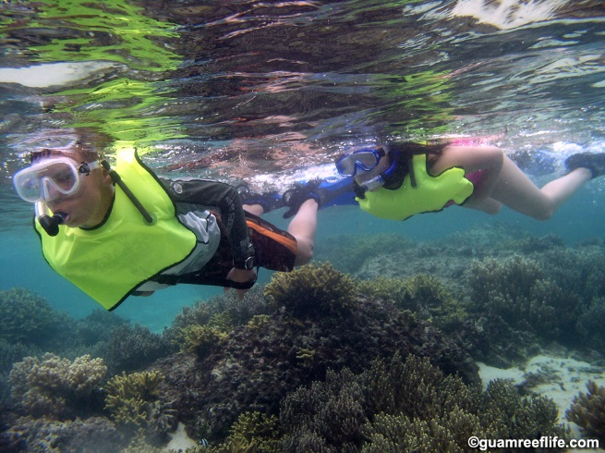
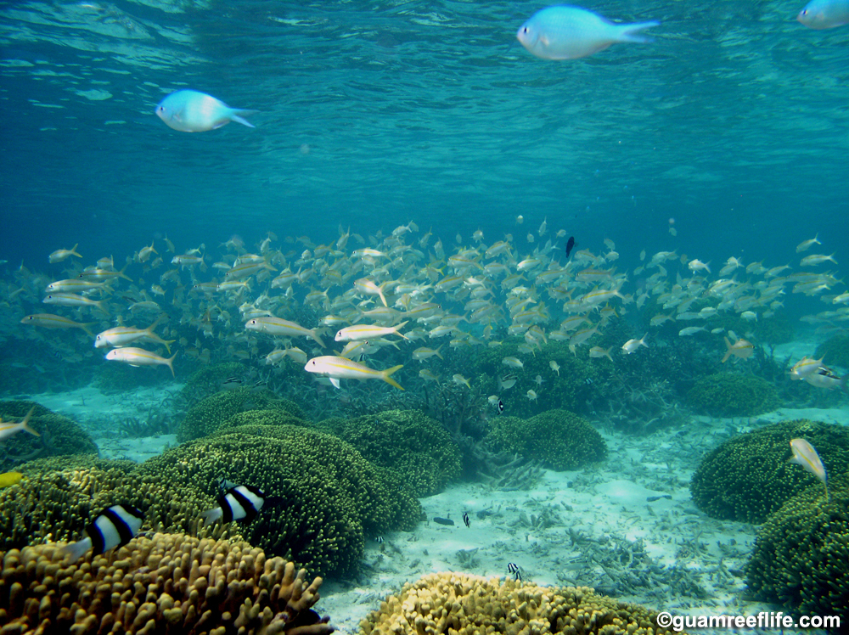
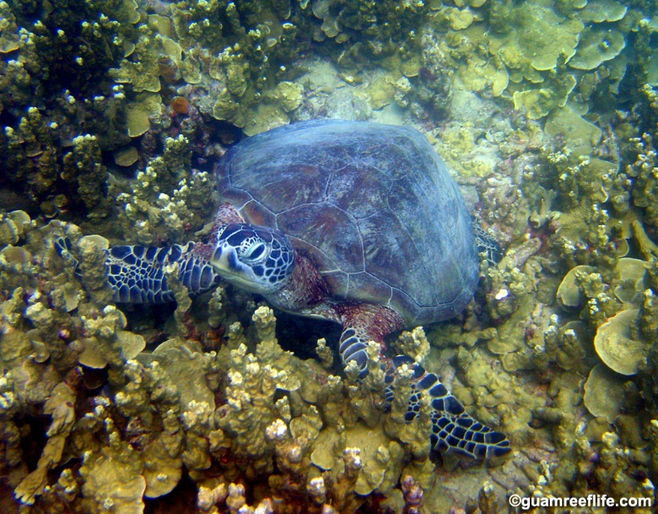
Why are Coral reefs Important?
Healthy coral reefs are among the most biologically diverse and economically valuable ecosystems on earth, providing valuable and vital ecosystem services

Slide 8
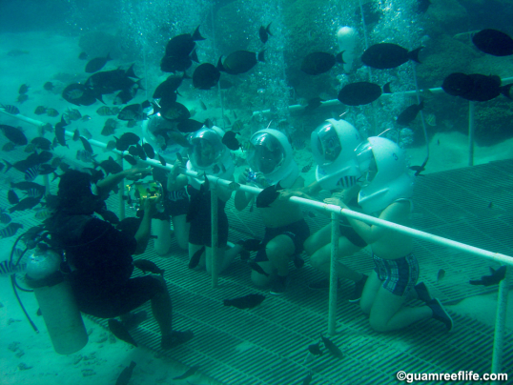

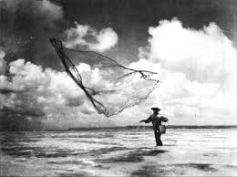
Why are Guam’s reefs important?
Economically Important
Estimated Value $139 million per year*
Provide jobs and income to local economies from fishing, recreation, and tourism
Source of food
Ecologically Important
Provide habitat, spawning and nursery grounds for economically important fish species
Protect coastlines from storms and erosion
Culturally and Socially Important
Coral reefs and their inhabitants are intricately woven into cultural traditions
*(van Beukering et al. 2007)

Slide 9
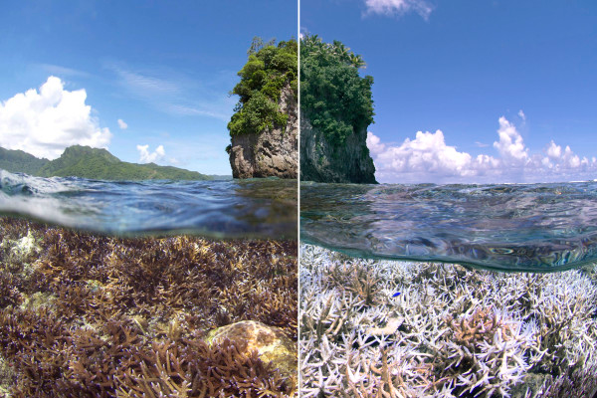
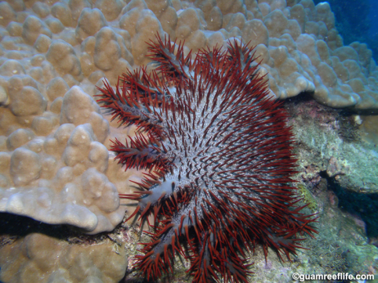
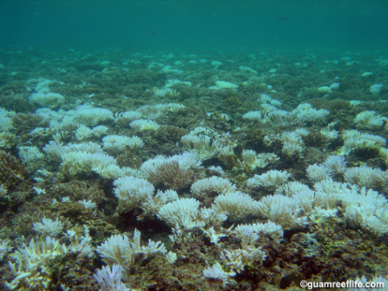
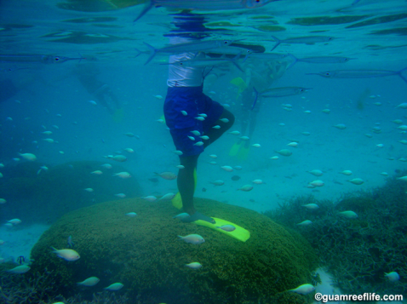
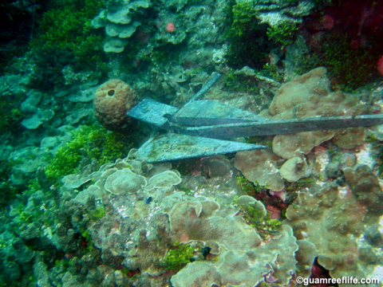
Threats to Guam’s reefs
Global Climate Change Effects
Ocean Acidification
Rising Sea Temperatures
Rising Sea Levels
Local Stressors
Land-based Sources of Pollution
Coral Bleaching
COTs
Boat groundings, anchor and mooring damage
Recreational use and misuse

Slide 10
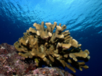
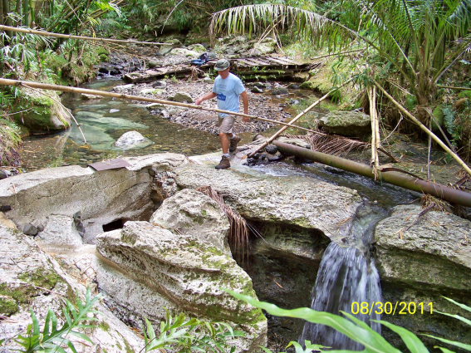
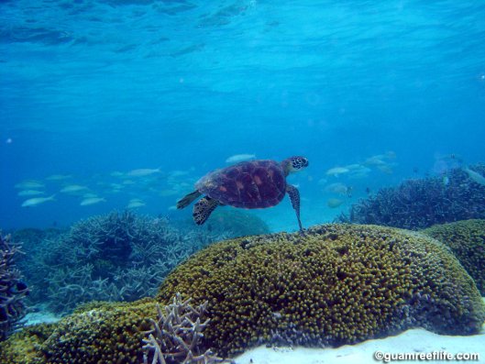
Local Action Strategies Improving the health of Guam’s coral reefs
Prioritize Funding and Management Efforts into 5 Focus areas
Land-based Sources of Pollution (LBSP)
Reducing the amount of sediment from development , fires, recreational users and agriculture in Guam’s watersheds
Fisheries Management
Support sustainable management of Guam’s reef fish to facilitate healthy fisheries and resilient coral reefs
Recreational Use and Misuse
Reducing negative recreational impacts
Climate Change and Reef Resilience
Addressing climate change, coral disease, nuisance and invasive species, and the resilience of Guam’s human communities affected by reef loss
Outreach, Awareness and Education
Raising public awareness to coral reef issues

Slide 11

Local Action strategies: From Planning to Implementation
Coral Reef Initiative Coordinating Committee (CRICC)
Directors and Administrators from
DoAg, BSP, GEDA, GEPA, DCA, UOG, DPR, GVB
Final word on Local Action Strategies and funding priorities
LAS Working Groups
Inter-Agency Working groups meet for each of the 5 focus areas
Determine strategies and projects to further the mission of improving Guam’s coral reef ecosystems
Coral Reef Initiative Policy Advisory Committee
Community Stakeholders meet and advise CRICC on the Guam LAS

Slide 12


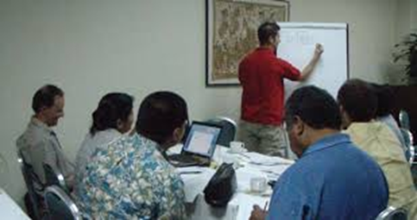
Coral Reef Coordinating committee Agency Administrators report to the Governor
LAS Working Groups
LBSP
Fisheries Mgmt
Recreational use
Climate Change
Awareness
CRIPAC
Community Stakeholders

Slide 13
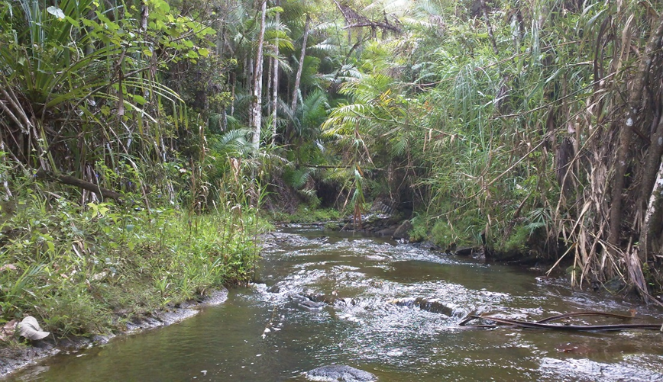
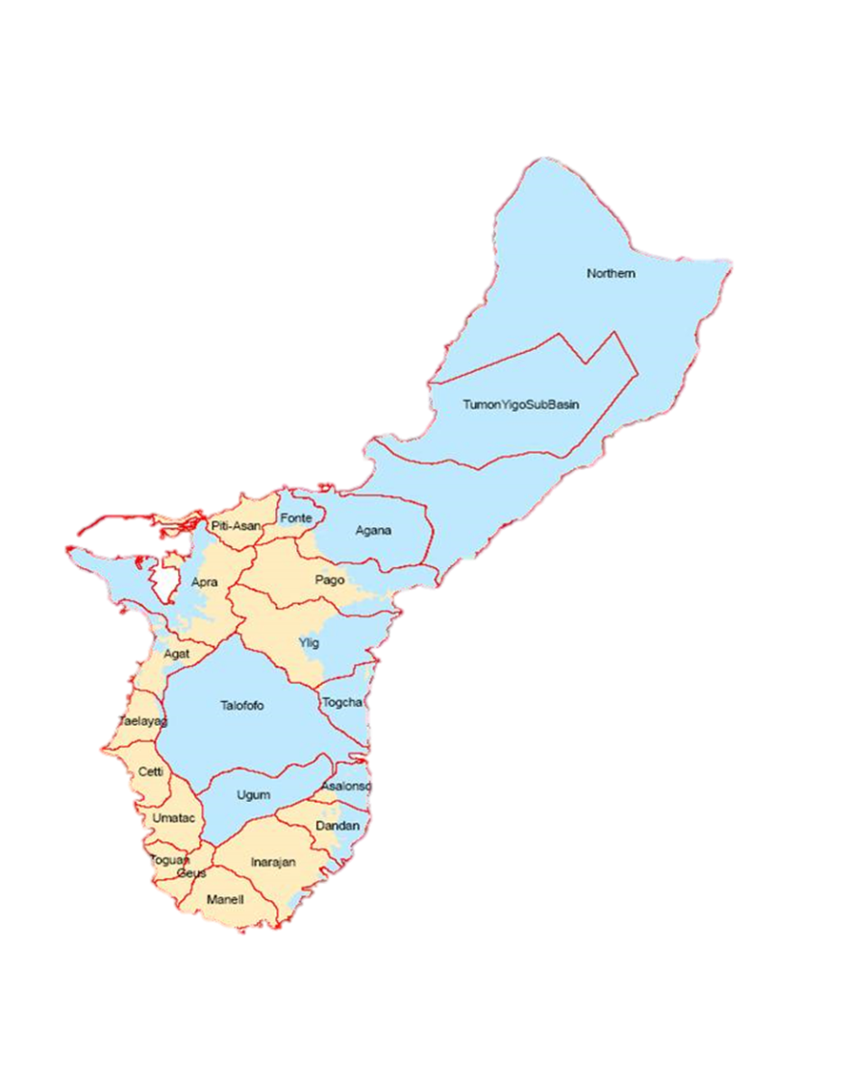
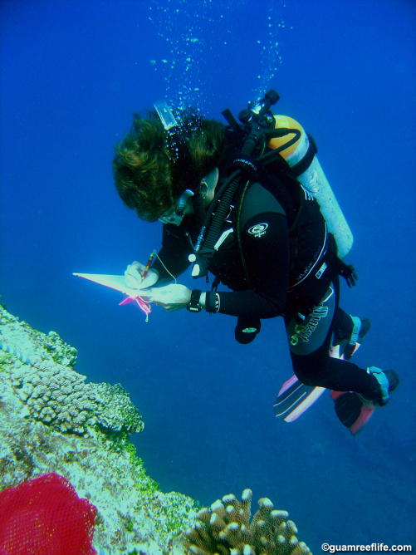
Current projects
Manell-Geus Watersheds
Streambed Stabilization
Bamboo Removal
Invasive Algae
Long Term Coral Reef Monitoring Program
Reef Resilience Strategy and Response Team
NOAA Coral Fellow
Outreach
Guardians of the Reef
Tasi Beach Guide

Slide 14
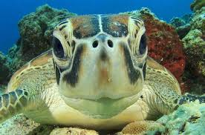
Questions and answers?
Thank you!!
Special Thanks to Guamreeflife.com for the pictures!

Slide 15
Plenary session II (Open Spaces and Marine Resources)
Jose Garrido
Historic Preservation Specialist
Department of Parks and Recreation

