Slide 1
Plenary Session I
(Economic development and land-use planning)
Brianna Benito
Industry Development Specialist
Guam Economic Development Authority
Matthew Sgro
Business Development Assistant Manager
Guam Economic Development Authority

Slide 2


Slide 3
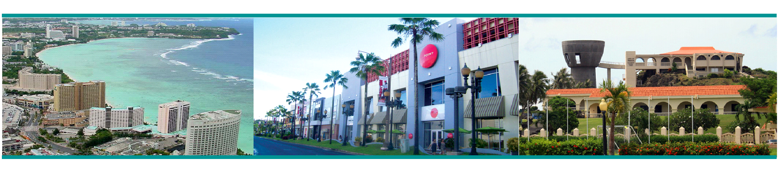

Mission Statement
GEDA’s mission is to develop a sound and sustainable economy through innovative programs that preserve and promote local culture, economic opportunities and the quality of life.

Slide 4
GEDA Programs
Qualifying Certificate (QC) Program
Encourages investment through the issuance of tax rebates and abatements
Guam Product Seal Program
Stimulates economic opportunities on Guam by promoting the manufacturing of local products
Loan Programs
  Guam Development Fund Act
  Agriculture Development Fund
  State Small Business Credit Initiative (SSBCI)
Notes:
BRI

Slide 5
Other Services
Investor concierge services
Trade Missions
Municipal Financing
Government Property Management Services
Notes:
BRI

Slide 6
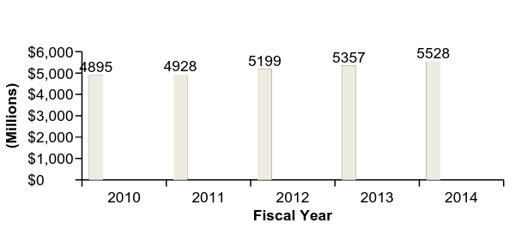
Guam Economic Overview
Recent Highlights
Guam’s GDP continues to expand Measured $5.53 billion in 2014, up 13% from 2010 Private fixed investment has increased 29% since 2010 FY2015 achieved the second highest number of visitor arrivals in Guam’s history, with 1.4 million visitors. Unemployment rate at 6.9% as of March 2015, down from 7.7% in December 2014
Gross Domestic Product (2010-2014) in Millions
13% Total Growth
___________________________
Sources: Guam Visitors Bureau, U.S. Bureau of Economic Analysis, U.S. Bureau of Labor Statistics and Guam Bureau of Labor Statistics.
Notes:
BRI

Slide 7
Employment Indicators
Unemployment rate at 6.9% as of March 2015, down from 7.7% in December 2014
Total number of persons unemployed in March 2015 was 4,840.
Employment data for June 2015 show the total number of private sector jobs up 1,270, or 2.7 percent, from June 2014.

Slide 8
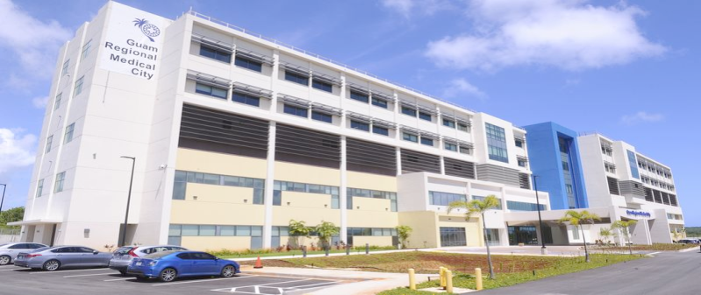
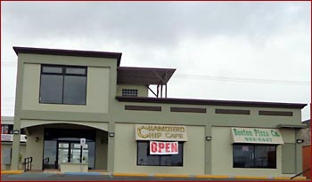
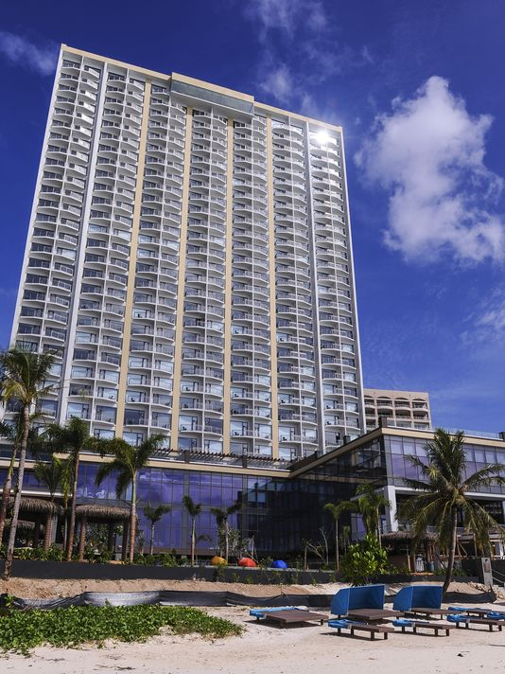
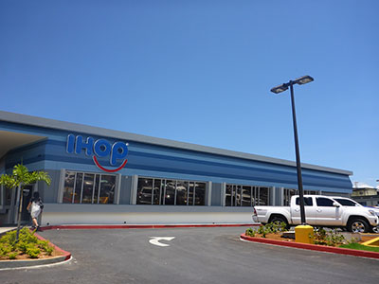
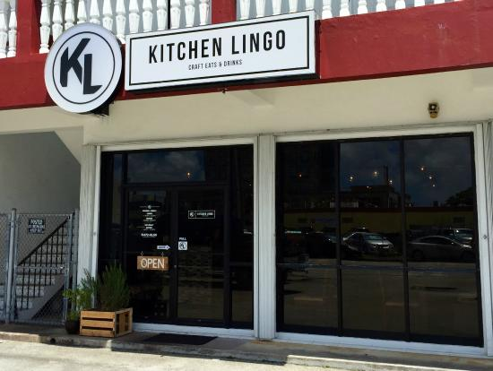


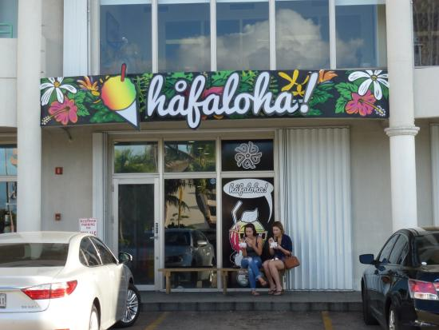
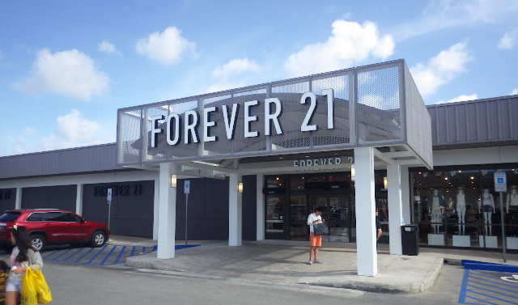
New Businesses
2015-16
Notes:
BRI

Slide 9
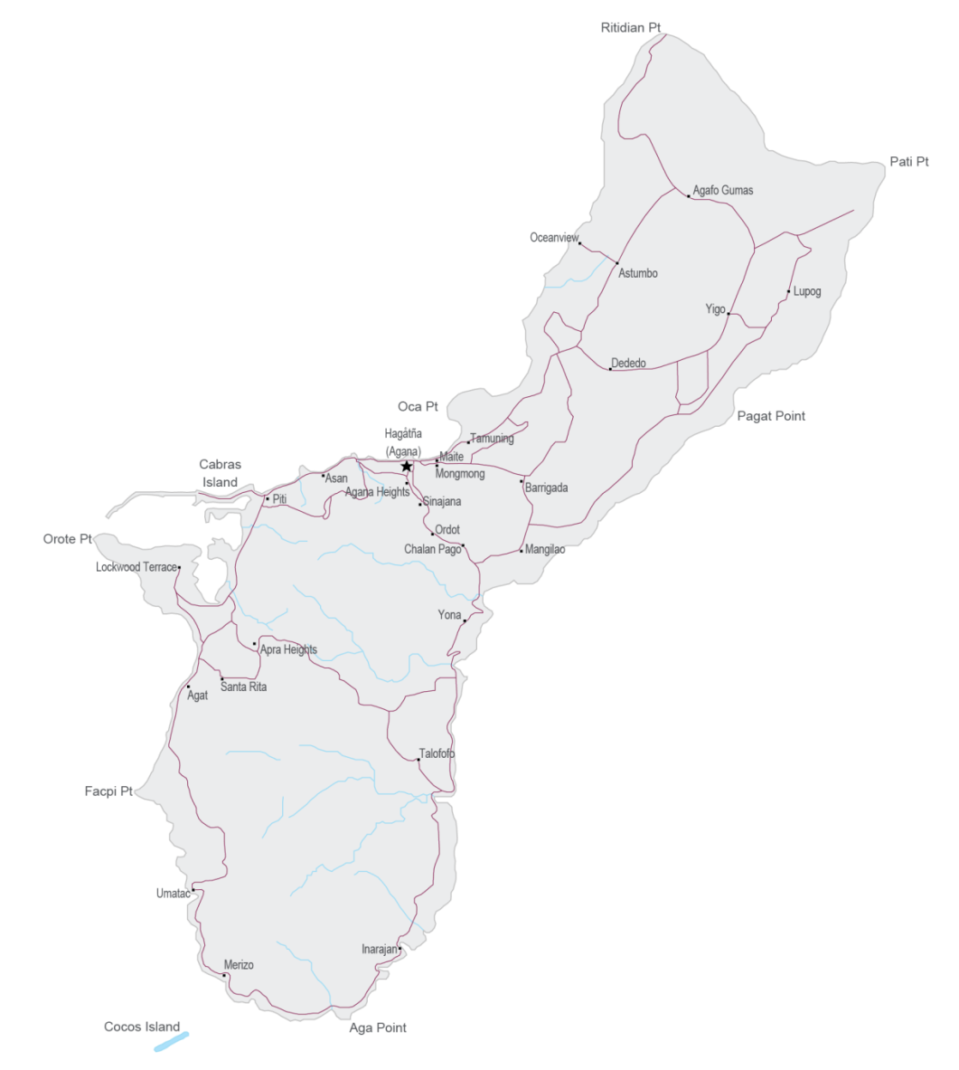
Tourism
2015: 1,409,033
2020: 2 million
  Hotel occupancy rates are the highest in over a decade at 80%
  Average room rates are at all-time high of $158 per night
GVB Vision 2020
  1,600 additional rooms
Special Hotel QC
  Currently: 1058; additional 1,302
  Total Investment: $387+ million
  Total Additional Jobs: 900+
Tsubaki Hotel
340-Room New Hotel (Construction Begins 2016)
Citta di Mare Hotel
500 New Hotel Rooms Planned
Garden Villa
102-New Hotel Rooms Proposed
Planet Earth Guam-650 Hotel Rooms
Lotte Hotel
Re-Opened 2014
MOYCORP Holdings-250 Rooms
Dusit Thani
Opened 2015
419 Rooms
$250 million
Pago Bay Resorts-300 Hotel Rooms
Ladera Tower
218 Rooms,
Conversion to Hotel
Notes:
BRI
(10%) of their total construction costs, which can be applied by the developer, at their discretion,
to the following taxes:
•
50%
of Unpledged
Business Privilege Tax
payable to the government of Guam
for twenty (20) years.
•
75% Income Tax Rebate for twenty (20) years.
•
100% Real Property Tax Abatement for ten (10) years on property utilized by the beneficiary for activities
stated in the QC.
•
100% of Use Tax Exemption with respect to the property used to construct, furnish and equip the new
facility construction or substantial expansion of an existing building.

Slide 10
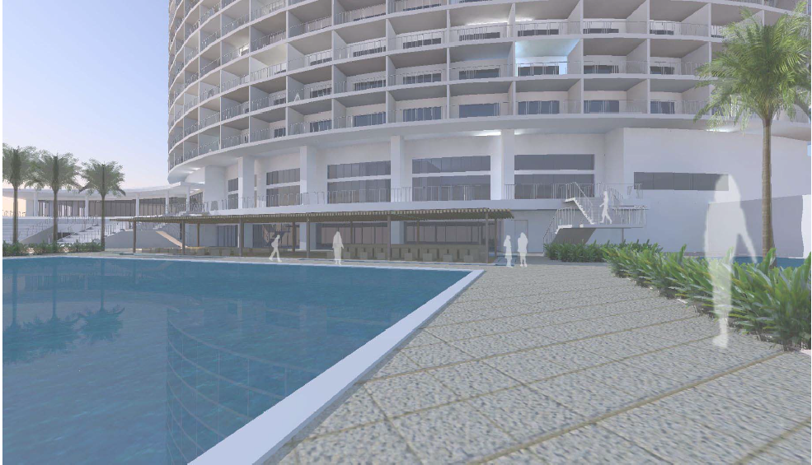
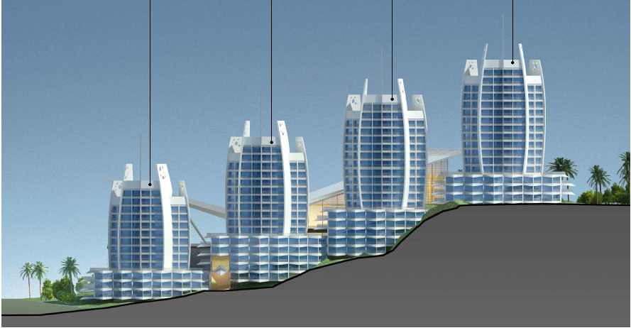
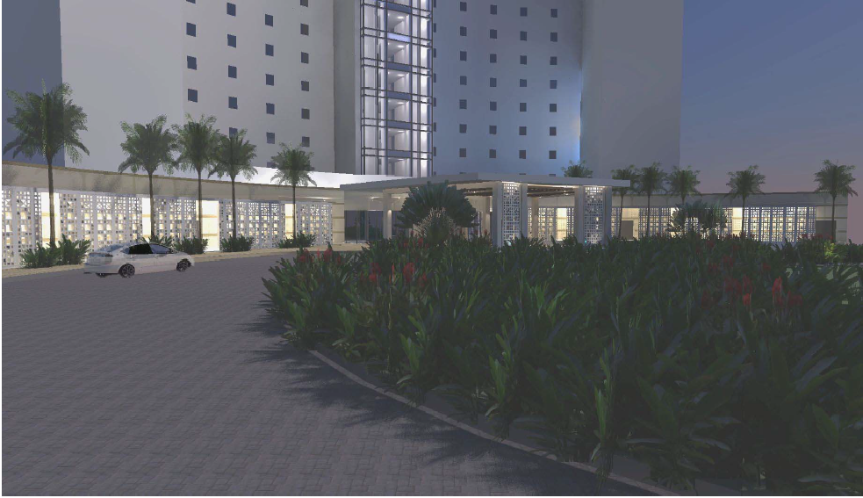
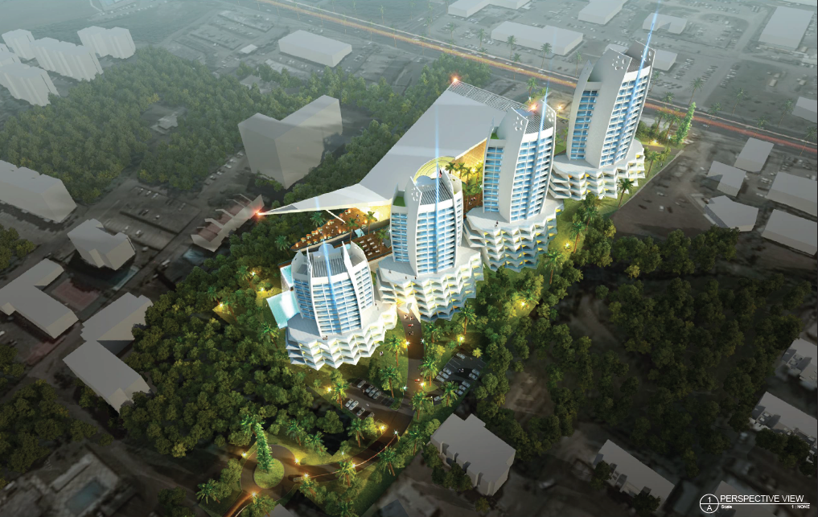
New Hotel Development
Notes:
BRI

Slide 11

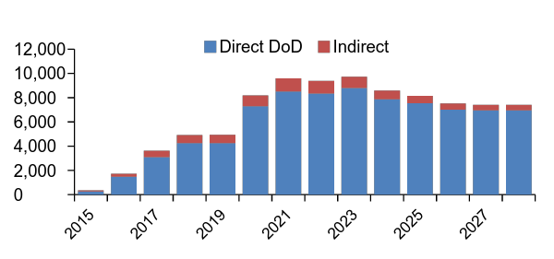
Pacific Military Realignment
The signing of the Record of Decision (ROD) in August 2015 for the Marine relocation begins the process for significant additional military investment in Guam
Current plan: approximately 5,000 Marines and 1,300 family members to be relocated to Guam from Japan
Cost estimate is $8.7 Billion and will be funded by the governments of Japan ($3.1B) and the U.S ($5.6B)
Will create approximately 7,000 full time jobs in 2021
2014 - 2015: $607+ Million on military construction/special contracts
  2016: $92+ million
Peak construction period is estimated to be in 2017-2018
Proposed NDAA for FY2016 Navy Appropriations | in $000s
Live Fire Training Range Complex | $125,677
Sanitary Sewer System Recapitalization | 45,314
Municipal Solid Waste Landfill Closure | 10,777
Energy Conservation | 5,330
Total Navy Appropriations | $187,098
Proposed NDAA for FY2016 Air Force Appropriations | in $000s
APR - Installation Control Center | $22,200
APR Dispersed Maintenance Spares SE Storage Facility | 19,000
APR - South Ramp Utilities | 7,100
PRTC Roads | 2,500
Total Air Force Appropriations | $50,800
Notes:
JULIUS

Slide 12

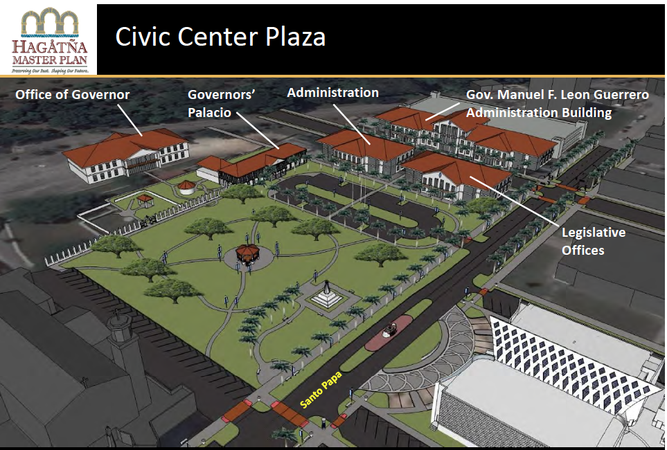
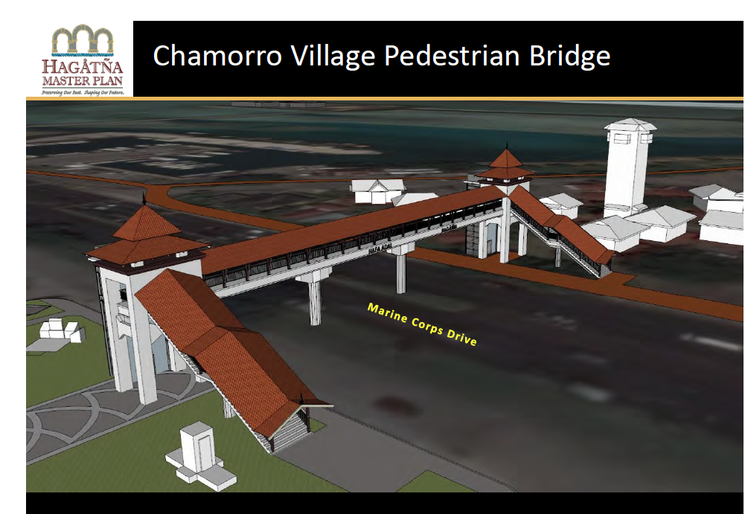
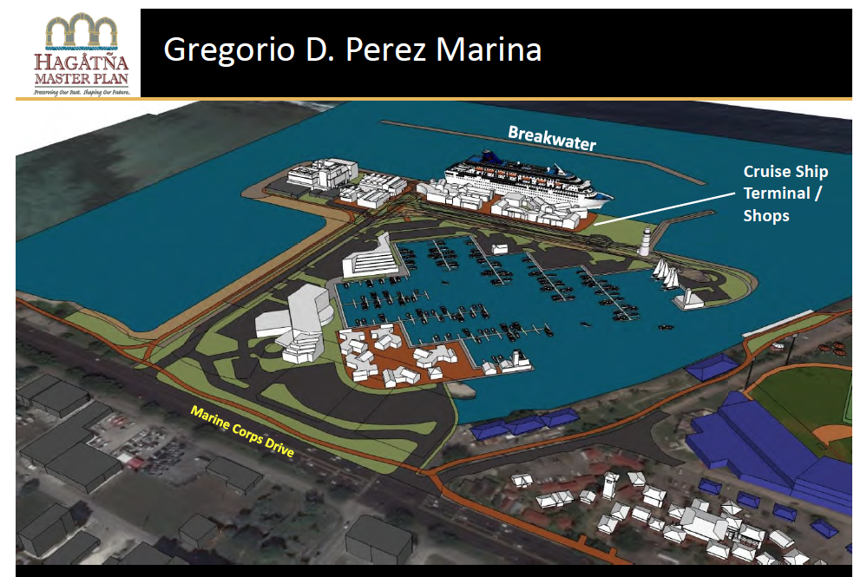
Hagåtña
Revitalization
Vision: A vibrant Hagatna as the center or cultural, civic, political, sports & economic vitality for Guam & the Western Pacific.
Matrix Master plan completed
Notes:
JULIUS

Slide 13
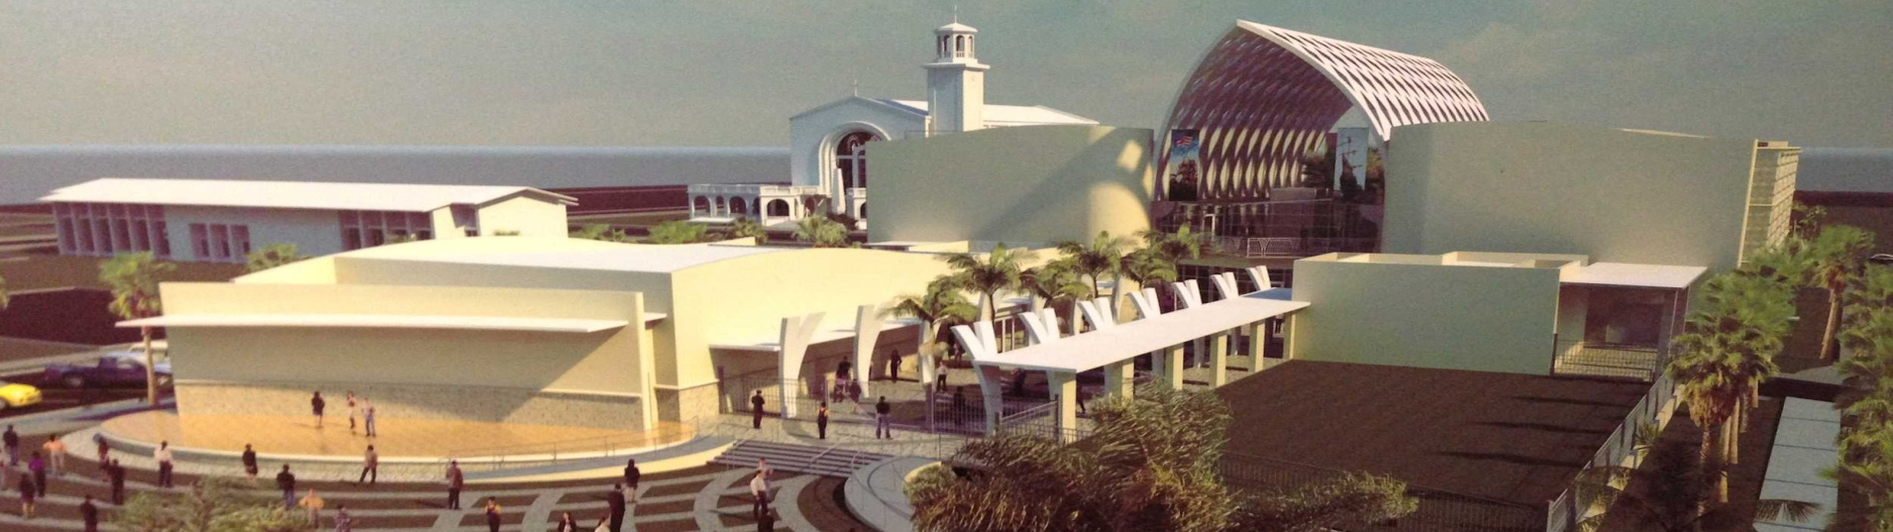
Hagåtña Revitalization

Slide 14
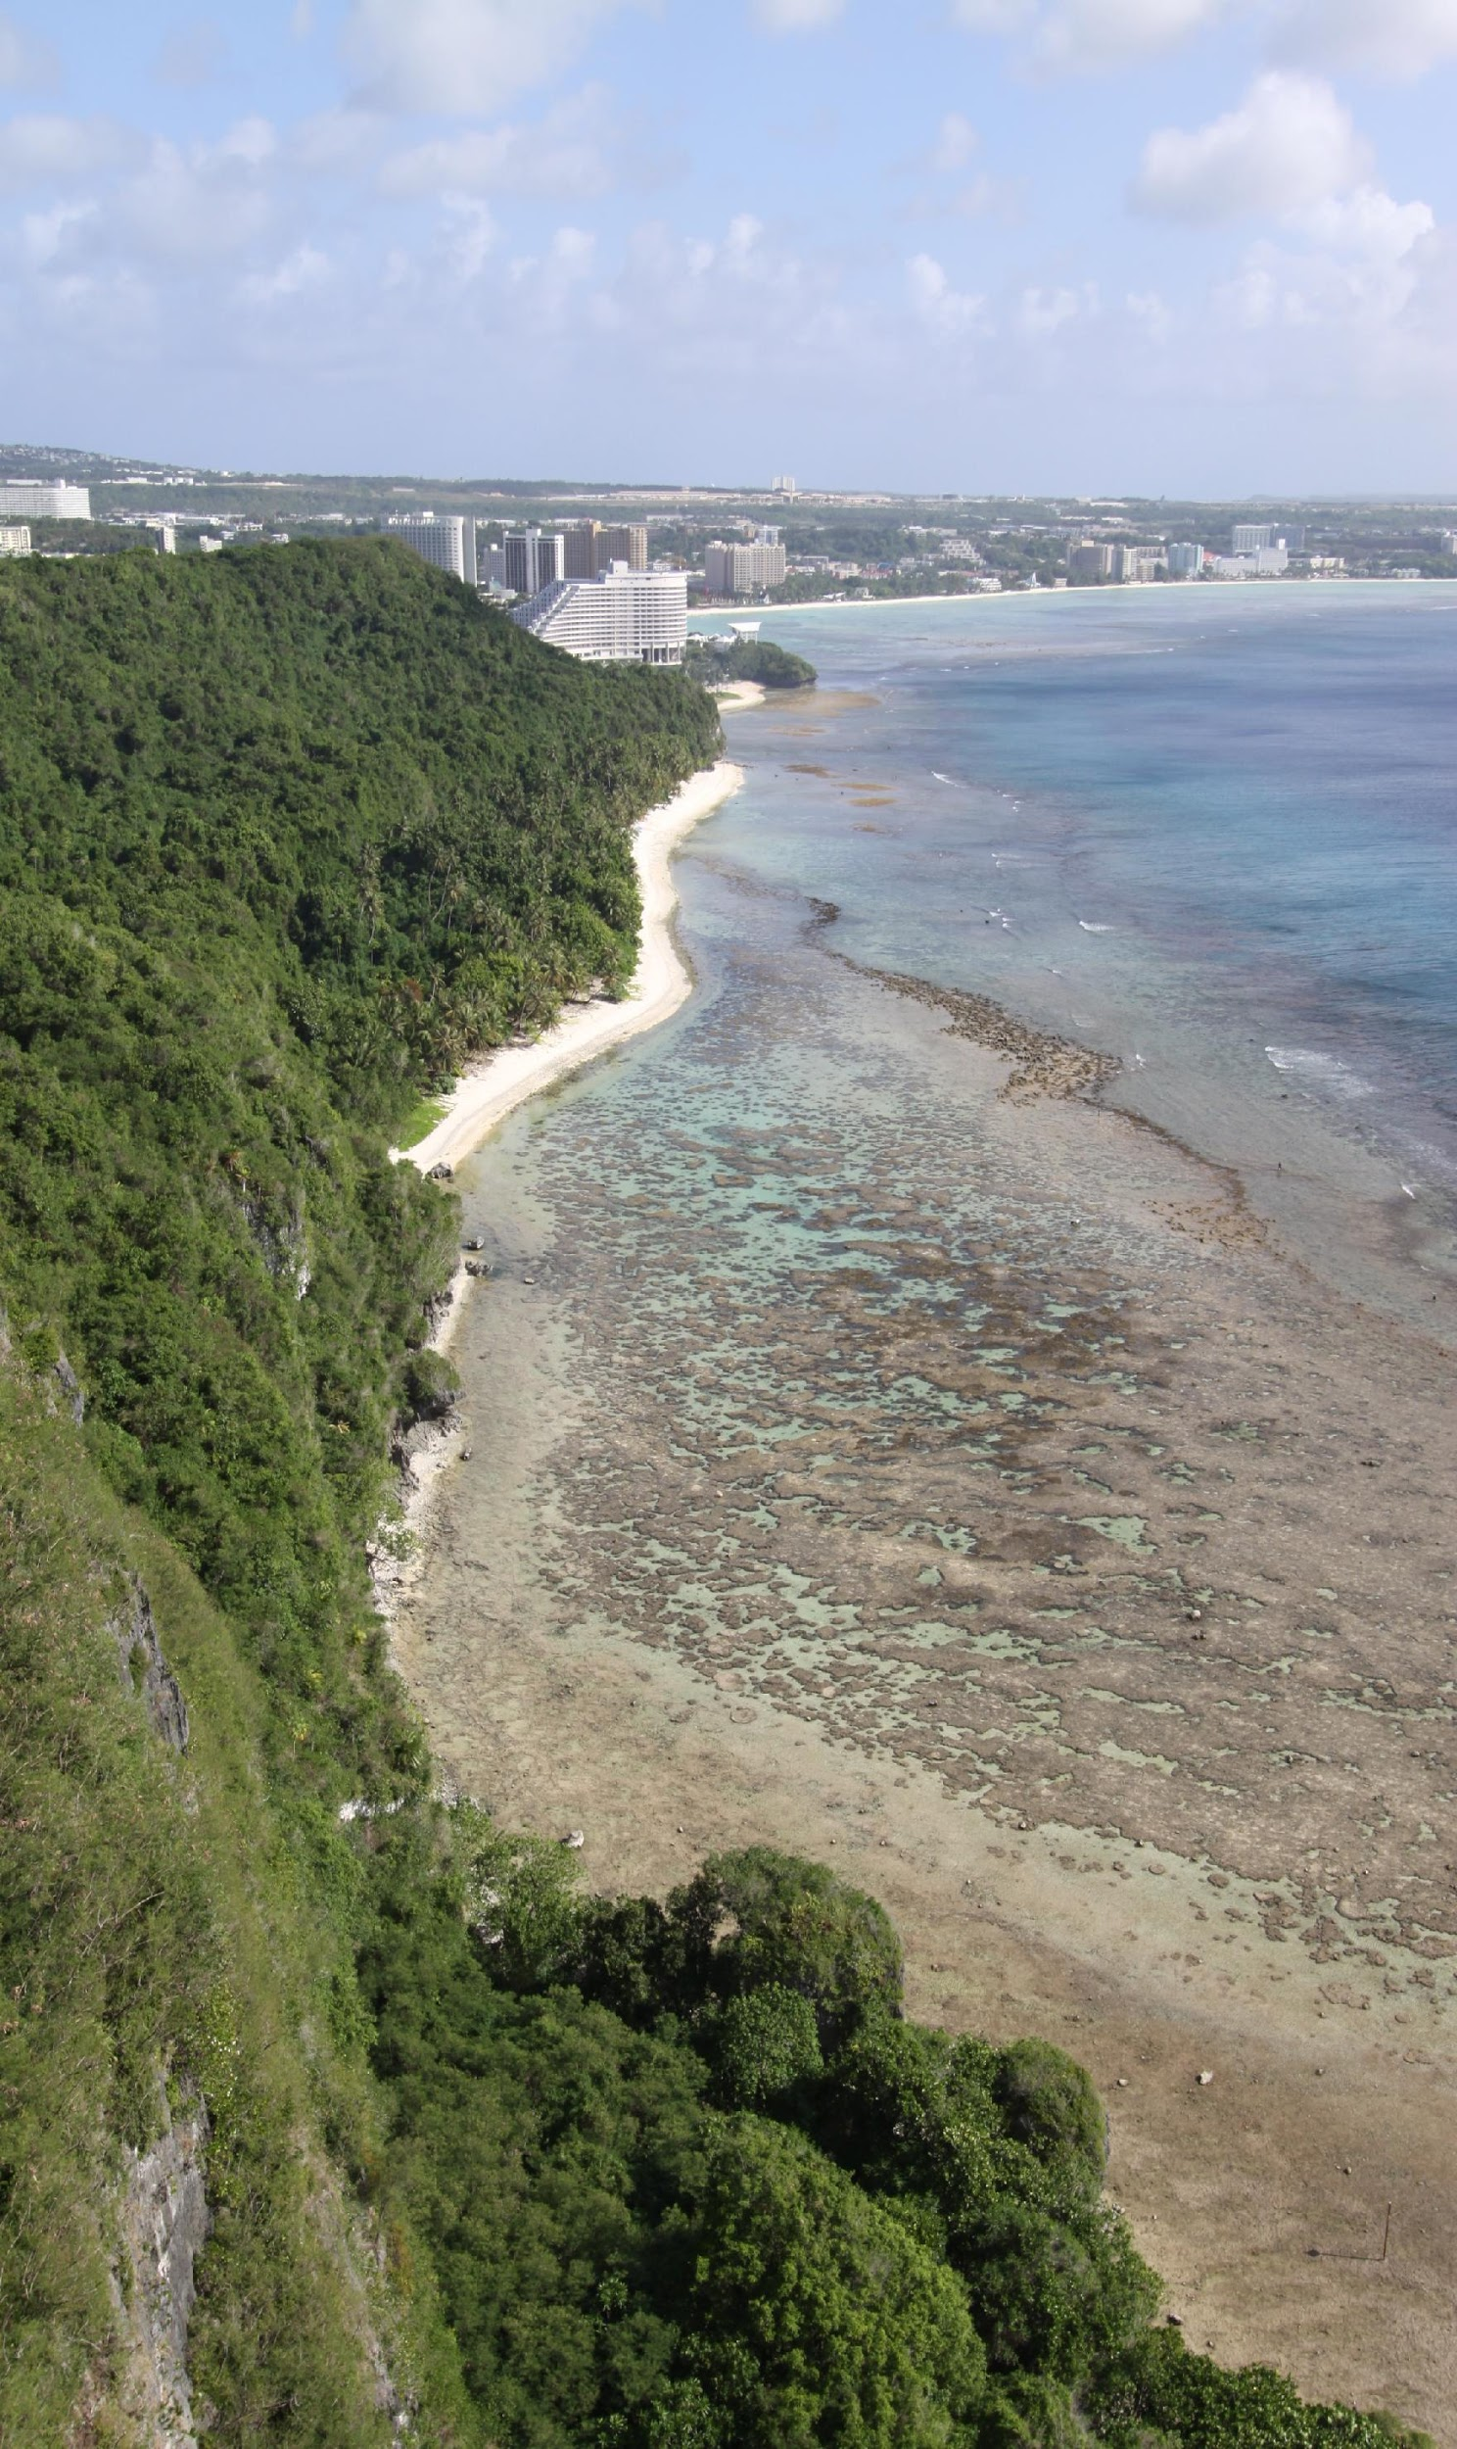
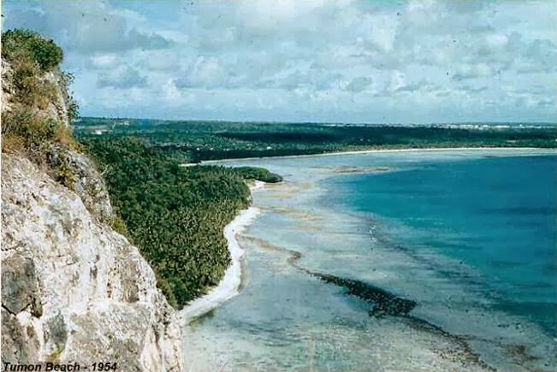
Notes:
JULIUS

Slide 15
Contact Us!
  590 South Marine Corps Drive
  ITC Building, Suite 511
  Tamuning, Guam 96913
  Tel: (671) 647-4332
  Fax: (671) 649-4146
Website: https://www.investguam.com
Facebook: https://www.facebook.com/GuamEDA

