Slide 1

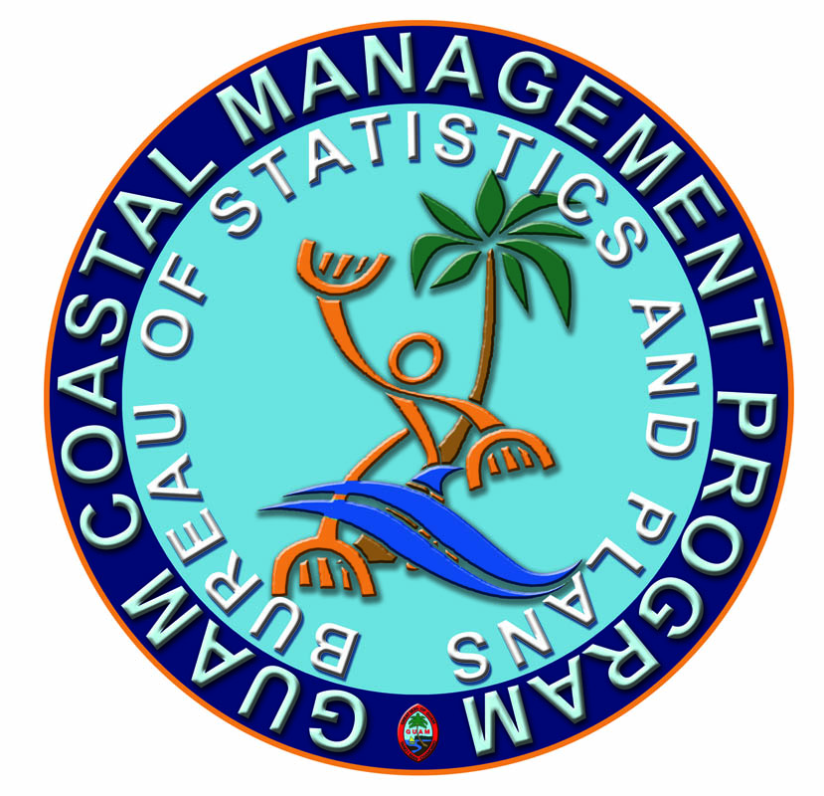

Slide 2
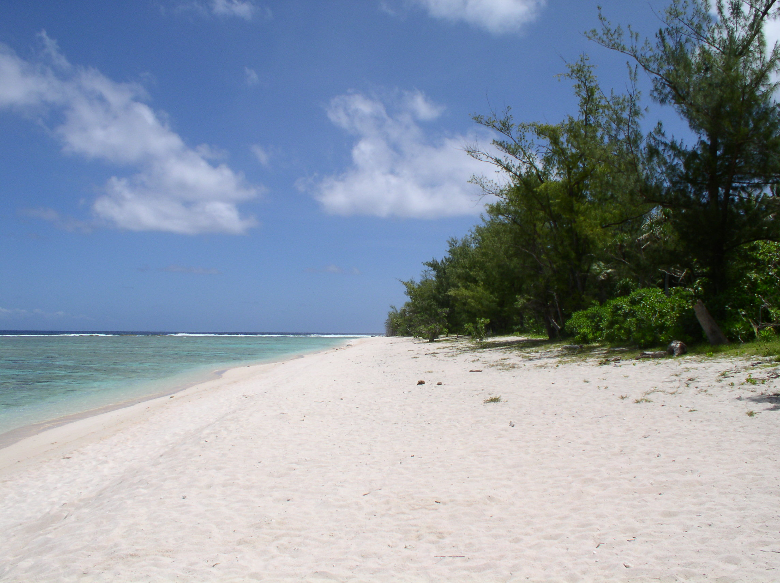
GCMP’s Mission
To manage Guam’s coastal resources, in partnership with network agencies and the community to protect, conserve, restore and enhance the environment and resources of Guam by ensuring the balance of economic development with environmentally prudent use of coastal resources for current and future generations.

Slide 3
About GCMP
Established in 1979 through the Coastal Zone Management Act
100% Federally Funded
CA between NOAA and BSP, Office of the Governor
EO78-37 Establishes Network Authority (Guam EPA, DLM, DPR SHPO

Slide 4
Management
Function
Federal Influence
Federal Consistency
Nat Resource Policy
Land Use
Application Review Committee, GLUC GSPC, Env. C.H.
Habitat Rest.
Information Transfer
Leadership Forums/Committees
Training
Assembly of Planners
Comprehensive
Planning
and Gov
Coordination
Geographic Information System / Data Coordinating
Outreach
MLS, Kika, ICC,
Publications, Media

Slide 5
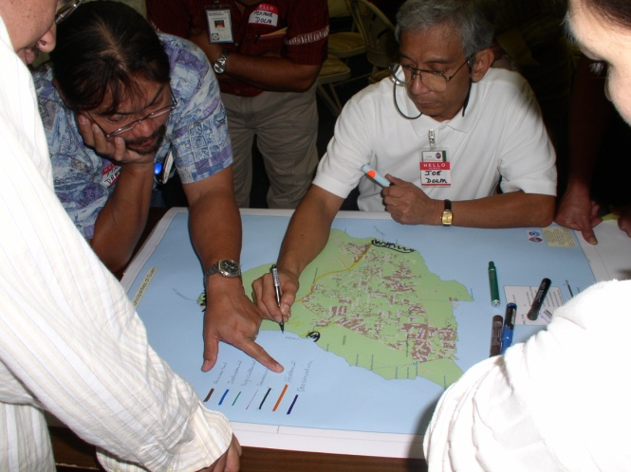
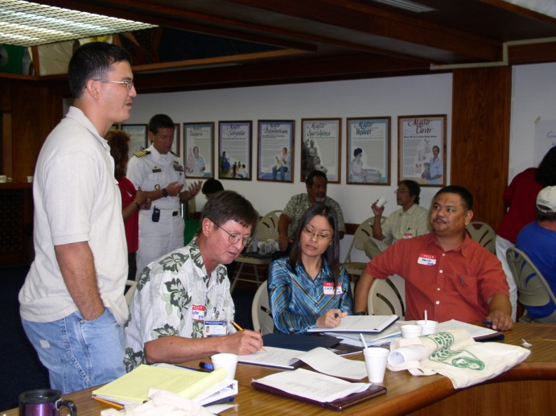
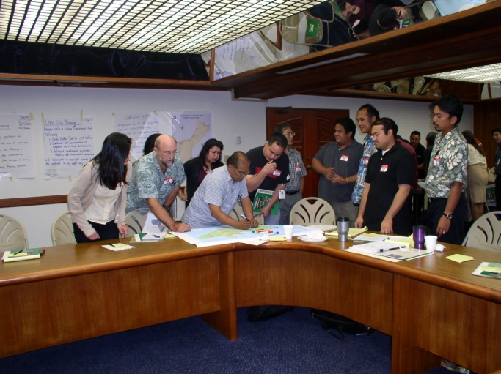
Application Review Committee (ARC)
Provides technical analysis and advice to the Guam Land Use Commission on development activities that do not meet zoning codes.
DLM, GEPA, DOAG, GWA, GPA, DPR, DPW, BSP
Established by EO 96-26

Slide 6
Application Review Committee (ARC)
Sign Variances / Height Variances
Tentative Development Plan
Conditional Uses
Zone Changes

Slide 7
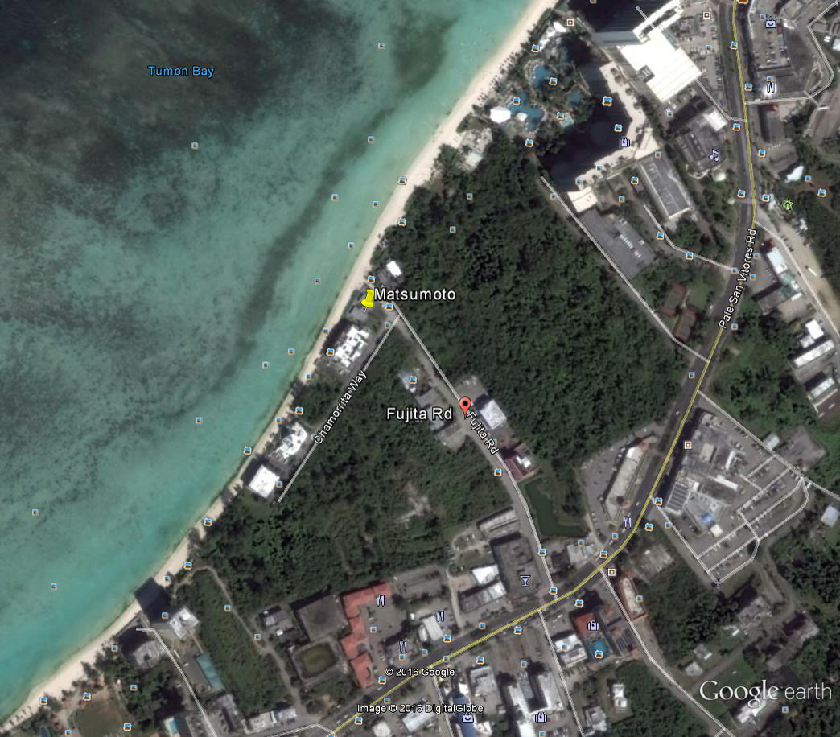
Tentative Development Plan
Notes:
Here is an aerial view of Piti and parts of Asan.
The reservoir is right here…point to reservoir and Santos Park.

Slide 8
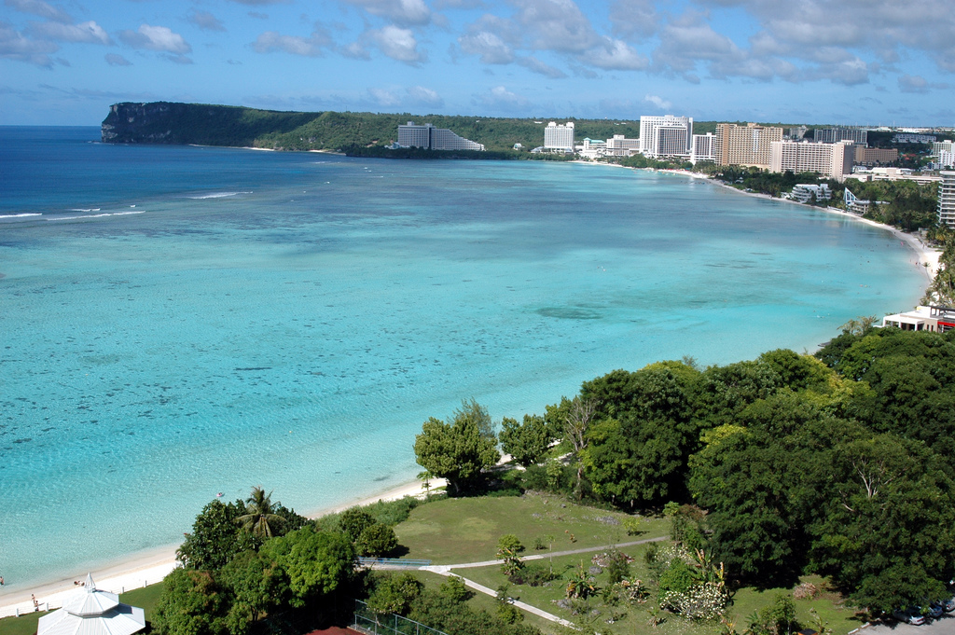
TDP: 6-Unit Apt. Complex
2-Story Building
2-3 Bedroom Units
11 Covered Parking Stalls
Demolition of existing duplex
Borders Marine Preserve

Slide 9
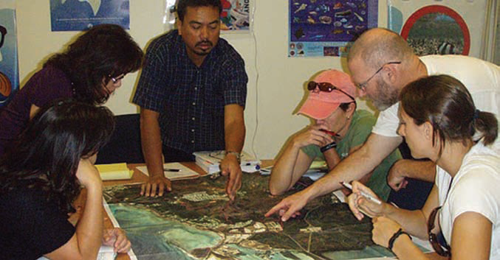
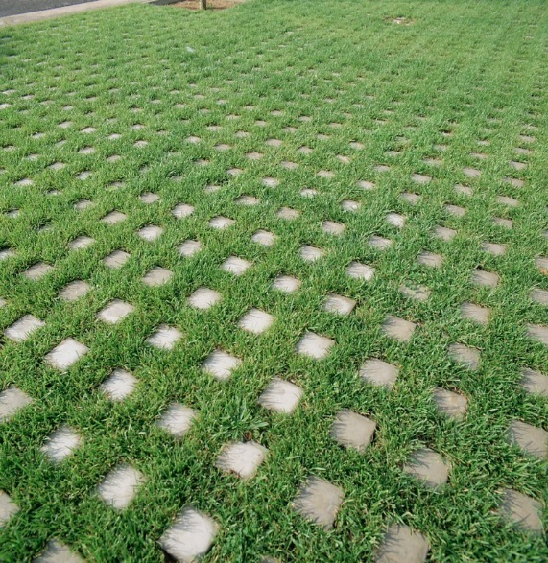
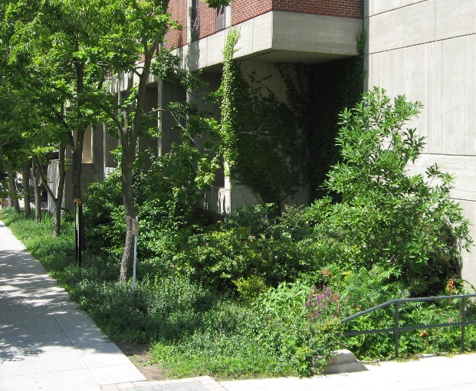
Position Statement: Apt. Complex
Protection of marine waters
Stormwater Management
Low Impact Development
Beach Access
Flood Zone

Slide 10
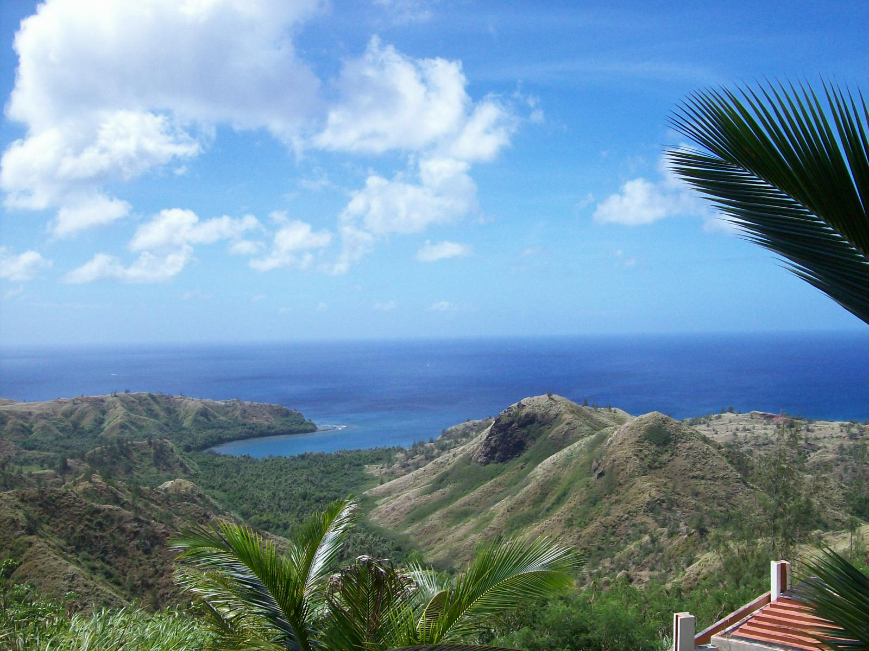

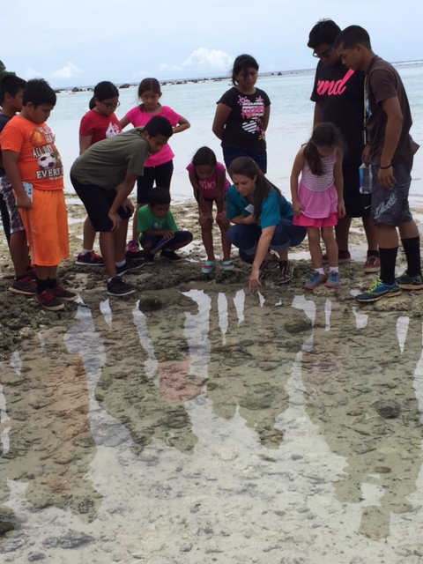
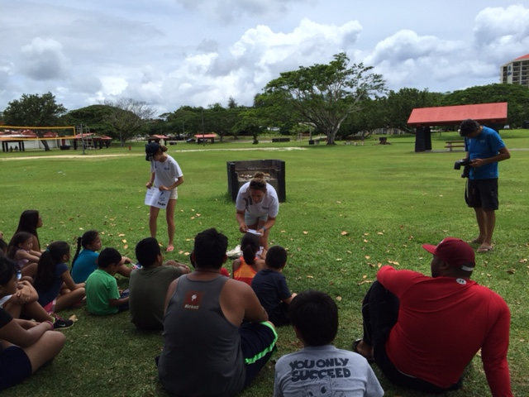
Public Outreach & Education
Watershed Awareness
Kika Clearwater Summer Camp
Man Land and Sea Newsletters
Earth day, Arbor day, Career day, and more!
Notes:
At GCMP we have adopted this watershed management approach in planning and management activities, and actively work w/ other agencies and organizations to address coastal resource protection issues using this concept. Our part as a government official is to recommend best management practices to protect our natural resources from ridge to reef and besides our position statements and determinations we conduct public outreach & education.

Slide 11
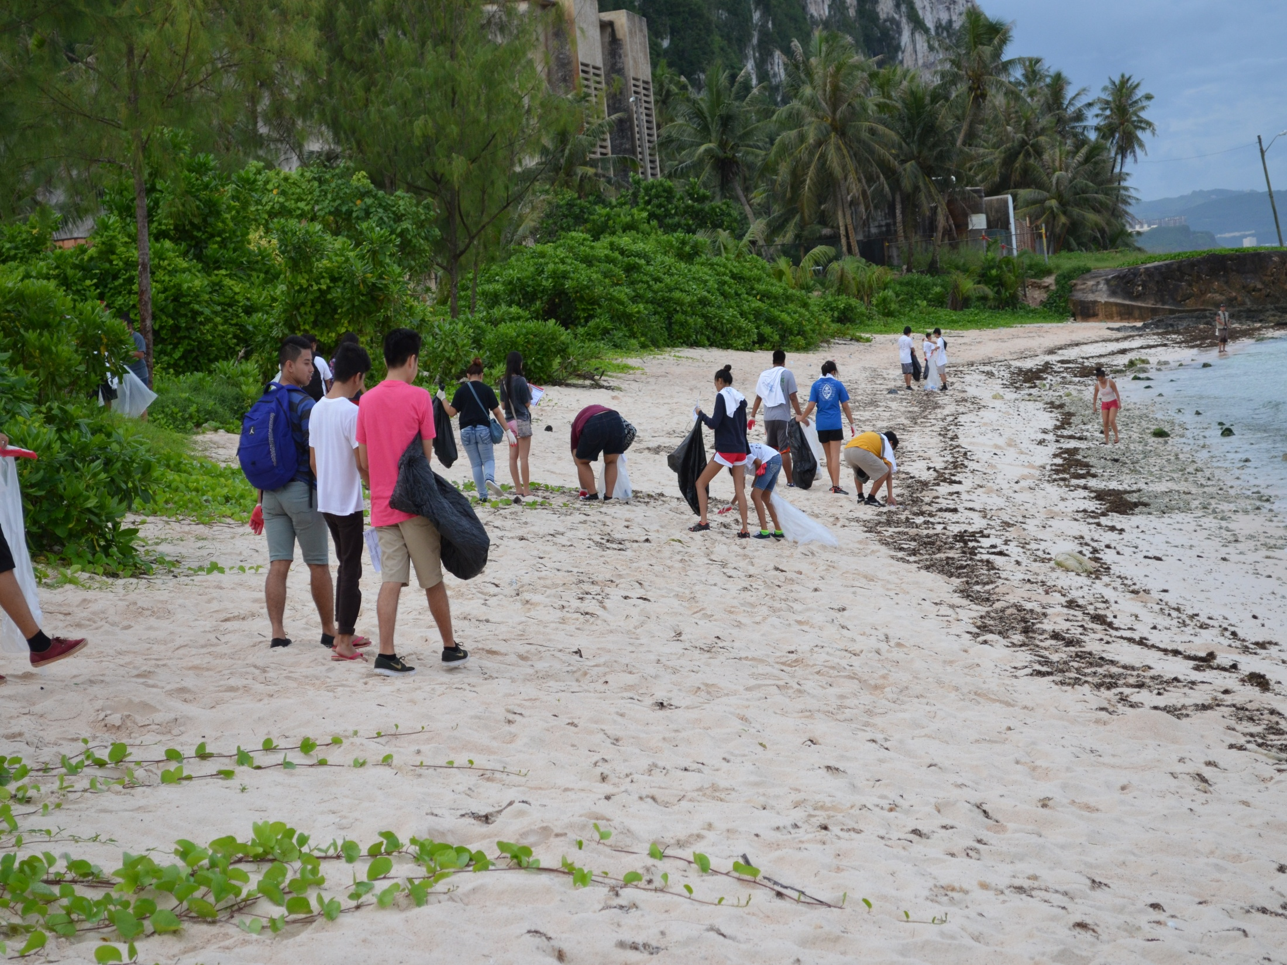
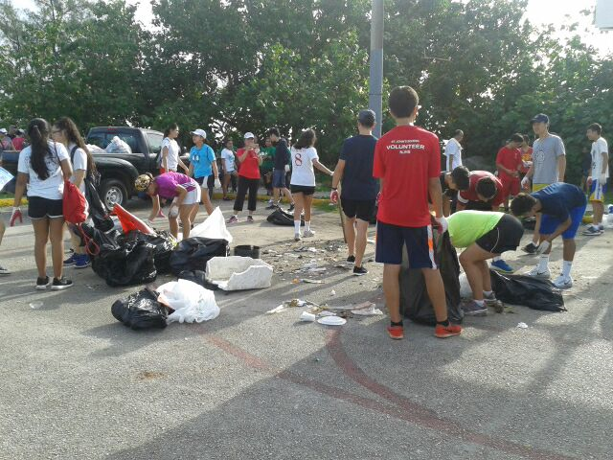
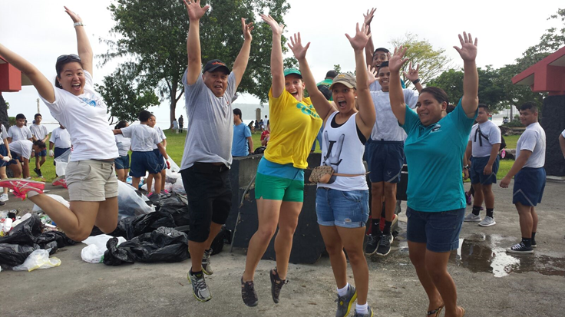
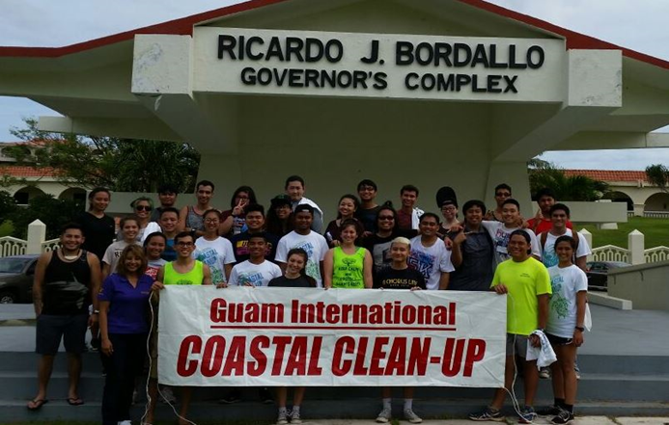
Guam International Coastal Cleanup
11
Notes:
How many of you have heard about the International Coastal Cleanup? Good most of you that means we are doing our job. Well the ICC is The biggest cleanup event and if I am not mistaken the biggest volunteer event on Guam. GCMP role in the ICC is the island’s lead coordinator. The ICC is the world’s largest one-day volunteer cleanup founded by the Ocean Conservancy that goes further than any other cleanup by collecting the data to be used to study marine debris or pollution behavior and Guam was one of 91 countries along with 50 US states that picked up more than 16 million pounds of trash in 2014.
This entails sending out reminders, conducting various meetings, and procuring supplies for the cleanup with other public-private-federal- partners. Additionally, we submit all the calculations of data to the Ocean Conservancy which is then used in national and international reporting on marine debris and the health of our seas. Last yr. 2015 we had over 4,000 participants and collected over 21,000 lbs of trash.
The Immediate benefits of continually conducting the ICC is the concrete actions preventing marine debris from entering our waters, having a clean beach for us and all our visitors, education and conversations on how to prevent and tackle marine debris.
And the long term benefits are a long term data collection back, community empowerment and coastal habitat planning.

Slide 12
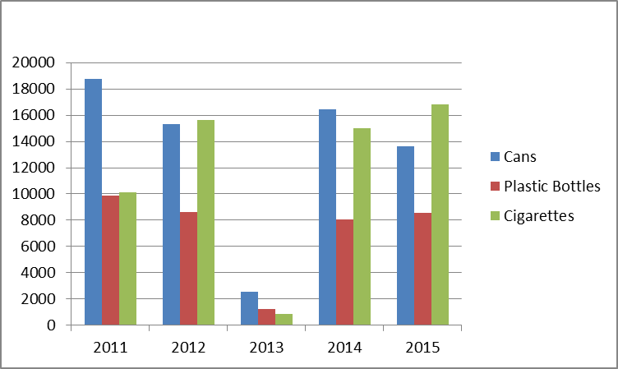
Top 3 Items 2011-2015
12
Notes:
Can I get guesses for Guam’s top 3 items of trash? So our top 3 items are Cans, Plastic bottles, & cigarettes.. Cigarettes are not too surprising we still seem them everywhere, but what is horrible is that cans & plastics bottles are on this list and they can be recycled! Money can be made here for our schools.

Slide 13
Snap shot 2011 v. 2015 data
Items 2011 2015 Difference
Amount % Amount %
Beverage Cans 18,756 21.14 13,625 14.67 ˅5,131
Cigarette Butts 10,108 11.39 16,822 18.11 ˄ 6,714
Plastic Beverage Bottles 9,861 11.12 8,538 9.19 ˅1,323
Participation 3876 4134 ˄ 258
Total pieces of trash 88,714 92,875 ˄4,161
Total pounds of trash 24,302 lbs 21,167 lbs ˅ 3,135
Total trash bags used 1,925 1,776 ˅ 149
13
Notes:
So here is a snapshot of 5years comparison of 2011 v 2015. Its great news both plastic bottles & cans decreases, but 6,000 increase in cigarette butts must be bad for not only our health as a community but our environmental health as well. The total lbs & trash bags used decreased so that’s a good thing for our landfill. However, the ultimate goal of the ICC is not to continue to have all these cleanups bc its costly, but the ultimate goal is to have a behavoir change and that we won’t be needing cleanups bc our island is beautiful and trash free.

Slide 14
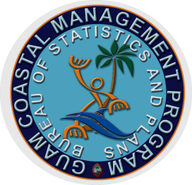
Manell-Geus Project
Patrick Keeler
Bureau of Statistics and Plans
Coastal Management Division

Slide 15
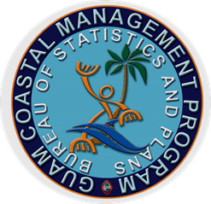
Grant Goals: “Develop a Framework for Assessing Green Infrastructure for Flood Mitigation”
Define the flooding problem
Research existing infrastructure options
Create green infrastructure matrix
(NOAA, 2015)
Notes:
1)Coastal Management will work to characterize the Manell Geus watershed by collecting existing hydrology and GIS data as well as assess the risks associated with flooding
2) Determine viability of options on Guam

Slide 16
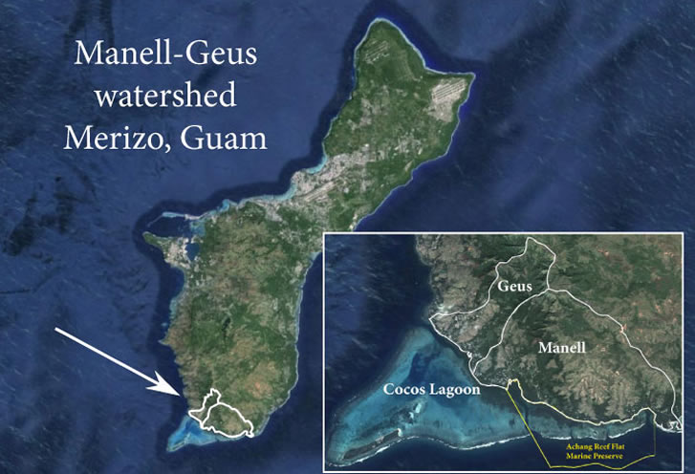
Manell-Geus: Brief synopsis
Sea grass and Coral Beds
Strong fishing traditions
Habitat for important species:
Haggan (Sea Turtle)
Mafute
Tiao (Goat Fish)
Manahak
Figure1. Guam Aerial Image (NOAA,2015)
NOAA,2015

Slide 17
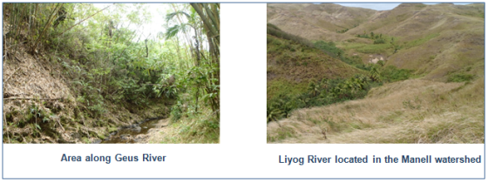
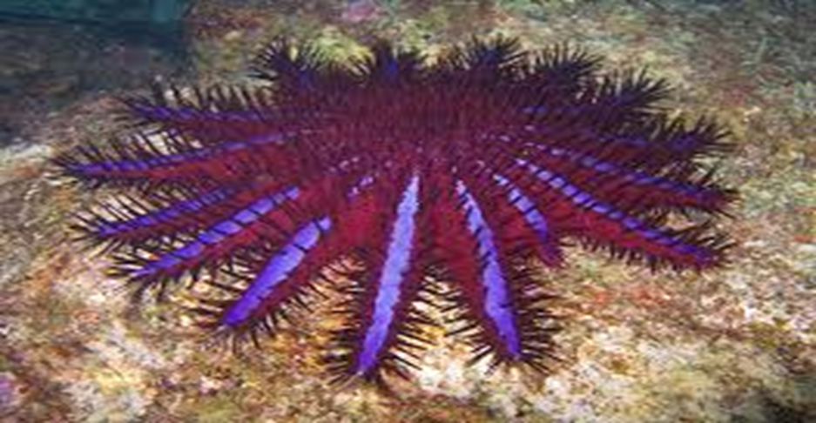
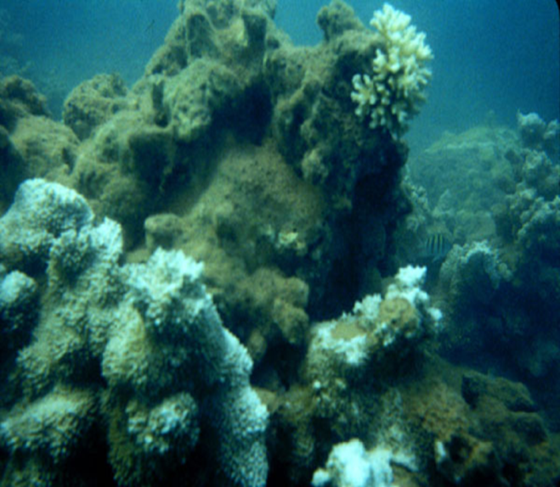
Manell-Geus Cont.
Ecosystem affected by poor water quality.
Causes:
  Erosion
  Sedimentation
  Crown-of-Thorns
(Hanson,2005)
(Field,2014)
NOAA, 2015

Slide 18

Define Flooding Problem
Study Parameters (Quantitative)
Acre ft./year
amount of precipitation(in.) (monthly and annually)
Costs of damage to habitat (i.e. flora/fauna/reef/water quality)
Costs of damage to infrastructure (i.e. businesses, roads, homes, etc.)
Percentage of Permeable Surfaces/ area of land developed
# of burns per year + acreage effected
Qualitative
Create and perform survey to assess local impacts
  -i.e. perceived cost and if possible actual cost
  Collect first hand accounts

Slide 19
Green Infrastructure (G.I.)
Why the need?
Reduces risk of sewer overflow, water contamination, erosion, damage, costs, etc.
Options:
Rain Gardens/Bioswales
Green Roofs
Permeable Pavements
Water Harvesting

Slide 20
G.I. Cont.
Rain Gardens
Bioswales
Rain Gardens are landscaped depressions designed to filter storm water runoff by utilizing vegetation as well as drains if necessary.
Benefits- minimize the amount of runoff entering storm drains.
Act as vegetative filtration system, reducing the amount of some pollutants
  -Carbon sequestration
Bioswales- landscaping technique used to redirect storm water. Most effective when coupled with rain gardens (depending on geography)
(Volkening, 2016)

Slide 21
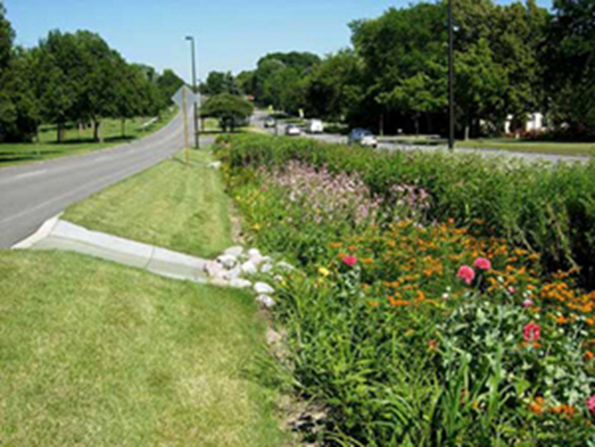
Rain Gardens cont.
Cost
Vegetation planted (vetiver/perenialls)
Labor cost
Bioswale →
Rain Garden →
(Volkening,2016)

Slide 22
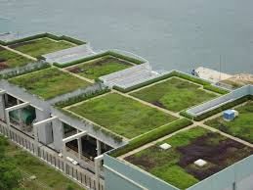
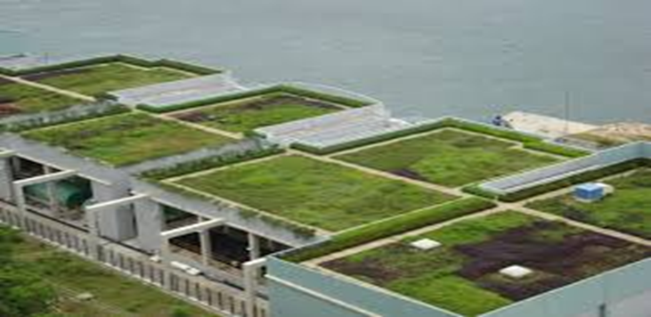
G.I. Cont.
Green Roofs- roof of a building covered partially to completely with vegetation and growing medium.
Benefits
-regulate storm water runoff (reduce flood risk)
-water pollutant control
-energy saving
-aesthetics
-improve air quality
-support local biodiversity
- food production
(Admin,2011)

Slide 23
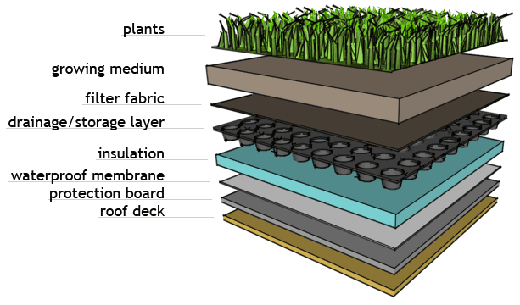
Green Roofs Cont.
Important note: Due to materials used in building houses in Guam, it is necessary to install an impermeable layer in between roof itself and growing medium.
Image 7
Image 9
(Green Roof Features,2007)

Slide 24
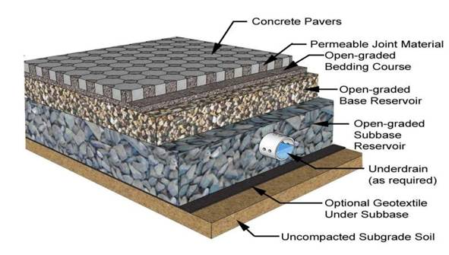
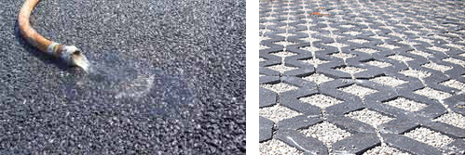
Permeable Pavements
Unlike impermeable pavements, permeable pavements allow for water infiltration.
(Johansen,2010)
(Smith,2006)

Slide 25
Permeable Pavements cont.
Pros
Reduce runoff by large percentage
Preventative measure against over-flooding
Improve water quality by trapping pollutants
Cons
Depending on type; some require more upkeep.
Not all meant for heavy water load areas (i.e. Guam)
Some have negative downstream effect, raising ground water level

Slide 26
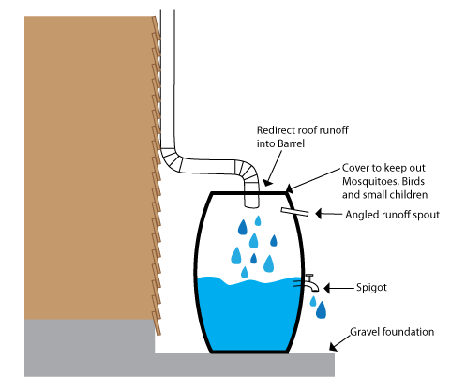
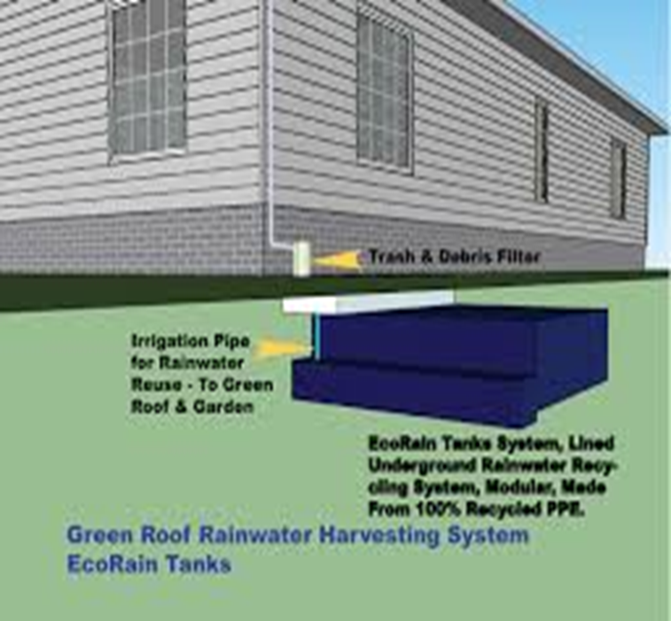
G.I. Cont.
Water Harvesting- direct collection of rain water.
Benefits:
  Able to reduce storm water runoff. Diminishing flooding.
  Reduces water bills
  FREE to use for variety of projects
(Long, 2015)
Image 11
(Songer, 2010)

Slide 27
Actual Cost
Get a local, reliable contractor to give estimates for equipment, installment, etc.
Cost appraisals found for G.I. practices via research only pertain to the mainland
Create incentives for proactive homeowners, citizens, and contractors.

Slide 28
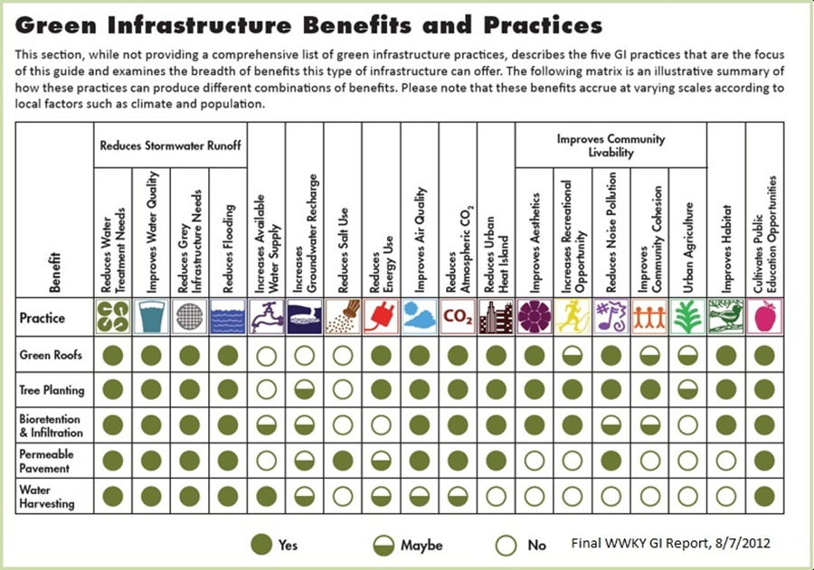
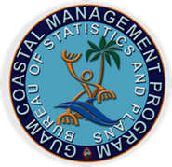
Green Infrastructure Matrix
Example:
(Value, 2011)

Slide 29
Community Involvement
Community itself can be extremely effective tool when mobilized properly
  With enough volunteers, directed properly, we should be able to establish effective riparian buffers (streambed fortifiers) and erosion controllers, simply by increasing indigenous vegetation.
  Reforestation best option for long term alleviation of
  Increased education = increased environmental consciousness

Slide 30
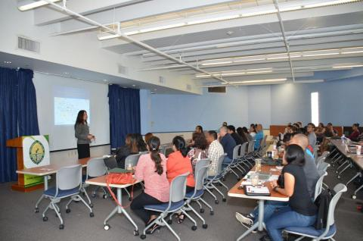
Community Outreach and Education
Determine what if any G.I. is already present in area
Work together with the community to come to a consensus on what would benefit and fit the community best.
Communicate findings to invested government branches as well as other stakeholders.
  Advise officials on best possible courses. (Ex. Pass legislation increasing penalty for setting fires; create incentives, etc. )
(Guam, 2014)
Notes:
op·por·tu·ni·ty cost- the loss of potential gain from other alternatives when one alternative is chosen.
"idle cash balances represent an opportunity cost in terms of lost interest"

Slide 31

Federal Consistency
What is it?
A process allowing coastal states and territories to review proposed activities and projects in order to manage coastal uses and resources, and to facilitate cooperation and coordination with Federal agencies under the Coastal Zone Management Act.
Reviewing all projects and activities:
Federal Agency Activities;
Activities Requiring a Federal License or permit; and
Federal Assistance to Local Governments.
31

Slide 32
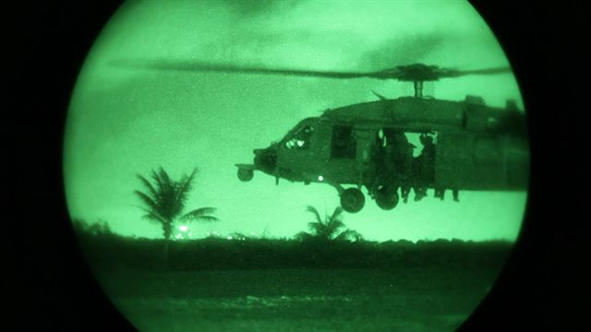
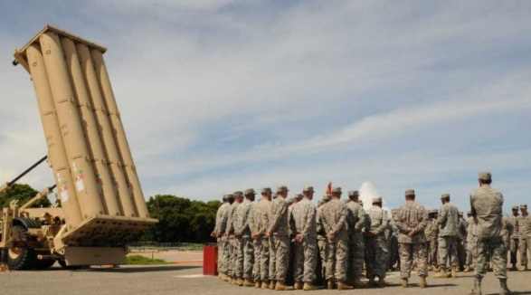
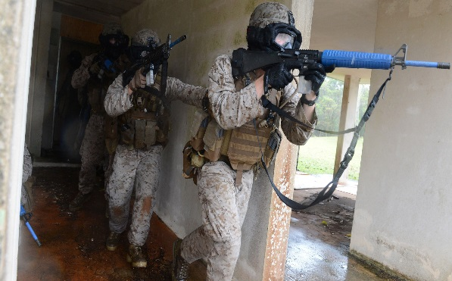
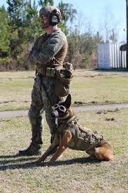
Terminal High Altitude Area Defense (THAAD)
Federal Agency Activities
Project Cases
Realistic Urban
Training Exercise
(RUTEX)
32

Slide 33
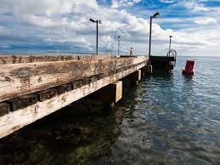
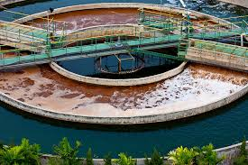
-Guam Waterworks Authority Wastewater and Sewage Treatment Plants
-TriStar Terminals Guam, Inc.
REQUIRING NPDES PERMIT
Activities Requiring a
Federal License or Permit
Project Cases
Repair of Merizo Pier and Boat Ramp
REQUIRING ACOE PERMIT
33

Slide 34
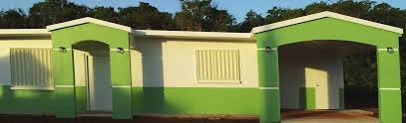
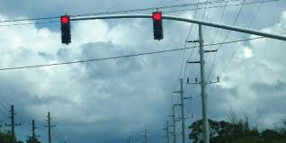
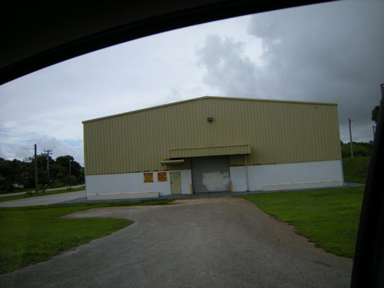
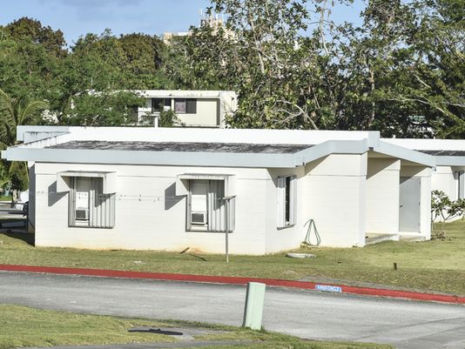
Department of Public Works
Replacement/upgrade of traffic signal systems
Federal Assistance to Local Governments - Project Cases
Guam Housing Urban Renewal Authority (GHURA)
New construction/rehabs/upgrades
34

Slide 35
1) Certification Statement required for activities requiring a Federal License or Permit
A letter describing the proposed activity and certifying that it “complies with Guam’s approved coastal management program and will be conducted in a manner consistent with such program”
2) PUBLIC NOTICE (for projects/activities 1 & 2)
– 21 day public comment period
REQUIREMENTS
35

Slide 36
Federal Consistency Layer
Guam Land Use Commission Layer
Master Street Layer
GIS Viewers
Tsunami Evacuation Map
Sea Level Rise
Coastal-Change Analysis Program (C-CAP)
Guam Resource Environmental Assessment Tool (GREAT)
5) Data Request and Sharing (networking), General Public,
GIS Users (Local and Federal counter-parts)
6) Pilot ARCSDE - Repository
7) GIS User Group – April 2016 (PGIS)
GIS
36

