Slide 1
Plenary session IV (Critical Infrastructure and Disaster Preparedness planning)
Edwin Reyes
Administrator, Guam Coastal Management Program
Bureau of Statistics and Plans
Pilar Carbullido
Program Cooridnator III
Guam Homeland Security/Office of Civil Defense
Joey T. Duenas
Chairman
Consolidated Commission on Utilities

Slide 2
Plenary session IV (Critical Infrastructure and Disaster Preparedness planning)
Edwin Reyes
Administrator, Guam Coastal Management Program
Bureau of Statistics and Plans

Slide 3
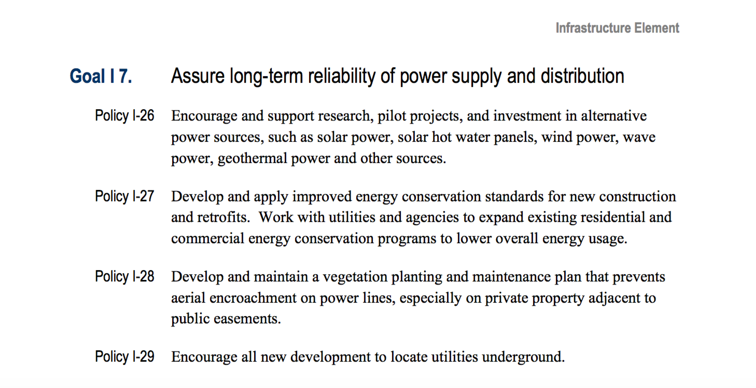
North and central land use plan
North and central land use plan

Slide 4
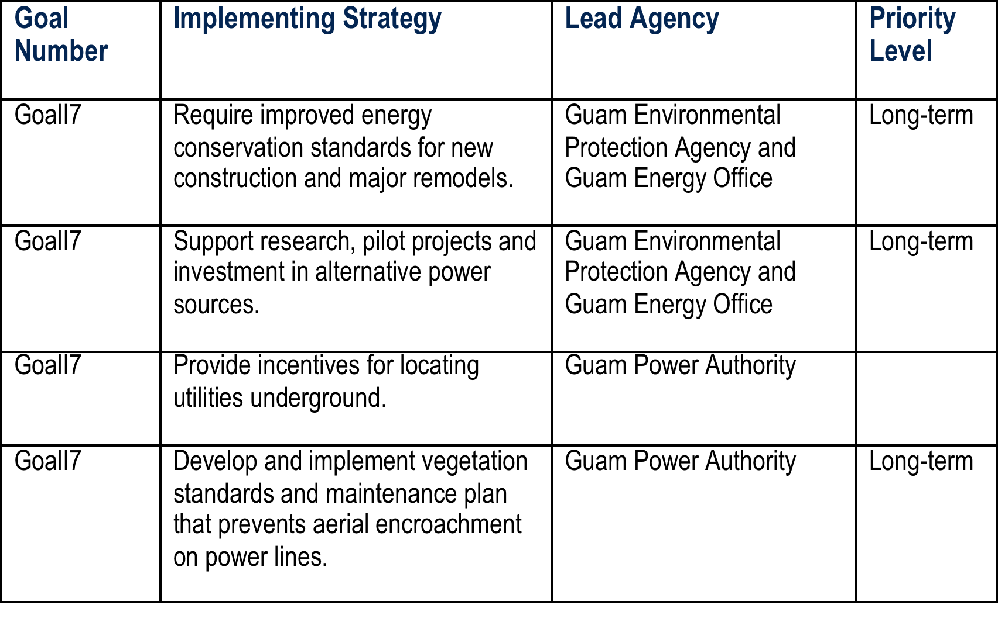

Slide 5
Plenary session IV (Critical Infrastructure and Disaster Preparedness planning)
Pilar Carbullido
Program Cooridnator III
Guam Homeland Security/Office of Civil Defense

Slide 6
Assembly of Planners Symposium Guam's Current Homeland Security and Emergency Management Planning Initiatives - A Whole Community Approach
UNCLASSIFIED/FOUO
Pacific Star Hotel, Tumon
March 8, 2016
UNCLASSIFIED/FOUO

Slide 7
Mission Statement
UNCLASSIFIED/FOUO
Coordinate and facilitate all Government of Guam, Military, and Federal Liaison Response Agencies and their resources in mitigating, preparing, responding, and recovering from any and all types of emergencies in order to protect the lives, environment, and property of the island of Guam.
www.ghs.guam.gov
UNCLASSIFIED/FOUO

Slide 8
Four Phases of Emergency Management
UNCLASSIFIED/FOUO
PREPAREDNESS
RESPONSE
RECOVERY
MITIGATION
www.ghs.guam.gov
UNCLASSIFIED/FOUO
Notes:
Please take note that Prevention is now part of this.

Slide 9
Homeland Security Advisor
Administrator
MRFC
PIO
Admin & Finance
Grants
Plans & Operations
Logistics
Preparedness
Response
Mitigation
Recovery
ESFs
ESF 1: Transportation
ESF 2: Communications
ESF 3: Public Works
ESF 4: Fire Fighting
ESF 5: Emergency Manage
ESF 6: Mass Care
ESF 7: Logistics
ESF 8: Medical
ESF 9: Search & Rescue
ESF 10: Hazardous
ESF 11: Agriculture
ESF 12: Energy
ESF 13: Public Safety
ESF 14: Long Term Recovery
ESF 15: External Affairs
ESF 16: Military
Organizational Structure
www.ghs.guam.gov
UNCLASSIFIED/FOUO
Notes:
Execution: Staff Chart

Slide 10
Operational Coordination
Federal Agencies
Private Sector
JRM
(ROC)
GHS/OCD
MRFC
VOAD and NGOs
Government of Guam
UNCLASSIFIED/FOUO
Notes:
Execution: Coordination for Title 10 Support

Slide 11
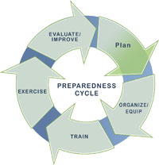
Planning
UNCLASSIFIED/FOUO
Planning makes it possible to manage the entire life cycle of a potential crisis. Strategic and operational planning establishes priorities, identifies expected levels of performance and capability requirements, provides the standard for assessing capabilities and helps stakeholders learn their roles. The planning elements identify what an organization’s Standard Operating Procedures (SOPs) or Emergency Operations Plans (EOPs) should include for ensuring that contingencies are in place for delivering the capability during a large-scale disaster.
www.ghs.guam.gov
UNCLASSIFIED/FOUO
Notes:
Planning makes it possible to manage the entire life cycle of a potential crisis. Strategic and operational planning establishes priorities, identifies expected levels of performance and capability requirements, provides the standard for assessing capabilities and helps stakeholders learn their roles. The planning elements identify what an organization’s Standard Operating Procedures (SOPs) or Emergency Operations Plans (EOPs) should include for ensuring that contingencies are in place for delivering the capability during a large-scale disaster.

Slide 12
Guam Comprehensive Emergency Management Plan (Guam CEMP)
UNCLASSIFIED/FOUO
Final Draft has been submitted to the Governor
Once approved, will replace the Guam Emergency Response Plan (GERP)
www.ghs.guam.gov
UNCLASSIFIED/FOUO
Notes:
Pursuant to Guam Civil Defense Act of 1951, the Guam Comprehensive Emergency Management Plan (GUAM CEMP) is the master operations document for the Territory of Guam in responding to all emergencies, and all catastrophic, major, and minor disasters. The GUAM CEMP defines the responsibilities of all levels of government, private, volunteer and non-governmental organizations (NGOs) that make up the Guam Emergency Operations Center Emergency Support Function (EOC ESF) Team. The GUAM CEMP also captures the authority and role of the federal government in response to incidents and emergency events on Guam, including those which are presidentially declared disasters. The GUAM CEMP ensures that all levels of government are able to mobilize as a unified emergency organization to safeguard the well-being of Guam’s residents and visitors. The GUAM CEMP is compliant with the National Incident Management System (NIMS), and incorporates the principles set forth in the Incident Command System (ICS). In 2004, Guam began utilizing NIMS as the standard procedure for incident management in the territory. Each employee of the Guam Homeland Security/Office of Civil Defense (GHS/OCD) and the EOC ESF Team is required, through the Agency’s Training and Exercise Unit, to complete required NIMS training and other training as it relates to their emergency support function.
The GUAM CEMP employs the strategic vision of Presidential Policy Directive 8 (PPD-8), to strengthen resiliency by involving partners at all levels of government as well as with NGOs and the private sector in the planning process. Additionally, the GUAM CEMP parallels federal activities set forth in the National Response Framework (NRF). The NRF details operating principles and protocols for major disasters. Together, PPD-8, the NRF and NIMS integrate the resources of jurisdictions, incident management and emergency response disciplines, NGOs, and the private sector into a seamless national framework for domestic incident response.
The 2013 revision of the GUAM CEMP represents the collective efforts of GHS/OCD and the Guam EOC ESF Team.

Slide 13
Guam Comprehensive Emergency Management Plan (Guam CEMP)
UNCLASSIFIED/FOUO
Guam CEMP Sub-Workgroups:
Sub-Workgroup on Transportation, Public Works, Engineering and Debris Management
Lead Agency: DPW
Support Agencies: GIAA, PAG, DOA Mass Transit, GDOE
Coordinating Agencies: GEPA, JRM, GSA, GWA, GPA DLM, CLT, DPR, MCOG, GNG, USCG, GHRA, GTA
Sub-Workgroup on Communication
Lead Agencies: GTA, GHS/OCD
Co-Lead Agencies: GPD, BIT
Support/Coordinating Agencies: GTA, GPD, GFD, CQA, PAG, GIAA, DPHSS, MCOG, GDOE, DPR, GPA, GMHA, GBHWC, JRM, USCG, GNG, USNH, NWS
Sub-Workgroup on Firefighting, Urban Search and Rescue, Oil and Hazardous Material Response
Lead Agency: GFD
Co-Lead Agencies: GEPA, USCG
Support/Coordinating Agencies: GPD, GNG, PAG, JRM, GHS/OCD, GTA, etc.
www.ghs.guam.gov
UNCLASSIFIED/FOUO
Notes:
In the development of Guam CEMP, several Sub-Workgroups were organized to take care of specific applicable Emergency Support Functions (ESF).

Slide 14
Guam Comprehensive Emergency Management Plan (Guam CEMP)
UNCLASSIFIED/FOUO
Guam CEMP Sub-Workgroups:
Sub-Workgroup on Emergency Management
Lead Agency: GHS/OCD
Support/Coordinating Agencies: NWS, BIT, DLM, GEDA, DOA/GSA, GNG
Sub-Workgroup on Mass Care, Housing and Human Services
Lead Agency: GDOE, MCOG, GHS/OCD
Support/Coordinating Agencies: (See related EO for the expanded list.)
Sub-Workgroup on Public Health and Medical Services
Lead Agency: DPHSS
Co-Lead Agency: GMHA
Support/Coordinating Agencies: GFD, GBHWC, JRM, USNH, Guam Medical Examiner, GNG
www.ghs.guam.gov
UNCLASSIFIED/FOUO

Slide 15
Guam Comprehensive Emergency Management Plan (Guam CEMP)
UNCLASSIFIED/FOUO
Guam CEMP Sub-Workgroups:
Sub-Workgroup on Agriculture and Natural Resources
Lead Agency: DOAg
Support Agencies: DPHSS, DOE, GEPA, MCOG, GNG, UOG
Coordinating Agencies:
Sub-Workgroup on Energy
Lead Agency: GPA
Support Agencies: DPW, GWA, GNG
Coordinating Agencies:
Sub-Workgroup on Public Safety and Security
Lead Agency: GPD
Support Agencies: CQA, JOG Marshals/Probation Officers, DYA, DOC, PAG Police, GIAA Police, DOAg Conservation Officers, GDOE SROs, MRFC-Guam, MCOG, GNG, DPR Park Rangers
Coordinating Agencies:
www.ghs.guam.gov
UNCLASSIFIED/FOUO

Slide 16
Guam Comprehensive Emergency Management Plan (Guam CEMP)
UNCLASSIFIED/FOUO
Guam CEMP Sub-Workgroups:
Sub-Workgroup on Military Support to Civil Authorities
Lead Agency: GNG
Support Agencies: JRM
Coordinating Agencies:
Sub-Workgroup on Long Term Community Recovery
Lead Agency: GHURA, GEDCA
Support Agencies: DLM, GHC, Office of the Governor, BSP
Coordinating Agencies:
Sub-Workgroup on Resource Support
Lead Agency: DOA/GSA
Support Agencies: DOL/AHRD, BBMR, DRT, MCOG, DCA/Guam Library, BSP
Coordinating Agencies:
www.ghs.guam.gov
UNCLASSIFIED/FOUO

Slide 17
Guam Comprehensive Emergency Management Plan (Guam CEMP)
UNCLASSIFIED/FOUO
Guam CEMP Sub-Workgroups:
Sub-Workgroup on External Affairs
Lead Agency: GHS/OCD, Office of the Governor
Support Agencies: All GovGuam Agencies with PIOs/PAOs
Coordinating Agencies:
www.ghs.guam.gov
UNCLASSIFIED/FOUO

Slide 18
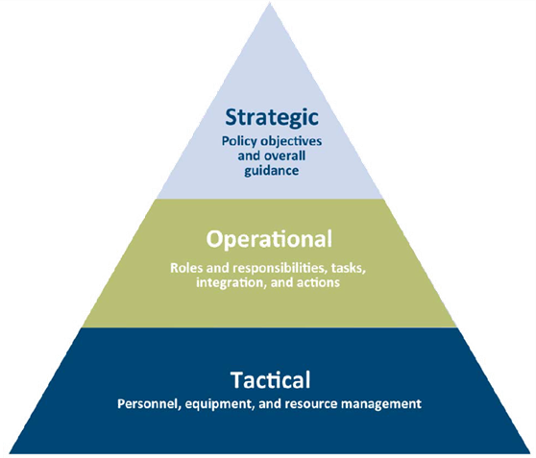
Guam Comprehensive Emergency Management Plan (Guam CEMP)
UNCLASSIFIED/FOUO
Strategic Plans – These plans are driven by policy from senior officials, set the context and expectations for operational plans, and describe a long-term vision for emergency management.
Operational Plans – These plans provide a description of roles and responsibilities, tasks, integration, and actions required of
plan stakeholders during emergencies. They are more
comprehensive, but less detailed than tactical plans.
Tactical Plans – These plans direct the
management of personnel, equipment and
resources that play a role in incident response.
www.ghs.guam.gov
UNCLASSIFIED/FOUO

Slide 19
Guam Comprehensive Emergency Management Plan (Guam CEMP)
UNCLASSIFIED/FOUO
Scenario-based planning – Builds a scenario for a hazard or threat. Potential impacts are analyzed to develop planning assumptions and appropriate response actions. This approach is used to develop hazard-specific annexes to a basic plan.
Function-based (functional) planning – Identifies common functions that stakeholders must perform during an emergency as well which entity is responsible for performing the course of action.
Capabilities-based planning – This approach looks at the resources needed to perform a specific emergency function and then matches stakeholders capacity to take the specific course of action.
www.ghs.guam.gov
UNCLASSIFIED/FOUO

Slide 20
Guam Comprehensive Emergency Management Plan (Guam CEMP)
UNCLASSIFIED/FOUO
Emergency Support Function Format
The plan is broken down
Basic Plan
Emergency Support Function Annexes
Hazard-, Threat-, or Incident-Specific Annexes
www.ghs.guam.gov
UNCLASSIFIED/FOUO

Slide 21
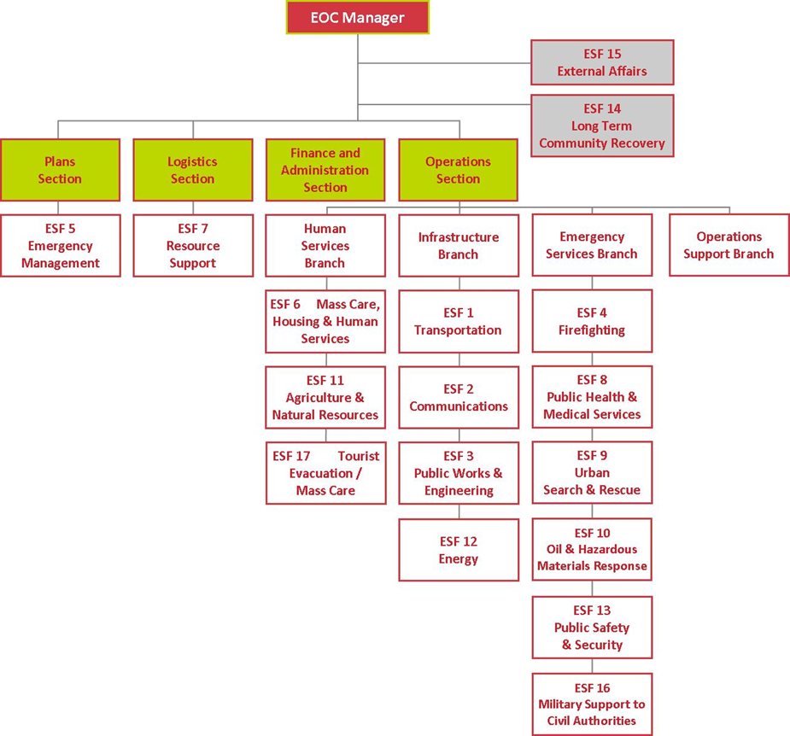
Guam Comprehensive Emergency Management Plan (CEMP) Workshop
UNCLASSIFIED/FOUO
www.ghs.guam.gov
UNCLASSIFIED/FOUO
Notes:
The Emergency Operations Center (EOC) organizational structure…
The Guam Comprehensive Emergency Management Plan (GUAM CEMP) describes the basic strategies, assumptions, operational objectives, and mechanisms through which the Guam Emergency Operations Center Emergency Support Function (EOC ESF) Team will mobilize resources and conduct activities to guide and support local emergency management efforts through preparedness, response, recovery, and mitigation. To facilitate effective operations, the GUAM CEMP adopts a functional approach that groups the types of assistance to be provided into 16 Emergency Support Functions (ESFs), formerly known as Response Activity Coordinators (RACs). Each ESF is headed by a primary agency selected based on its authorities, resources, and capabilities in that ESF’s functional area. The primary agency appoints an Emergency Coordination Officer (ECO) to manage the ESF’s function in the Emergency Operations Center (EOC).

Slide 22
Guam Comprehensive Emergency Management Plan (Guam CEMP)
UNCLASSIFIED/FOUO
Comprehensive Emergency Management
All Hazards Planning
Comprehensive Resource Planning
Catastrophic Planning
Information Support for Emergency Planning and Operations
Relationship to Other Plans
www.ghs.guam.gov
UNCLASSIFIED/FOUO
Notes:
F. Relationship to Other Plans
· Relationship to Other Territorial Plans: The GUAM CEMP is supported by a number of specialized Government of Guam and federal plans such as the Tactical Interoperable Communications Plan, Guam Catastrophic Typhoon CONPLAN, 2011 Guam Hazard Mitigation Plan, etc. Such plans are incorporated into the GUAM CEMP by reference and stored in the GHS/OCD digital reference library.
· Relationship to Federal Plans: The GUAM CEMP provides for integration of territorial response operations with the federal agencies responding to emergency situations in Guam at the request of the Governor. This plan is consistent with FEMA’s Guam Catastrophic Typhoon OPLAN (Aug 2010), which is wholly incorporated into this plan by reference. The GUAM CEMP also recognizes other regional planning efforts developed under the National Response Framework (NRF), which are stored in the GHS/OCD digital reference library.
· Relationship to Interstate/Inter-island Agreements: The GUAM CEMP addresses provisions for requesting emergency assistance from other states or providing emergency assistance to other states in accordance with the Emergency Management Assistance Compact (EMAC) and a number of specialized agreements to which Guam is a party.

Slide 23
Guam Catastrophic Typhoon Plan
UNCLASSIFIED/FOUO
The Guam Catastrophic Typhoon Plan represents a cooperative effort by an intergovernmental team.
The Operations Plan (OPLAN) provides a specific strategy to execute a joint Territory, Federal, and private sector preparation and response to a catastrophic typhoon for the Territory of Guam.
www.ghs.guam.gov
UNCLASSIFIED/FOUO
Notes:
Leo is currently in FEMA Region IX, Oakland CA, for the second week now working with FEMA and various Federal agencies for the revision of the Guam’s Typhoon Catastrophic OPLAN. This activity will lead to a big event in Guam sometime in June drawing local leaders as well as leadership of various Federal agencies and Federal ESFs. Most of you will be invited in related planning activities scheduled for the next 6-10 months.
The Guam Catastrophic Typhoon Plan represents a cooperative effort by an intergovernmental team. Detailed planning was also a product of interagency effort in which stakeholders throughout both the Territory of Guam and the Federal government, most often in the form of Territory and Federal Emergency Support Functions, worked with private sector representatives to address many of the challenges inherent in a catastrophic typhoon scenario.
The Operations Plan (OPLAN) provides a specific strategy to execute a joint Territory, Federal, and private sector preparation and response to a catastrophic typhoon for the Territory of Guam. The focus of the plan scenario is the support of the Territory of Guam population in the aftermath of a catastrophic typhoon. This plan is scalable and adaptable for use in neighboring islands, and is focused on typhoon response and establishing a framework for long-term recovery.

Slide 24
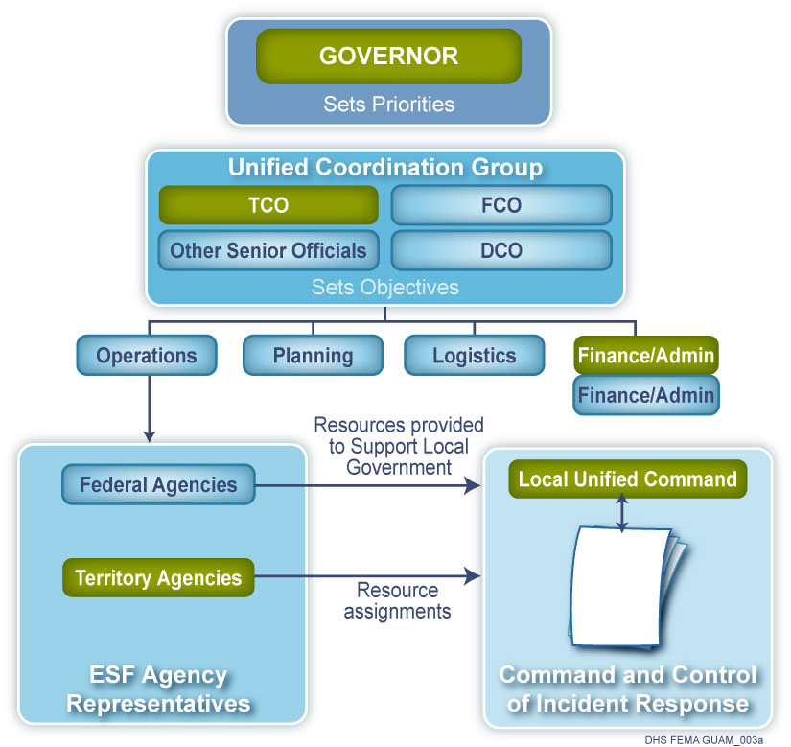
Guam Catastrophic Typhoon Plan
UNCLASSIFIED/FOUO
Coordinating Structure
www.ghs.guam.gov
UNCLASSIFIED/FOUO
Notes:
The coordinating structure utilizes a joint Territory and Federal approach. The Territory Coordinating Officer (TCO), also referred to as the State Coordinating Officer (SCO), and the Federal Coordinating Officer (FCO) achieve and maintain unity of effort by establishing a joint Territory and Federal Unified Coordination Group to coordinate disaster response activities consistent with the priorities set by the Governor of Guam.

Slide 25
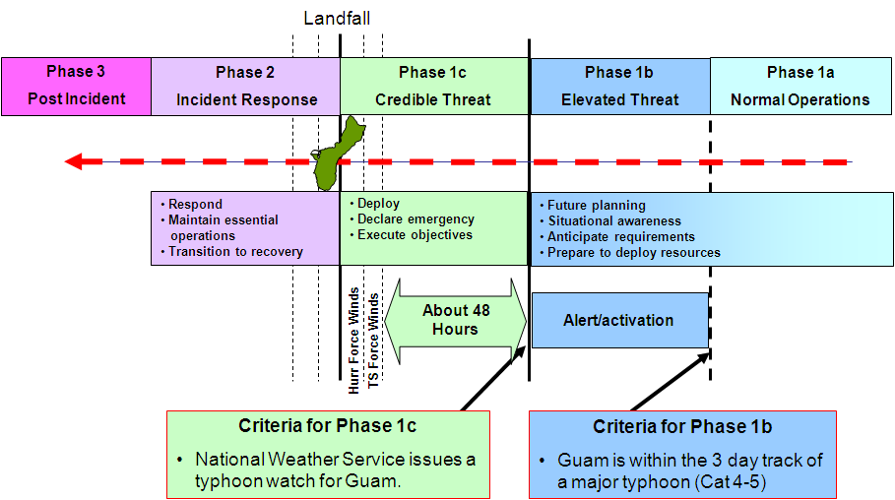
Guam Catastrophic Typhoon Plan
UNCLASSIFIED/FOUO
Tasks by Phase for Typhoon Response
www.ghs.guam.gov
UNCLASSIFIED/FOUO
Notes:
Preparing for and responding to a catastrophic typhoon that may affect the Territory of Guam poses several challenges to Guam. Many of these challenges are addressed in the OPLAN, including but not limited to Guam's size and location, which are limited factors considering Guam's long distance from other land masses. Preparations for response and the framework for recovery must begin long before the impact of a catastrophic typhoon.
The preparation and response outlined in Guam's Catastrophic Typhoon Plan are predicated on a phased approach based on objective criteria consistent with input from the National Weather Service (NWS). The planning strategy described throughout this plan applies a systematic decision making process linked to NWS predictions. Each phase is associated with an increased level of certainty and increased level of commitment of resources.

Slide 26
Guam Catastrophic Typhoon Plan
UNCLASSIFIED/FOUO
Consistent with guidance from Senior Agency Officials and the Federal Interagency Typhoon Concept Plan, the Unified Coordination Group will set the phases according to the following criteria:
Phase 1a: Normal Operations. This Phase is the "steady-state" condition when there is no storm that poses a threat to the Territory of Guam.
Phase 1b: Elevated Threat. An elevated threat occurs when Guam is within the three-day probable track of a typhoon system.
Phase 1c: Credible Threat. This Phase begins when the NWS determines that Guam may experience Typhoon Force Winds, or a Typhoon Watch has been issued.
Phase 2: Incident and Incident Response. Once landfall occurs, employing resources to save lives, protect property and the environment, and preserve the social, economic, and political structure of the Territory of Guam become the main priorities.
Phase 3: Post-Incident (Recovery and Mitigation). The Post-incident phase includes actions taken to meet Unified Coordination Group objectives and to set conditions to transition responsibility to long-term recovery that restore services, continue government operations, and promote economic recovery.
www.ghs.guam.gov
UNCLASSIFIED/FOUO

Slide 27
Guam Catastrophic Typhoon Plan
UNCLASSIFIED/FOUO
In agreement with the Governor of Guam's specific objectives for a response and recovery effort in the aftermath of a catastrophic typhoon, the following objectives are essential to the response:
Perform Life Saving and Sustaining Measures
Conduct Mass Care and Sheltering
Minimize Risk to Tourists
Maintain Functionality of the Water Distribution System
Deliver Fuel to Maintain Essential Services
Conduct Debris Clearance
Protect On-Island Critical Resources
Maintain Continuity of Port Operations
Restore Power Infrastructure
www.ghs.guam.gov
UNCLASSIFIED/FOUO

Slide 28

Guam Hazard Mitigation Plan
UNCLASSIFIED/FOUO
2014 Guam HMP was developed to satisfy the requirements of Section 409 of the Stafford Act and Section 322 of Disaster Mitigation Act of 2000.
Data collection and update have been initiated.
Notably, the Hazard Identification and Risk Assessment Section is very useful.
Main focus of the ongoing updating is climate change and its impacts, such as: sea level rise, climate migration, etc.
www.ghs.guam.gov
UNCLASSIFIED/FOUO
Notes:
As a condition of receiving federal disaster mitigation funds, the 2014 Guam HMP was developed and must meet the requirements of Section 409 of the Stafford Act and Section 322 of DMA 2000. Section 322 of DMA 2000 requires that all U.S. states and territories have a mitigation plan in place that describes the planning process for identifying hazards, risk, and vulnerabilities, identifies and prioritizes mitigation actions, encourages the development of local mitigation, and provides technical support for these efforts.
DMA 2000 addresses a range of topics focused primarily on the importance of pre-disaster infrastructure mitigation planning to reduce disaster losses nationwide and the control and streamlining of the administration of federal disaster relief and programs to promote mitigation activities. According to the Stafford Act, the purpose of Title I, Predisaster Hazard Mitigation, is:
…to establish a national disaster hazard mitigation program –
to reduce the loss of life and property, human suffering, economic disruption, and disaster assistance costs resulting from natural disasters; and
to provide a source of predisaster hazard mitigation funding that will assist States and local governments (including Indian tribes) in implementing effective hazard mitigation measures that are designed to ensure the continued functionality of critical services and facilities after a natural disaster.
Major provisions of the Stafford Act include funding for pre-disaster mitigation activities, developing multi-hazard maps to better understand risk, establishing state and local government infrastructure mitigation planning requirements, defining how states can assume more responsibility in managing the Hazard Mitigation Grant Program (HMGP), and adjusting ways in which management costs for projects are funded.

Slide 29
What’s Next?
UNCLASSIFIED/FOUO
Training and Exercises
Multi-Year Training and Exercise Calendar
Resources/Assets Inventory
Preparedness and Capability Assessments
State Preparedness Report (SPR)
National Incident Management System (NIMS) Compliance Self-Assessment
Threat, Hazard and Risk Assessments
Threat and Hazard Identification and Risk Assessment
www.ghs.guam.gov
UNCLASSIFIED/FOUO
Notes:
You will soon see GHS/OCD collaborating with your respective departments and various stakeholders and support agencies on these…

Slide 30
What’s Next?
UNCLASSIFIED/FOUO
Ongoing Planning Requirements
Revision of Guam’s Catastrophic Plan
Revision of FEMA Public Assistance (PA) Administrative Plan
Revision of FEMA Hazard Mitigation Grant Program (HMGP) Administrative Plan
Revision CEMP’s Disaster Debris Management Plan c/o the Debris Task Force lead by DPW
Revision of Environmental Response Plan c/o BSP
Revision of Emergency Operations Center (EOC) Standard Operating Procedures (SOP)
Revision of Emergency Operations Center (EOC) Positions Checklists
Revision of Guam Hazard Mitigation Plan
Development of Protected Supplement on Contingency Plan for Foreign Military Threats
www.ghs.guam.gov
UNCLASSIFIED/FOUO

Slide 31
Questions…
PILAR CARBULLIDO
Earthquake/Tsunami Program Manager
671.483.0395
Email: pilar.carbullidon@ghs.guam.gov
Other Contact:
Leo Espia
Deputy Administrator/
Chief Planner
671.483.0361
Email: leo.espia@ghs.guam.gov
Thank you!

Slide 32
Plenary session IV (Critical Infrastructure and Disaster Preparedness planning)
Joey T. Duenas
Chairman
Consolidated Commission on Utilities

Slide 33
Guam Power Authority
Strategic Planning Meeting
A.E. Balajadia, P.E.
Manager, Engineering
John J. Cruz, Jr., P.E.
Manager, Strategic Planning & Operations Research

Slide 34
Planning Responsibilities
Engineering
Medium-Range Distribution Planning
SPORD
Long-Range Transmission Plan
Integrated Resource Plan
Demand-Side Management
Strategic Plan
Operations Planning
Quality Management Plans

Slide 35
Generation Resources
552.4 MW Total, 281.5 MW System Peak
96.2% reserve margin
Base Load Capacity: Privatized
210.6 MW Under PMCs
Private Management, Public Employees, Incentives to Reduce O&M and Staffing Costs
141 MW Under IPPs
Tango Plant staffed with Public Employees
Reserve and Peaking Capacity
40 MW Under IPP

Slide 36
With all the generation reserve, what’s the rush for resource planning?

Slide 38
Sustainable Renewable Energy Part of Long-Range Planning
By end of 2005
Load, Sales and Fuel Forecasts
Integrated Resource Plan
Next Base Load Unit Addition
Sea Water Air Conditioning Feasibility Study
Demand-Side Management Program Design
Establish an Avoided Cost to Allow for Purchase of Public/Private Sources of Renewable Electric Energy

Slide 39
Candidate Generation Mix
In the Integrated Resource Plan, GPA will investigate the following technologies as candidates to meet projected energy demands:
Steam Turbines
Slow and Medium Speed Diesels
Conventional & Combined Cycle Combustion Turbines
Renewable Energy
Sea Water Air Conditioning
Wind Turbines
OTEC
Solar (Remote Off-Grid Service)
Fuel Diversity (LNG, Coal)
Demand-Side Management
Energy Efficient Appliances

Slide 40
Why Renewable Energy?

Slide 41
Strong, Competent Leadership has Achieved Increased Fuel Efficiencies Over Prior Management
Fuel Cost Saving
GPA is reaching the point at which increased efficiencies can no longer offset rising fuel prices.

Slide 42
Dilemma: Greater Efficiencies But Rising Fuel Prices
GPA is projecting 95% of Energy from Baseload Units for the Current LEAC.

Slide 43
GPA is projecting 95% of Energy from Baseload Units for the Current LEAC.

Slide 45
Alternative Energy Initiatives
On-going Focus Group of Island Stakeholders
Monthly Teleconference Between Regional and Federal Stakeholders to Update Territorial Renewable Energy Assessment
Demand-Side Management
Program Re-design and Re-Deployment
Sea Water Air Conditioning Project
Detailed Feasibility Study
Projected annual savings of over 3.2 million gallons of imported fuel
Alternative Fuel Vehicles: Electric Vehicle Initiative
Meter Reader and Field Service Vehicle Pilot
Feasibility Study for Implementing Wind Turbines at Fadian Point, the Future GPA Industrial Park
GPA is an Economic Catalyst
Green Power means less dependence on foreign oil
Keep your money multiplying on Guam

Slide 46
Sea Water Air Conditioning
Provides cold air conditioning service to major hotels and business along Tumon Bay, Guam.
Replaces Electric Chiller Equipment
The primary benefit is the reduction in fuel oil used by GPA to generate electric energy to operate commercial chilled water air conditioning systems.
Feasibility Study Kick-Off Meeting May 23, 2005

Slide 47
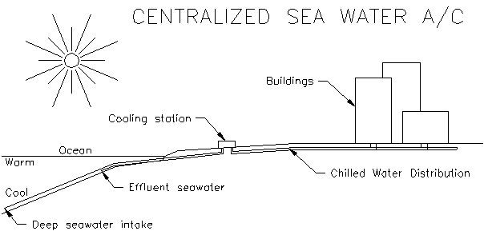
Typical Sea Water Air Conditioning System

Slide 48
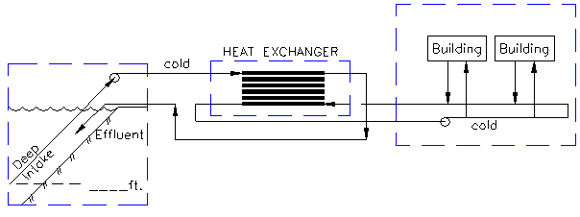
Typical Building Set up using Sea Water Air Conditioning

Slide 49
Long-Term Strategic Direction
Renewable Energy
Energy Efficiency
Underground Initiative
Utility Planning

Slide 50
Integrated Resource Plan
FY 1999

Slide 51
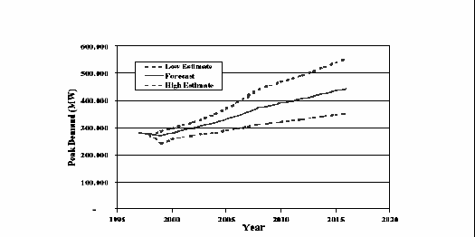
Load Forecast

Slide 52
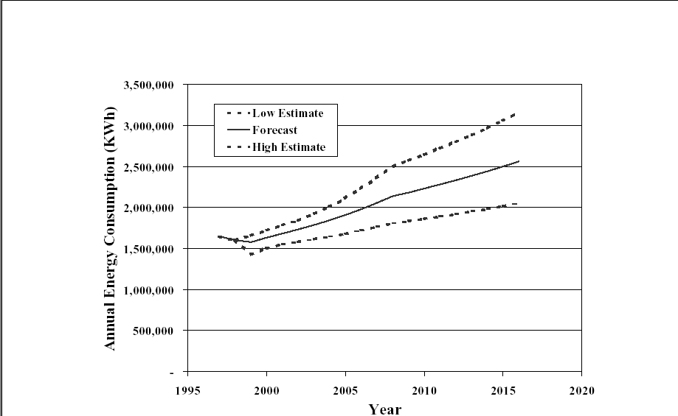
Sales Forecast

Slide 53
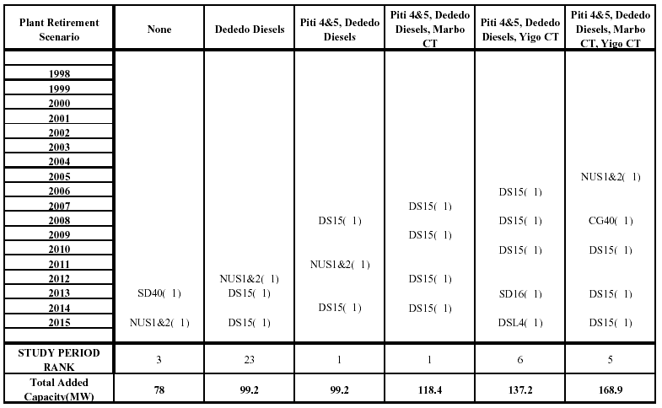
Generation Expansion Plan

Slide 54
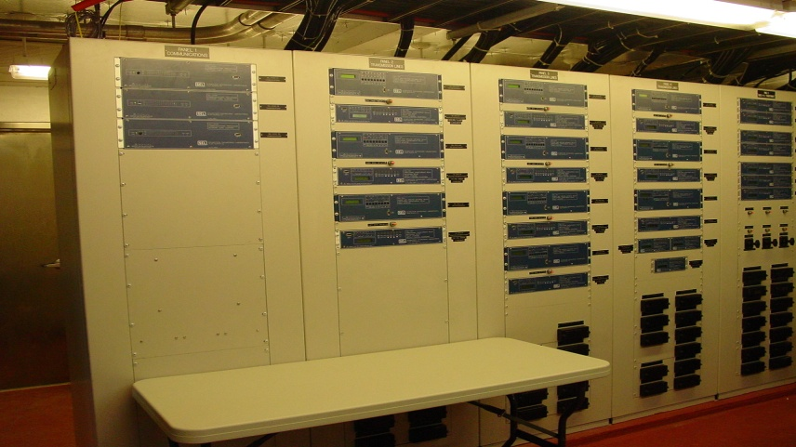
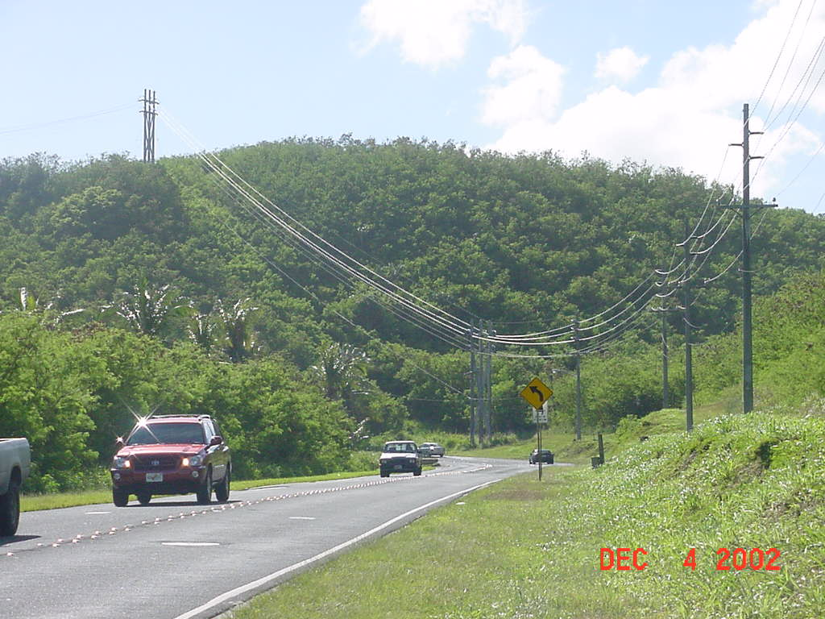
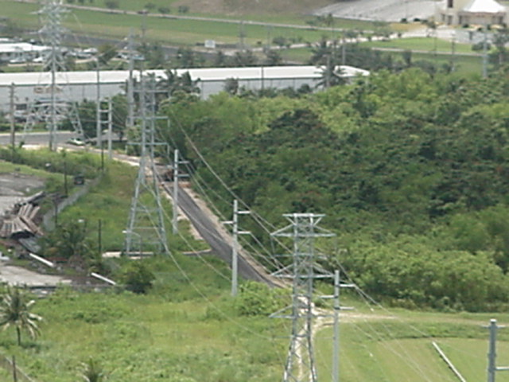
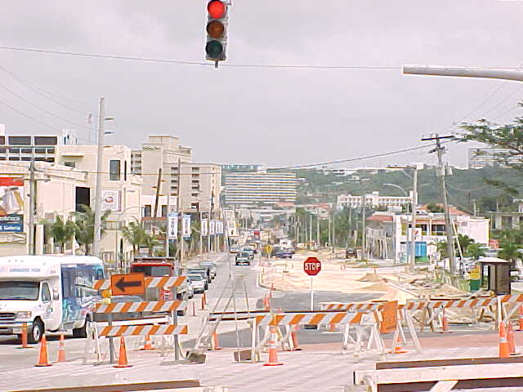
Major Accomplishments FY 2004
Harmon Substation Protection Upgrade Project ($1.42M)
Barrigada to Talofofo 34.5 kV Line Upgrade ($1.9M)
115 kV Access Road Upgrade and Repair ($1.98M)
Tumon Beautification Project – Under-Ground Power Conversion ($4.7M)

Slide 55
Major Projects Underway
Harmon to Tumon 34.5 kV Underground Line Conversion
1426 Grant

Slide 56
Major Projects Underway
Tamuning to Tumon 34.5 kV Underground Line Conversion
1426 Grant

Slide 57
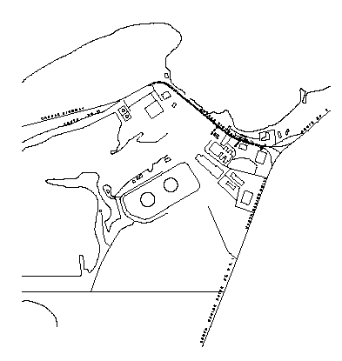
Major Projects Underway
P-003 Underground Conversion to Cabras
1426 Grant

Slide 58
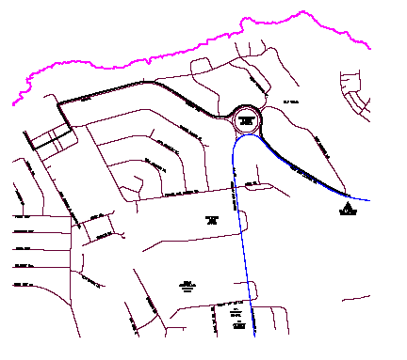
Major Projects Underway
P-401 Underground Conversion to GMH – 1426 Grant

Slide 59
Major Projects Underway
Harmon to Tanguisson 34.5 kV Underground Lines Conversion
1446 Grant

Slide 60
Major Projects Underway
Macheche to GAA 34.5 kV Underground Line Conversion
1446 Grant

Slide 61
Major Projects Underway
Macheche to San Vitores 34.5 kV Underground Lines Conversion
1446 Grant

Slide 62
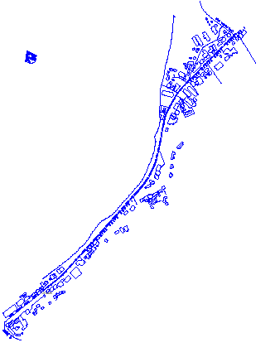
Major Projects Underway
Agana – Tamuning 34.5 kV and 13.8 kV Underground Conversion
(Uttams to Bank Pacific) – 1446 Grant

Slide 63
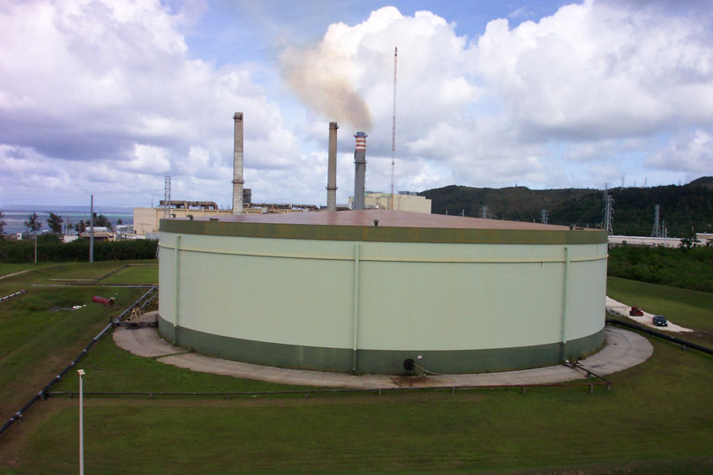
Major Projects Underway
Piti Fuel Farm Bulk Storage Tank Cleaning and Repairs

Slide 64
Major Projects UNDERWAY
System Stability, Reliability and Protection Coordination Study
Evaluation of coordination of substation and power plant relays
Evaluation of generation and T&D practices to avoid system blackouts
GIS and Pole Survey Project
Field survey of over 35,000 poles has been conducted
Mapping of poles and attached assets in progress

Slide 65
Major Projects PLANNED
GPA Underground Initiative
20 year plan developed
$600 million planned cost
Distribution System Medium Range Planning & Performance Analysis
5-year performance evaluation
Power Factor Correction/Capacitor Installation
Reliability Study
GIS & Facility Marking Project
Maintain pole asset database
Reflect additions and changes on mapping system
Pole numbering system
Phasing identification

Slide 66
FEMA Underground Projects

Slide 67
System Improvements (Revenue Funded)

Slide 68
Engineering Capital Improvement Projects (CIP)
FY 2005 - FY 2010 (x $1,000)
* * * Complete Project List * * *

Slide 69
Engineering Capital Improvement Projects (CIP)
FY 2005 - FY 2010 (x $1,000)
* * * Complete Project List * * *

Slide 70
Engineering Capital Improvement Projects (CIP)
FY 2005 - FY 2010 (x $1,000)
* * * Complete Project List * * *

Slide 71
Engineering Capital Improvement Projects (CIP)
FY 2005 - FY 2010 (x $1,000)
* * * Complete Project List * * *

Slide 72
GENERATION - CIP PROJECTS

Slide 73
GENERATION - CIP PROJECTS

Slide 74
Cabras I & II Capital Improvement Projects & Plant Improvement Projects

Slide 75
Cabras I & II Capital Improvement Projects & Plant Improvement Projects

Slide 76
Plenary session V (Bridging Fiscal Opportunities)
Kate Baltazar
Administrator
Guam State Clearinghouse
Troy Torres
Governor’s Strategic Planning Advisor
Imagine Guam Initiative
John A.B. Pangelinan
Budget and management Analyst Supervisor
Bureau of Budget and Management Research

Slide 77
Governor’s office
Mark Calvo
Chief of Staff
Managing Planning

Slide 78
Managing Planning

Slide 79
Concept
"Organization doesn't really accomplish anything. Plans don't accomplish anything, either. Theories of management don't much matter. Endeavors succeed or fail because of the people involved. Only by attracting the best people will you accomplish great deeds."
In a brain-based economy, your best assets are people. We've heard this expression so often that it's become trite. But how many leaders really "walk the talk" with this stuff? Too often, people are assumed to be empty chess pieces to be moved around by grand viziers, which may explain why so many top managers immerse their calendar time in deal making, restructuring and the latest management fad. Immerse yourselves in the goal of creating an environment where the best, the brightest, the most creative are attracted, retained and, most importantly, unleashed!

Slide 80
Concept
Part I: "Use the formula P=40 to 70, in which P stands for the probability of success and the numbers indicate the percentage of information acquired.”
Part II: "Once the information is in the 40 to 70 range, go with your gut."
Don't take action if you have only enough information to give you less than a 40 percent chance of being right, but don't wait until you have enough facts to be 100 percent sure, because by then it is almost always too late. Today, excessive delays in the name of information-gathering breeds "analysis paralysis." Procrastination in the name of reducing risk actually increases risk.

