Slide 1
Plenary session V (Bridging Fiscal Opportunities)
Kate Baltazar
Administrator
Guam State Clearinghouse
Troy Torres
Governor’s Strategic Planning Advisor
Imagine Guam Initiative
John A.B. Pangelinan
Budget and management Analyst Supervisor
Bureau of Budget and Management Research

Slide 2
Plenary session V (Bridging Fiscal Opportunities)
Kate Baltazar
Administrator
Guam State Clearinghouse

Slide 3

KATE G. BALTAZAR
ADMINISTRATOR

Slide 4
BUENAS!

Slide 5
Historical Perspective
Federal - Presidential Executive Order 12372 signed in 1983 by then-President Ronald Reagan
Local - Title 5 GCA, 1983 - placed under the purview of the Office of the Lt. Governor of Guam

Slide 6
Functions
Intergovernmental Review
Monitoring and Compliance / Advocacy
Training & Development

Slide 7
Training
Grantwriting
Grants Management
Project Management
Strategic Planning
Other

Slide 8
BSP Planners Training
Needs Assessment Survey

Slide 9
Q & A

Slide 10
Plenary session V (Bridging Fiscal Opportunities)
Troy Torres
Governor’s Strategic Planning Advisor
Imagine Guam Initiative

Slide 11
Plenary session V (Bridging Fiscal Opportunities)
John A.B. Pangelinan
Budget and Management Analyst Supervisor
Bureau of Budget and Management Research

Slide 12
Prelude
The Bureau of Budget and Management Research’s (BBMR) presentation today is based on the budgetary planning of a line department or agency of the Executive Branch. It does not focus on the qualitative aspects of the island’s environment; but the budgetary process presented today can be applied to those environmental programs seeking local and federal funding.
However, BBMR is of the opinion that any enhancement to Guam’s environment that could co-exist with existing economic infrastructure, resulting in increased “tax revenues,” would be most welcomed.

Slide 13
The Budget Process: Strategic Planning for Result

Slide 14
The Budget Process: Strategic Planning for Results
Introduction
Mission Statement
Program Objectives
Strategic Goals

Slide 15
The Budget Process: Strategic Planning for Results
Mission Statement (Why was the agency established?)
Validation
Enabling Legislation
Other Legislations mandating specific performance
Governor’s Executive Order (s)
Organizational Chart
Divisional Breakdowns
Workloads
Various Tasks and Activities

Slide 16
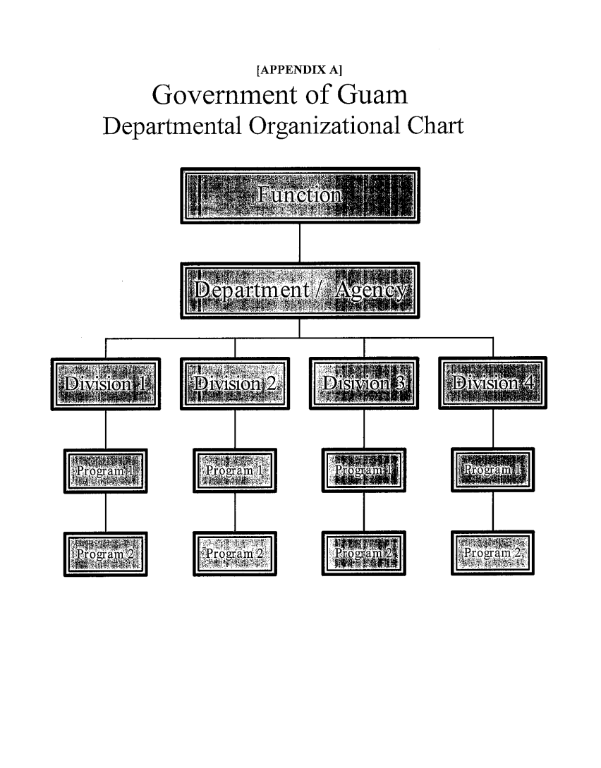
The Budget Process: Strategic Planning for Results - Mission Statement
[BBMR AN-N1]
Government of Guam
Fiscal Year 2017 Budget
Department / Agency Narrative
FUNCTION: _______________________________
DEPT. / AGENCY: _______________________________
MISSION STATEMENT:
GOALS AND OBJECTIVES:

Slide 17
The Budget Process: Strategic Planning for Results
Program Objectives
Divisional Breakdown = Major Program
Sectional Program Objective
Workload Indicators
Task or Activity 1: Number accomplishment and Unit Cost
More than 1 Task or Activity

Slide 18
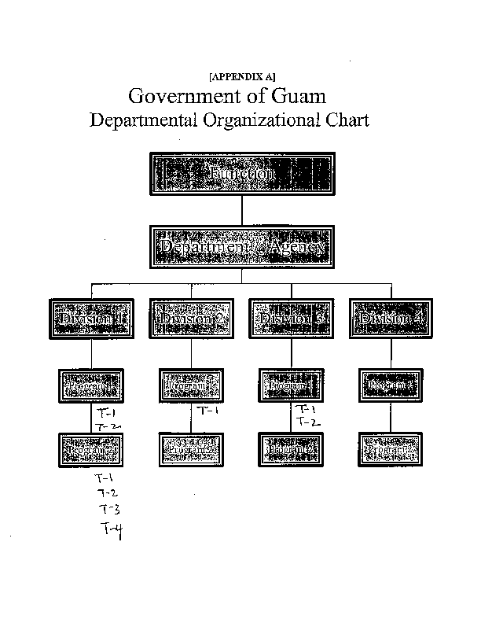
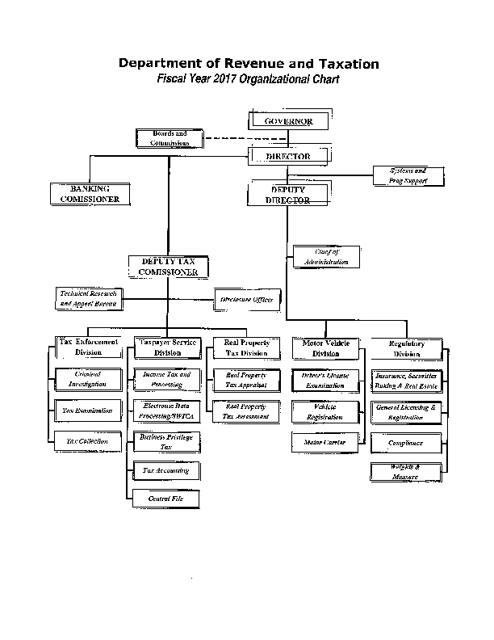
The Budget Process: Strategic Planning for Results – Program Objectives

Slide 19
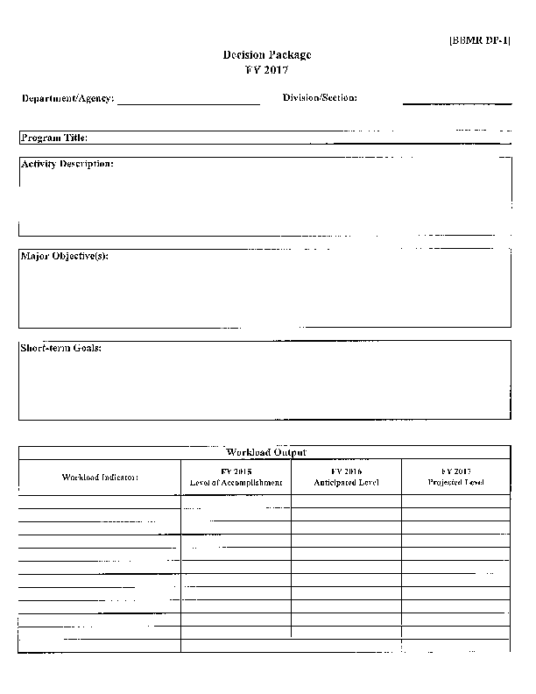
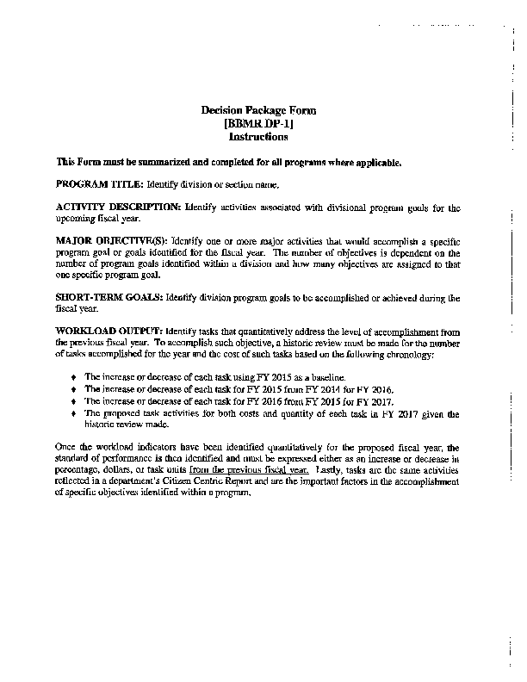
The Budget Process: Strategic Planning for Results – Workload Output

Slide 20
The Budget Process: Strategic Planning for Results – Work Load Outputs
Work Load Outputs (Indicators)
Identify tasks that quantitatively address the level of accomplishment from the previous fiscal year. To accomplish such objective, a historic view must be made for the number of tasks accomplished for the year and the cost of such tasks based on the following chronology.
The increase or decrease of each task using FY 2015 as the baseline.
The increase or decease of each task for FY 2015 from FY 2014 for FY 2016.
The increase or decrease of each task for FY 2016 from FY 2015 for FY 2014
The proposed task activities for both cost and quantity of each task in FY 2017, given the review made (Program Objectives for FY 2017).

Slide 21
The Budget Process: Strategic Planning for Results – Work Load Outputs
Once the work load indicators have been identified, the performance standard for FY 2017 is then identified and must be expressed either as an increase or decrease in percentage, dollars or task units the previous year.
Monitor objectives to determine whether or not proposed increases or decreases in work output is taking place (reporting system of tracking expectation against actual results).
Manage program objectives by identifying problem and providing solutions within the program so that expectations for that year are met.

Slide 22
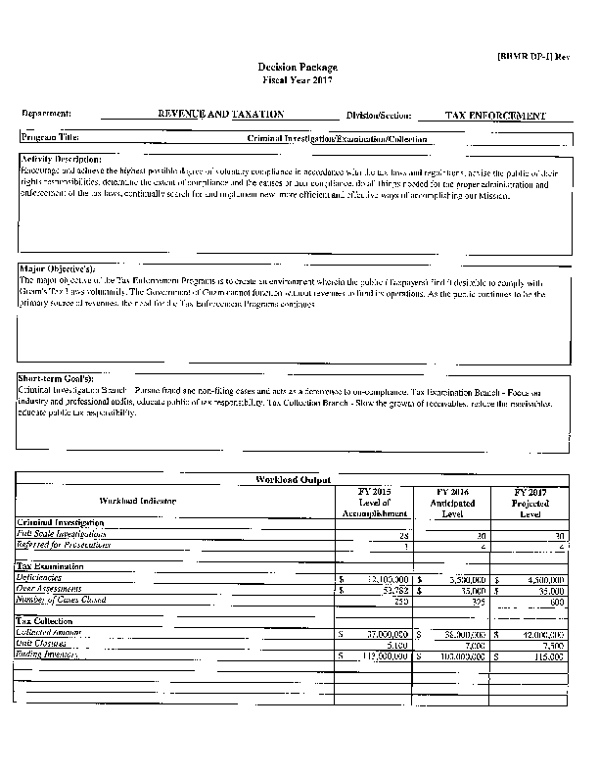
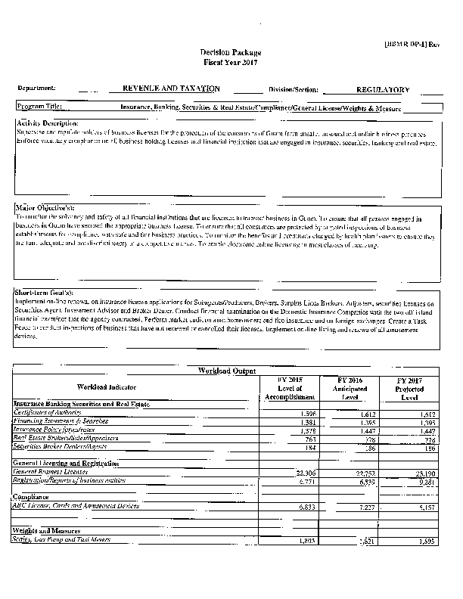

Slide 23
The Budget Process: Strategic Planning for Results – Strategic Planning.
Strategic Planning
Sum of all proposed work outputs for the coming fiscal year by a departmental division or a combination of some or all divisions of an organizations.
Analyze impact of the proposed work outputs to determine outcome that could be either quantified or qualified appropriately.
Write the strategic goal or goals of the department for the coming fiscal year,

Slide 24
Budget Process: Strategic Planning for Results – Strategic Goals
Strategic Goal (s)
Appointing Authority, Director or Administrator, etc. determines the upcoming goals of the department based on the past performance of the department.
It is his or her vision of the accomplishment (s) that will take place in the coming fiscal year.
Success or failure on achieving desired results is dependent on the proper monitoring and managing of program objectives.

Slide 25
Summary
Review the departmental Mission Statement to determine if updates are required based on new legislative mandates and Executive Orders.
Review your organizational chart to ensure your Mission Statement is in line with the current chart.
Review the department’s divisional programs and their corresponding work-outputs to determine past and current performance.
Develop performance expectations for new fiscal year.

Slide 26
Summary
Develop reporting system to track expectation to actual in new fiscal year.
Formulate the strategic plan based on expected outcomes.
Analyze overall strategic plan
Write Strategic Goals
Analyze tracking reports for progress throughout the fiscal year.

