Slide 1

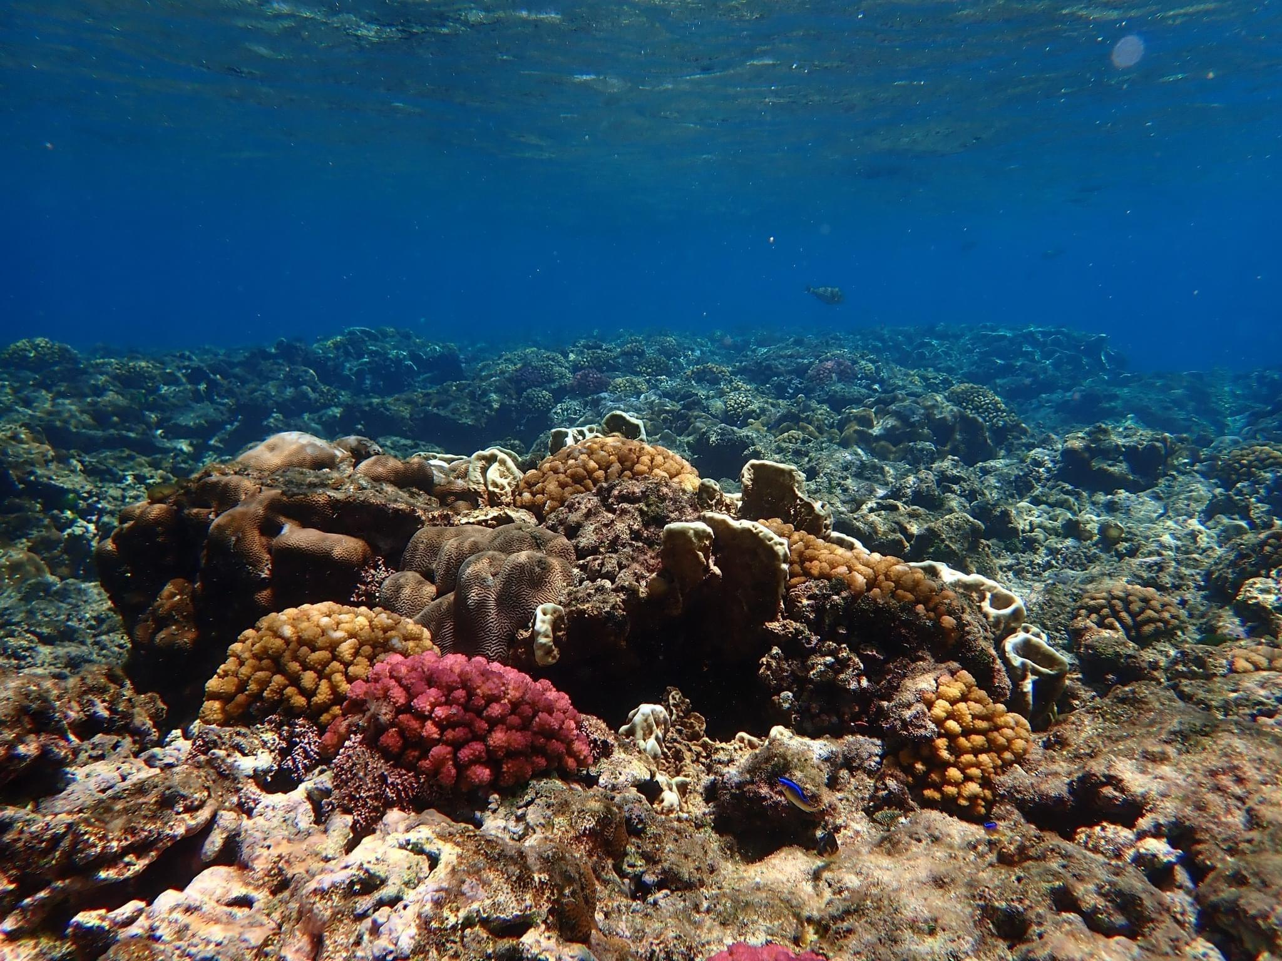
9TH ASSEMBLY OF PLANNERS
AUGUST, 2024
Update on Guam’s Coral Reefs
Presented by Olivia Bañez

Slide 2
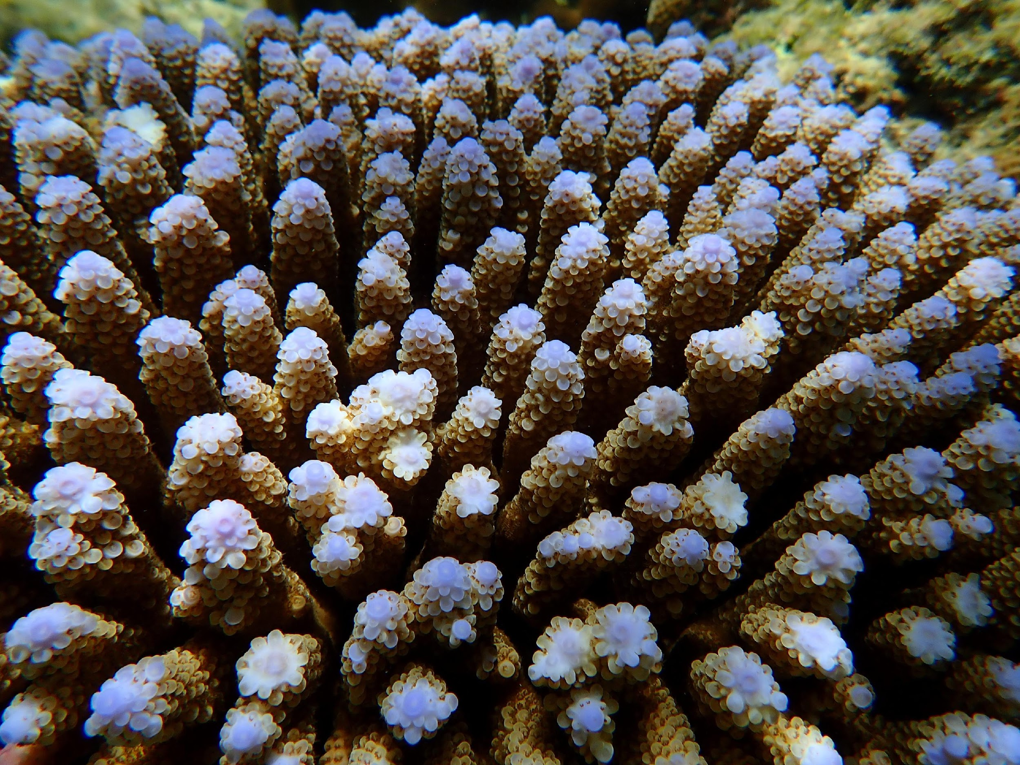
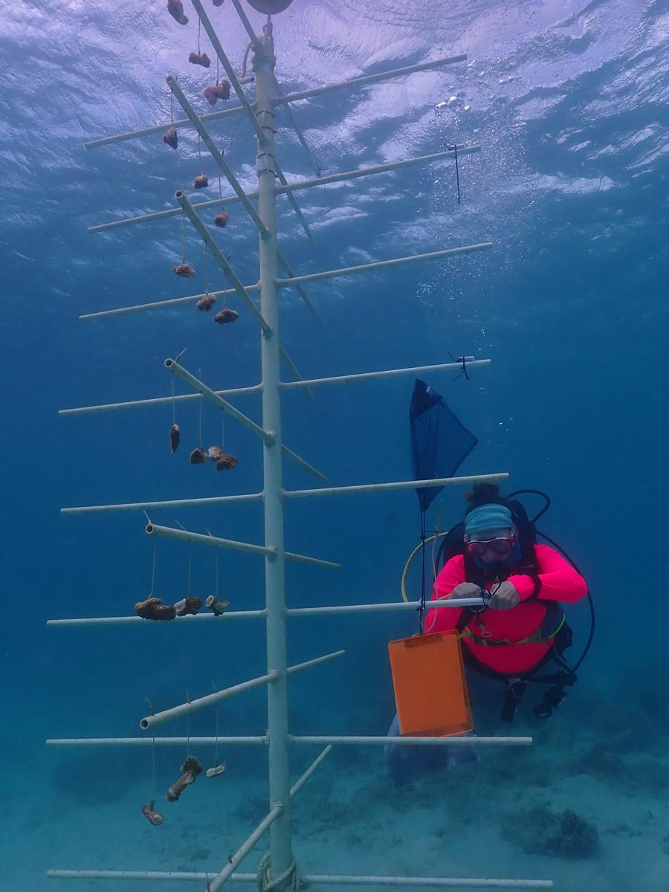
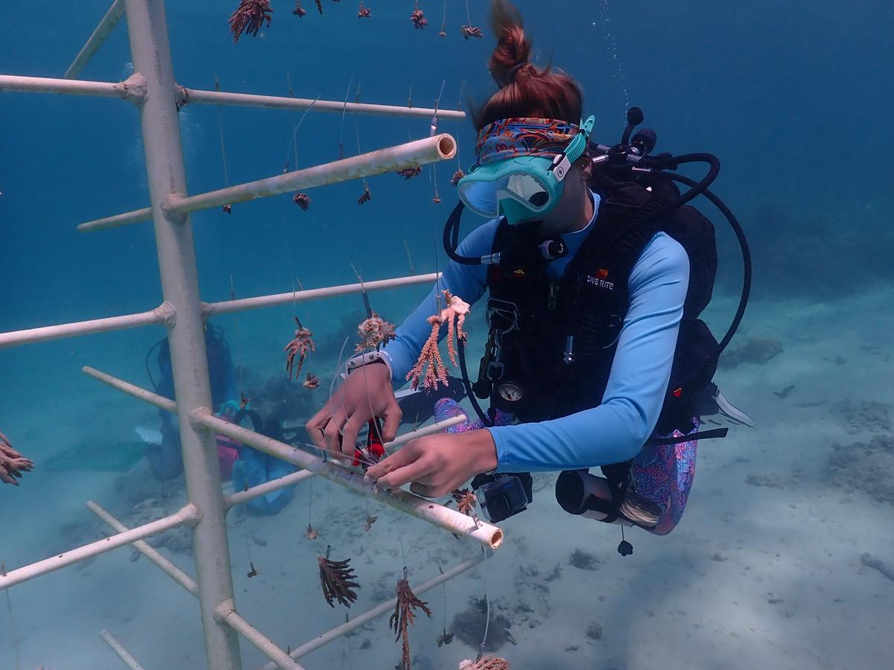


Guam Coral Reef Initiative
Established in 1997 by Executive Order 97-10
Managing all aspects of Guam’s coral reefs
Management plans
Community outreach
Mangrove and seagrass conservation
Watershed management
Coral reef restoration

Slide 3
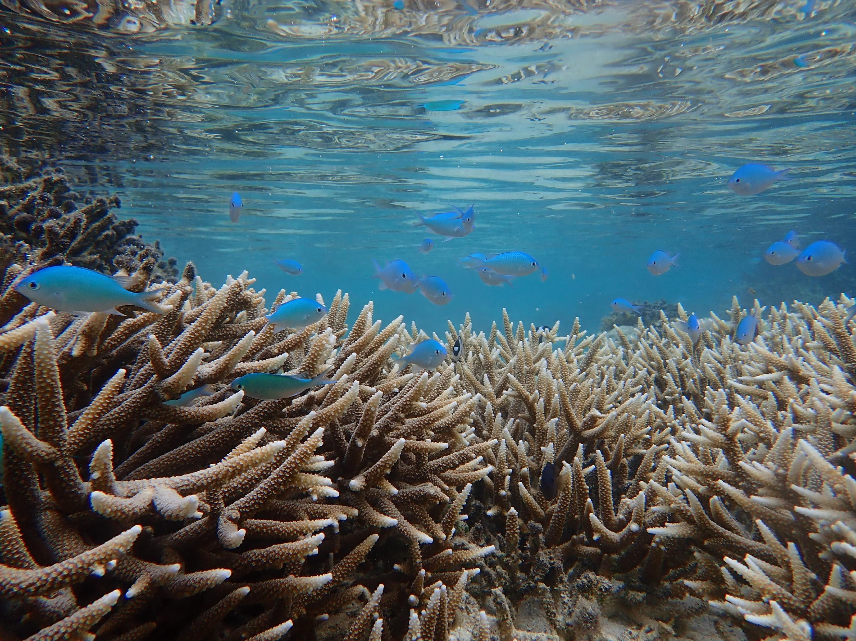
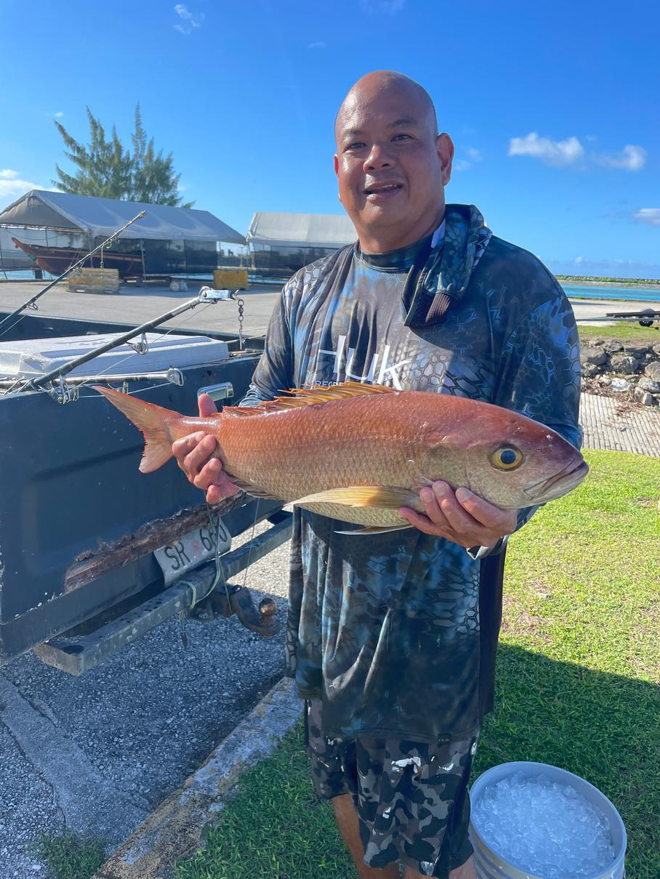
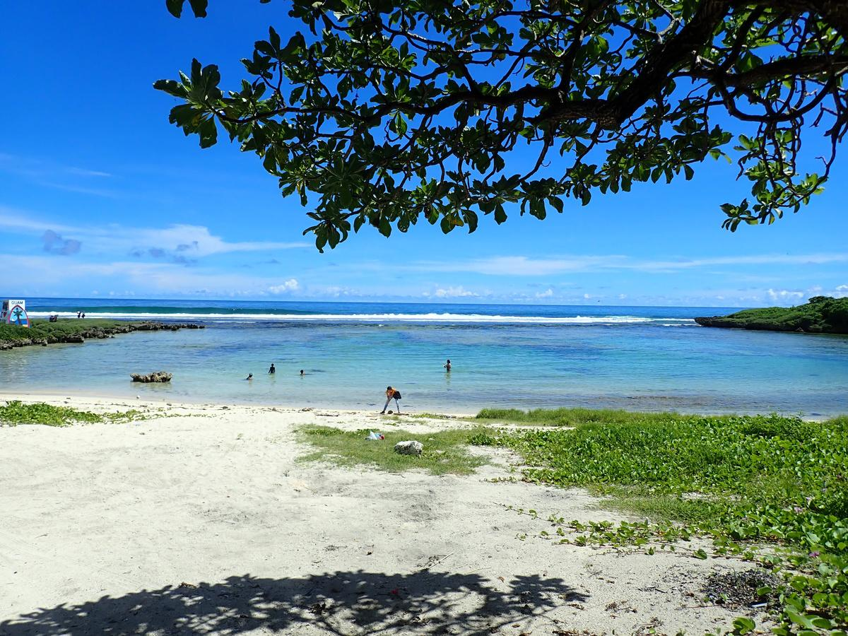
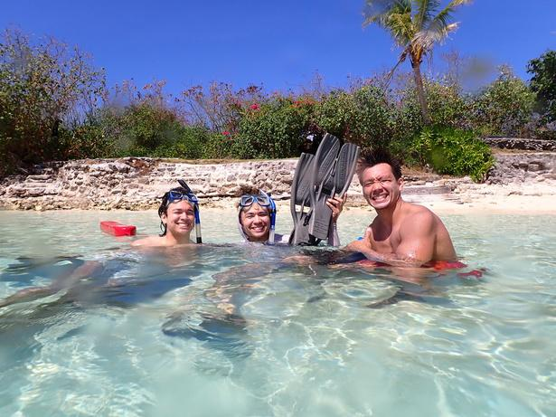
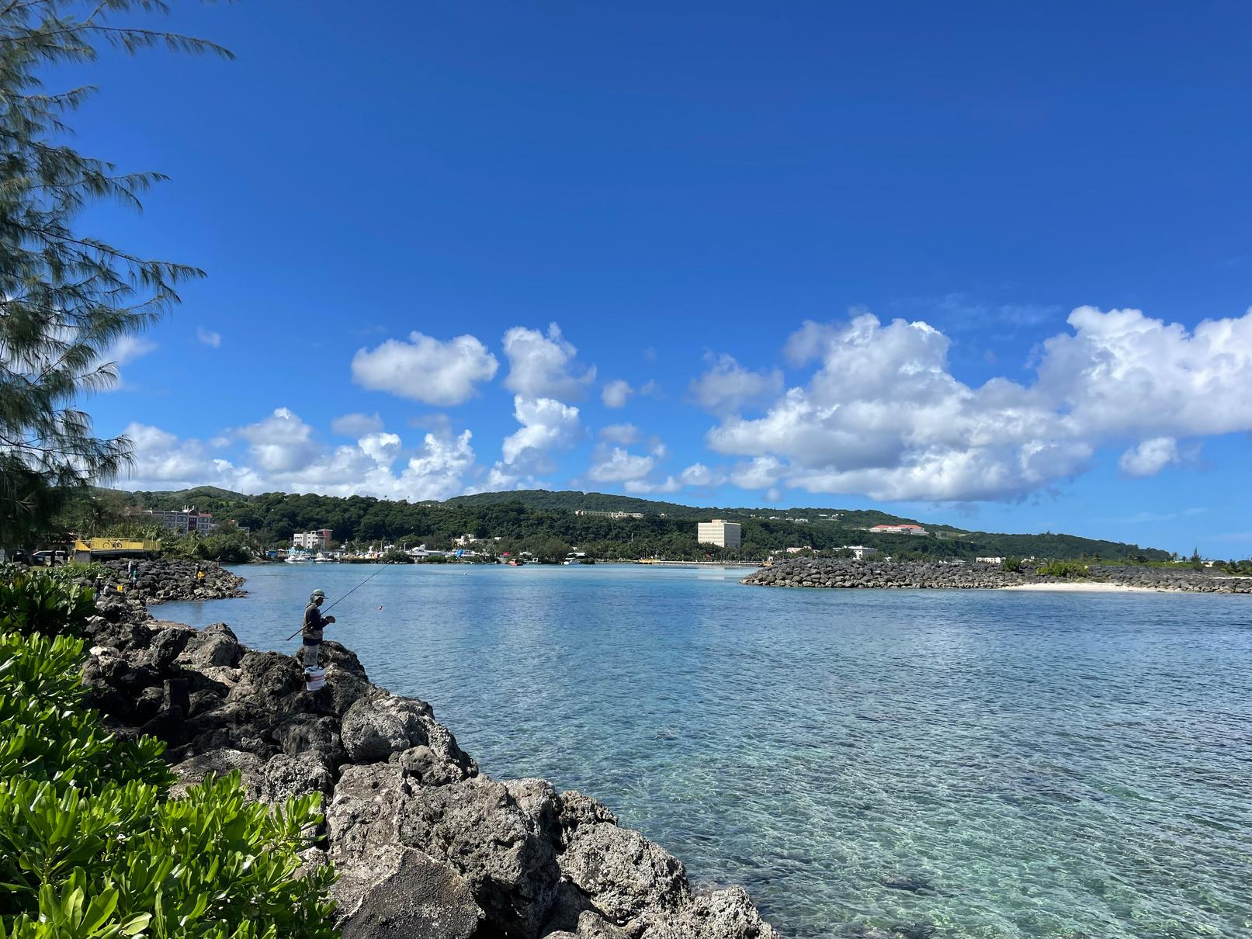
Guam’s Coral Reefs
42
square miles of shallow reef
400
species of hard coral
$63.46 M
calculated annual value
Providing seafood
Protecting the coast
Tourism
Cultural and recreational value

Slide 4
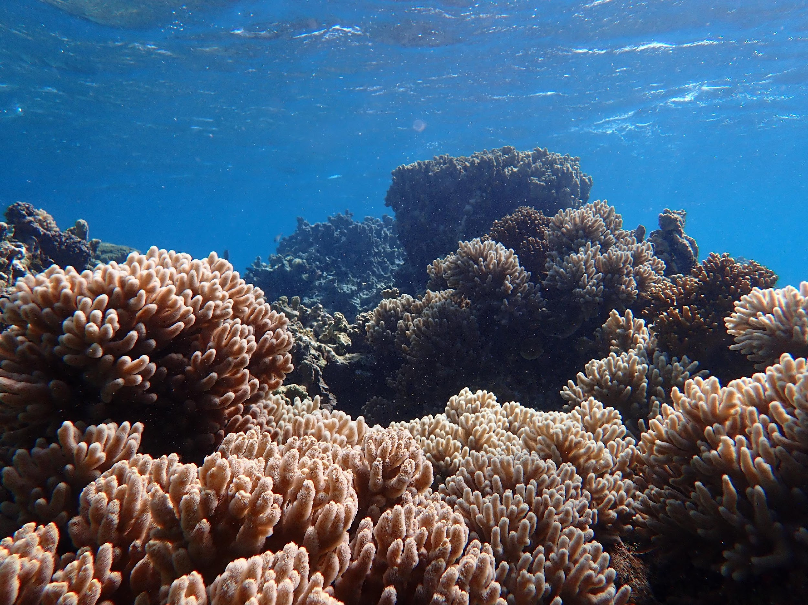






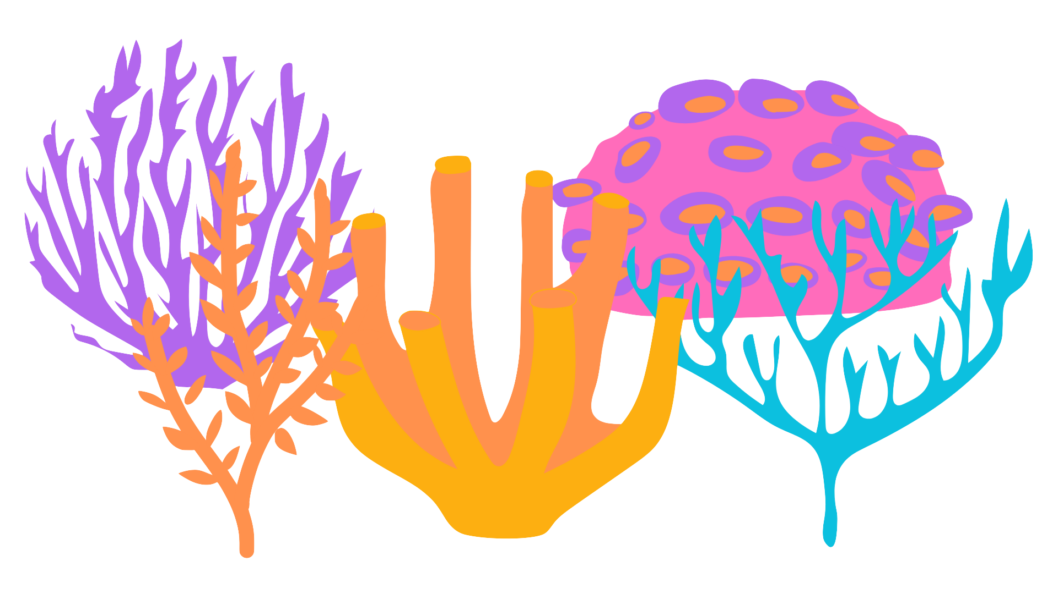

Basics of Coral
Bleaching

Slide 5
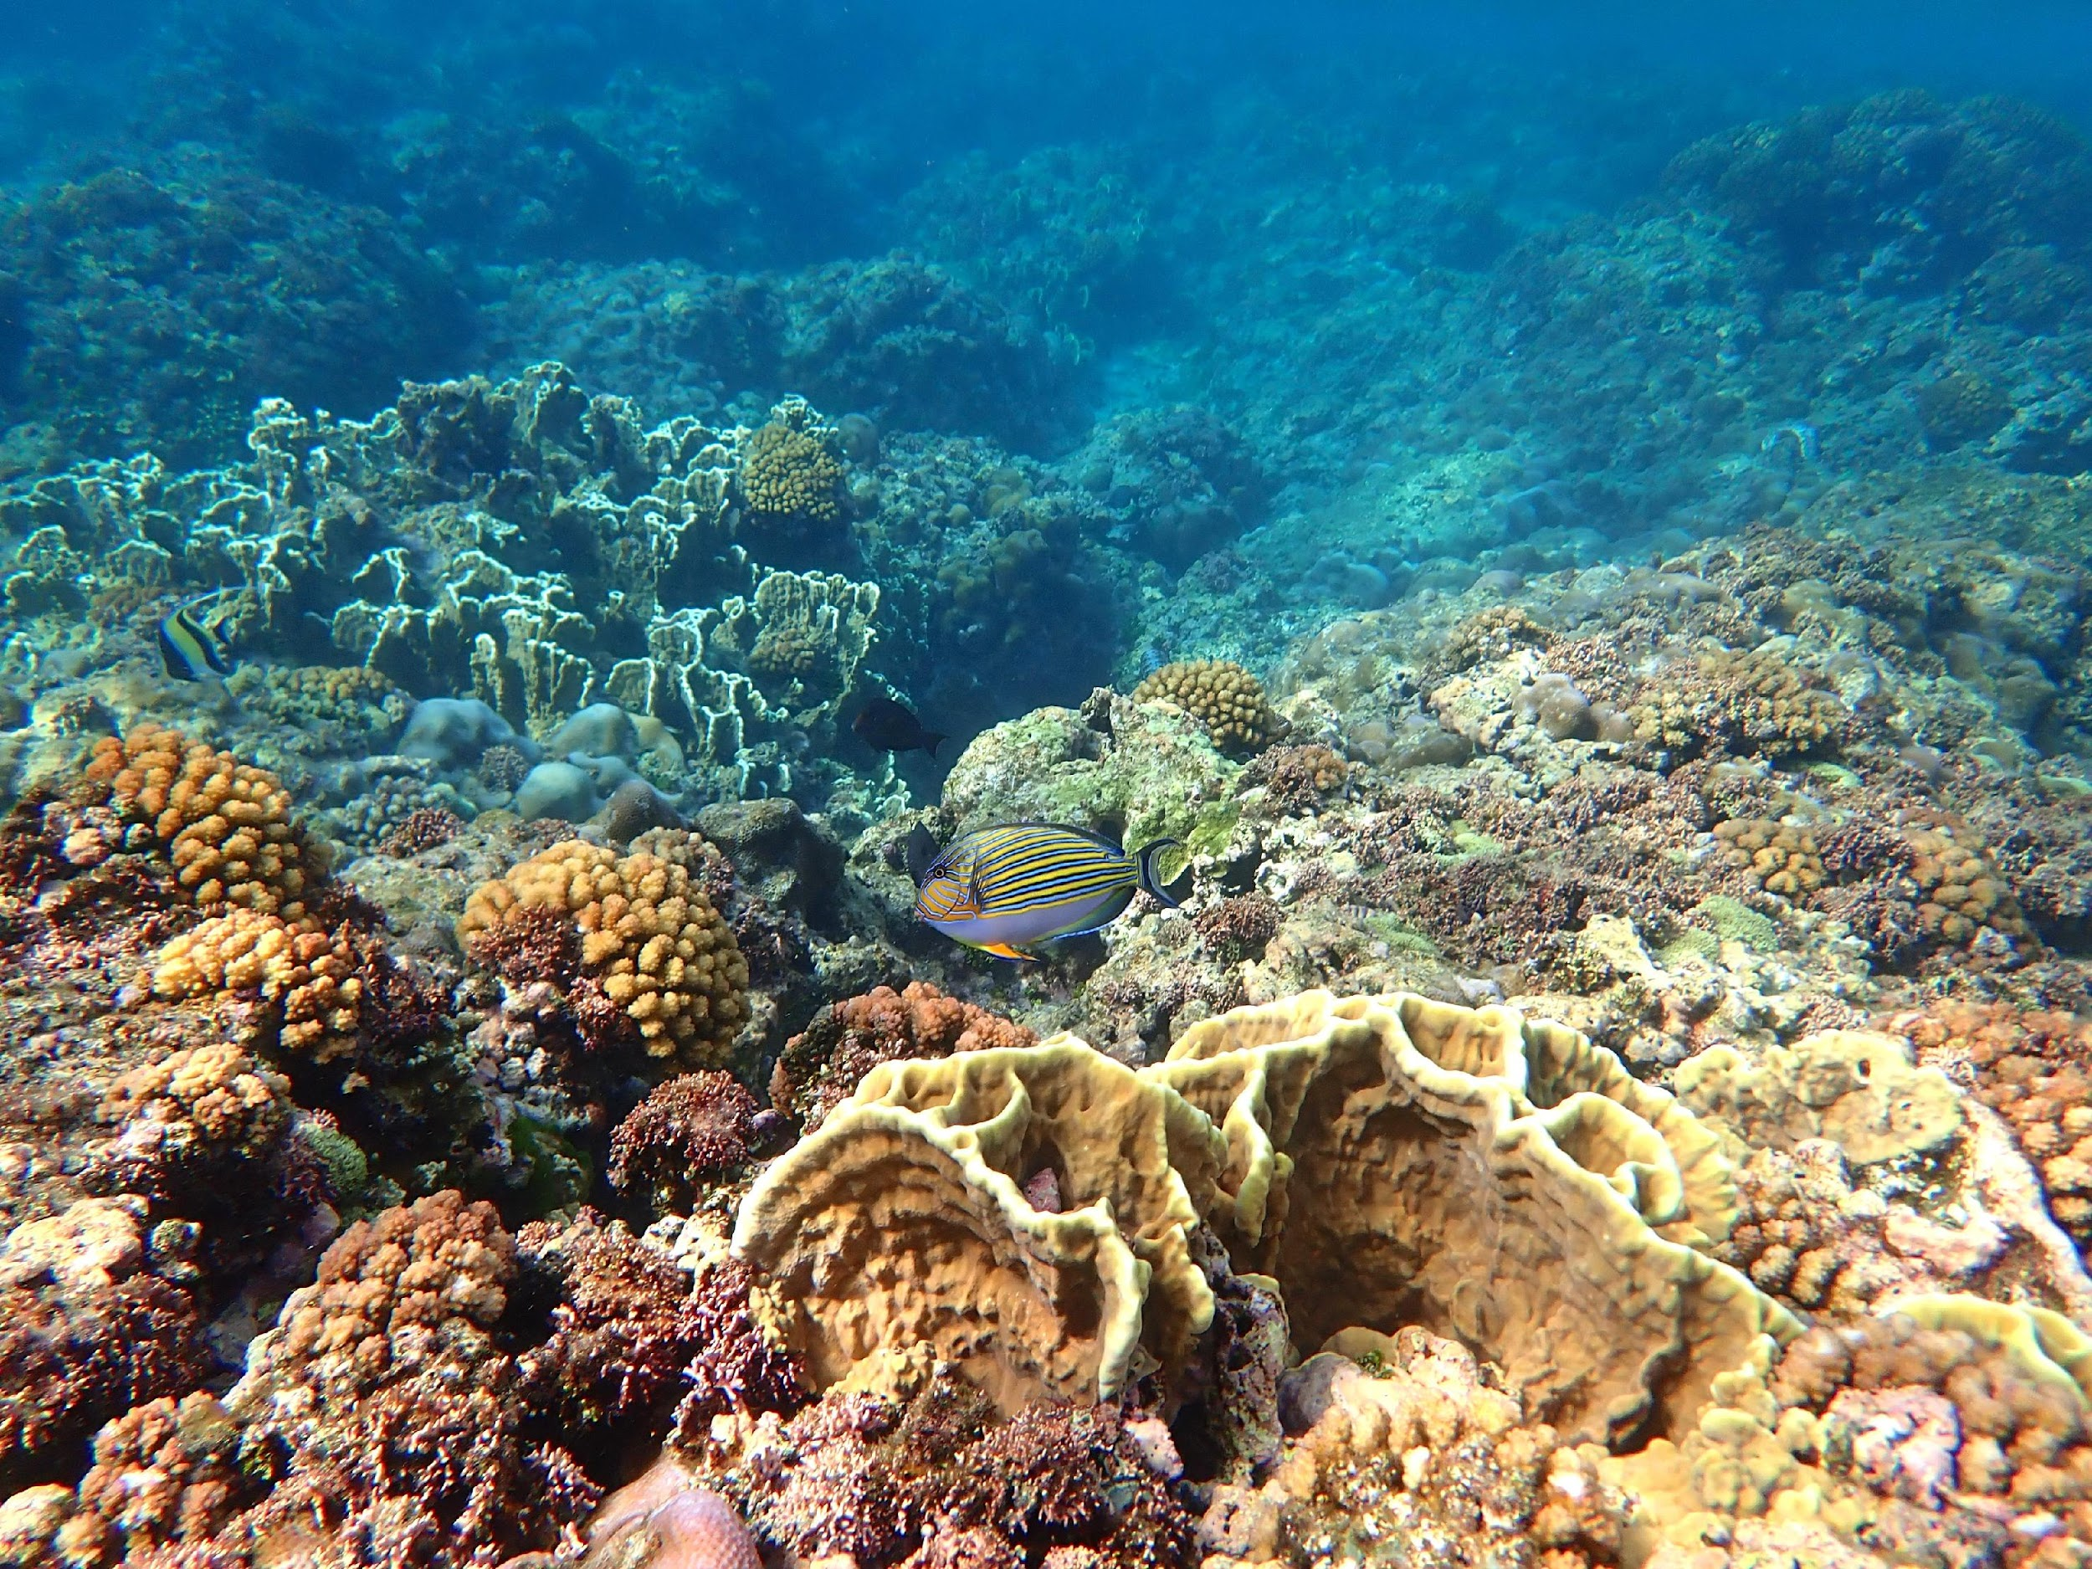
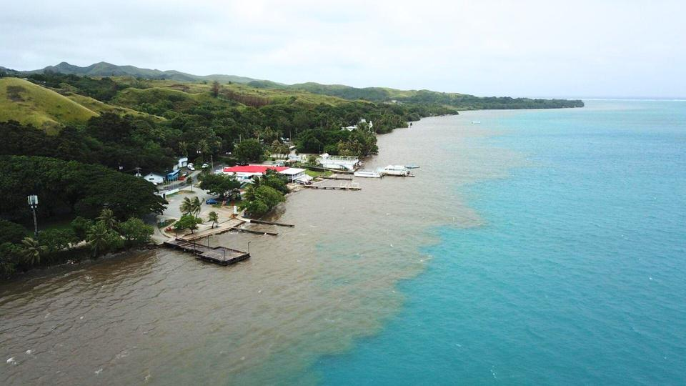
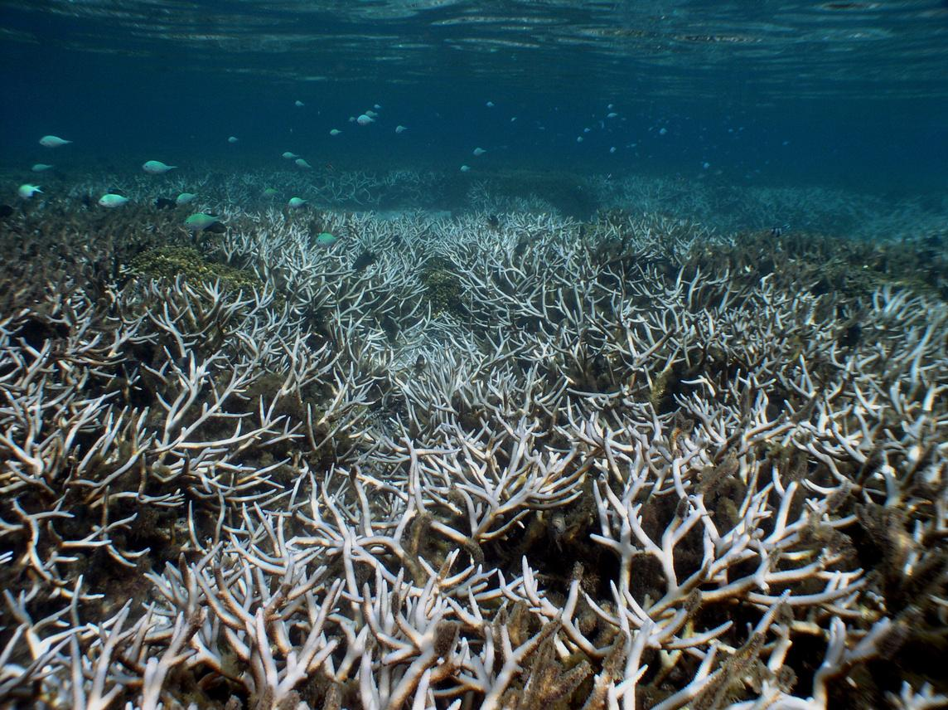
Causes of Coral Bleaching
1
Warming waters
2
Sediment runoff
Photo by Dontana Keraskes/The Guam Daily Post
3
Polluting chemicals
4
Extreme low tides
Photo by Dave Burdick

Slide 6
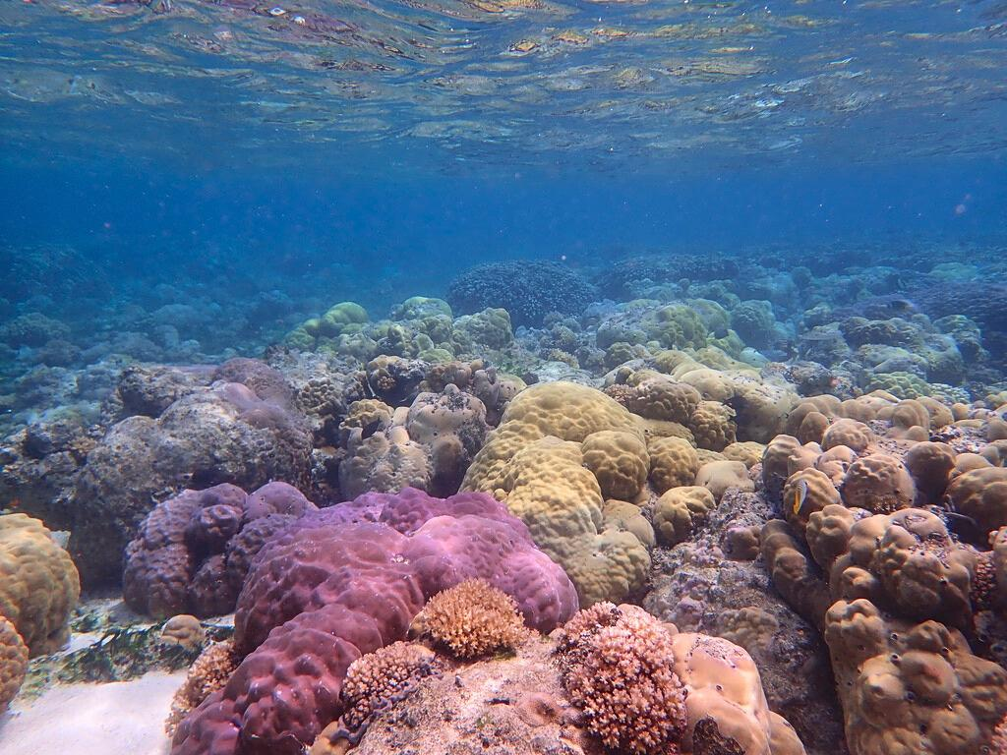
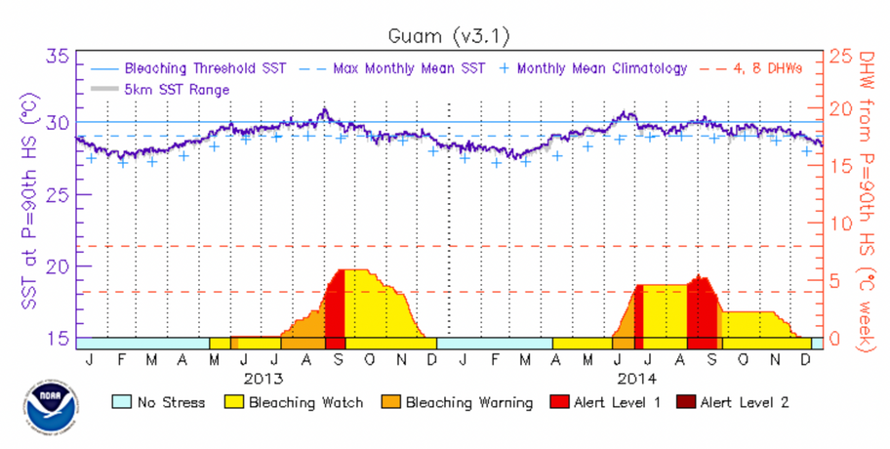
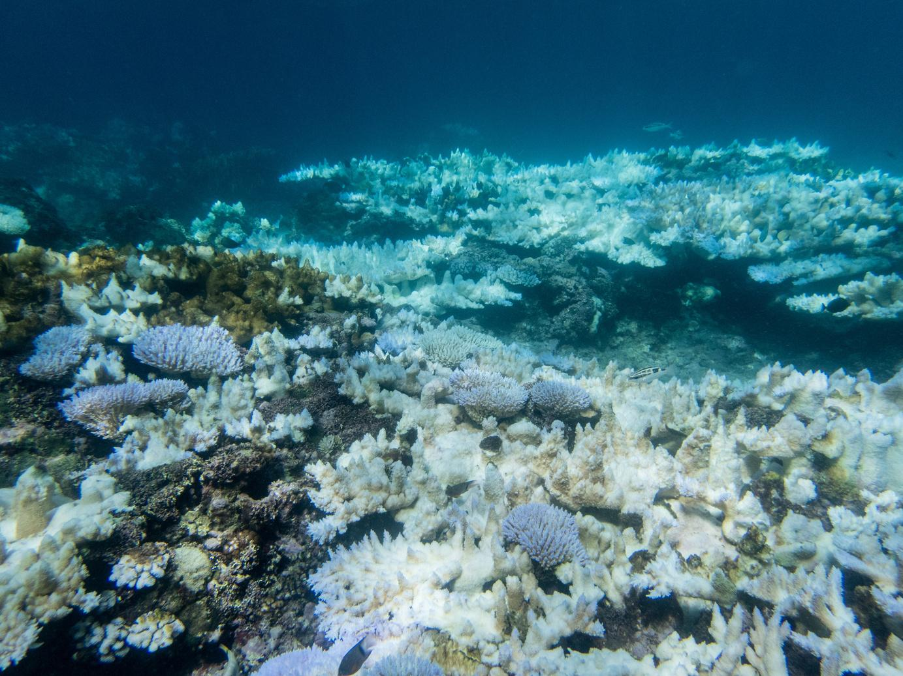
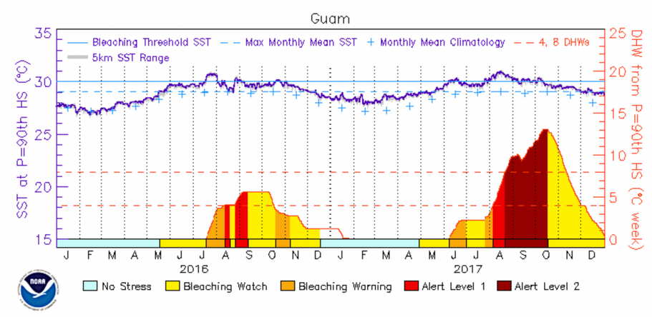
Guam’s history of bleaching
2013 - 2017 severe bleaching
1/3 of Guam’s coral died
Eastern exposure Acropora abrotanoides community bleaching in 2017
Photo by Dave Burdick

Slide 7
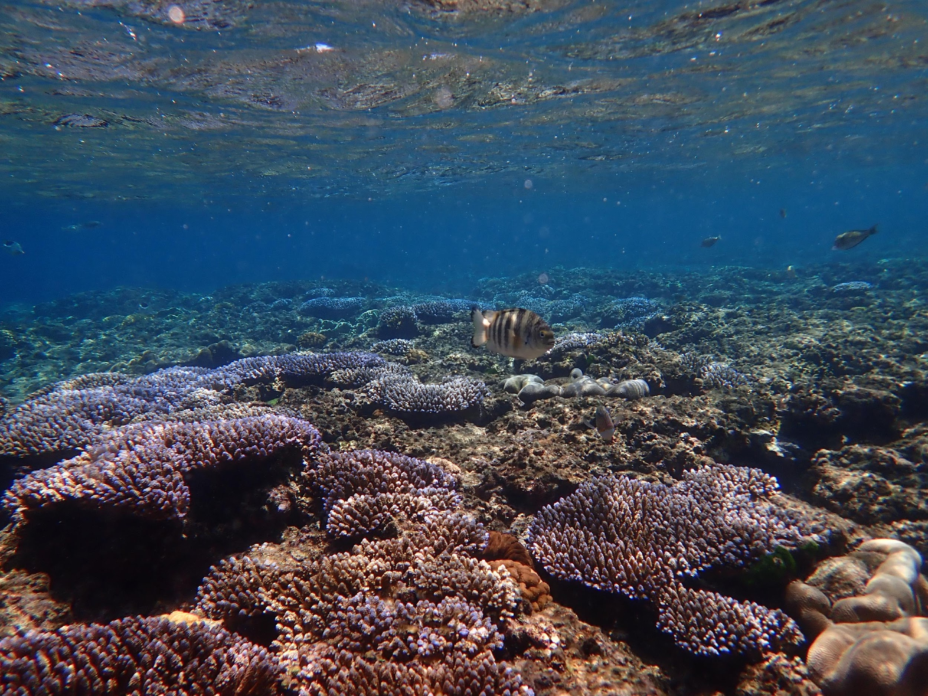
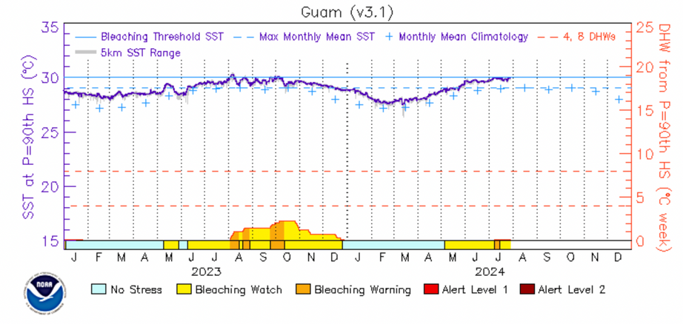
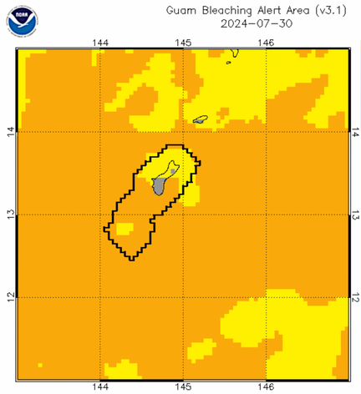
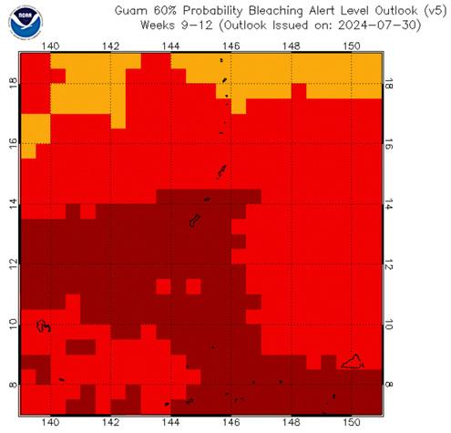
Current Status
Bracing for bleaching
No major bleaching since 2017
Slightly more than half of the reefs are improving, but still haven’t fully recovered to pre-bleaching health
As of April, we are experiencing the 4th global bleaching event
Guam’s bleaching level as of 7/30/24
Guam’s predicted bleaching level for 10/22/24

Slide 8
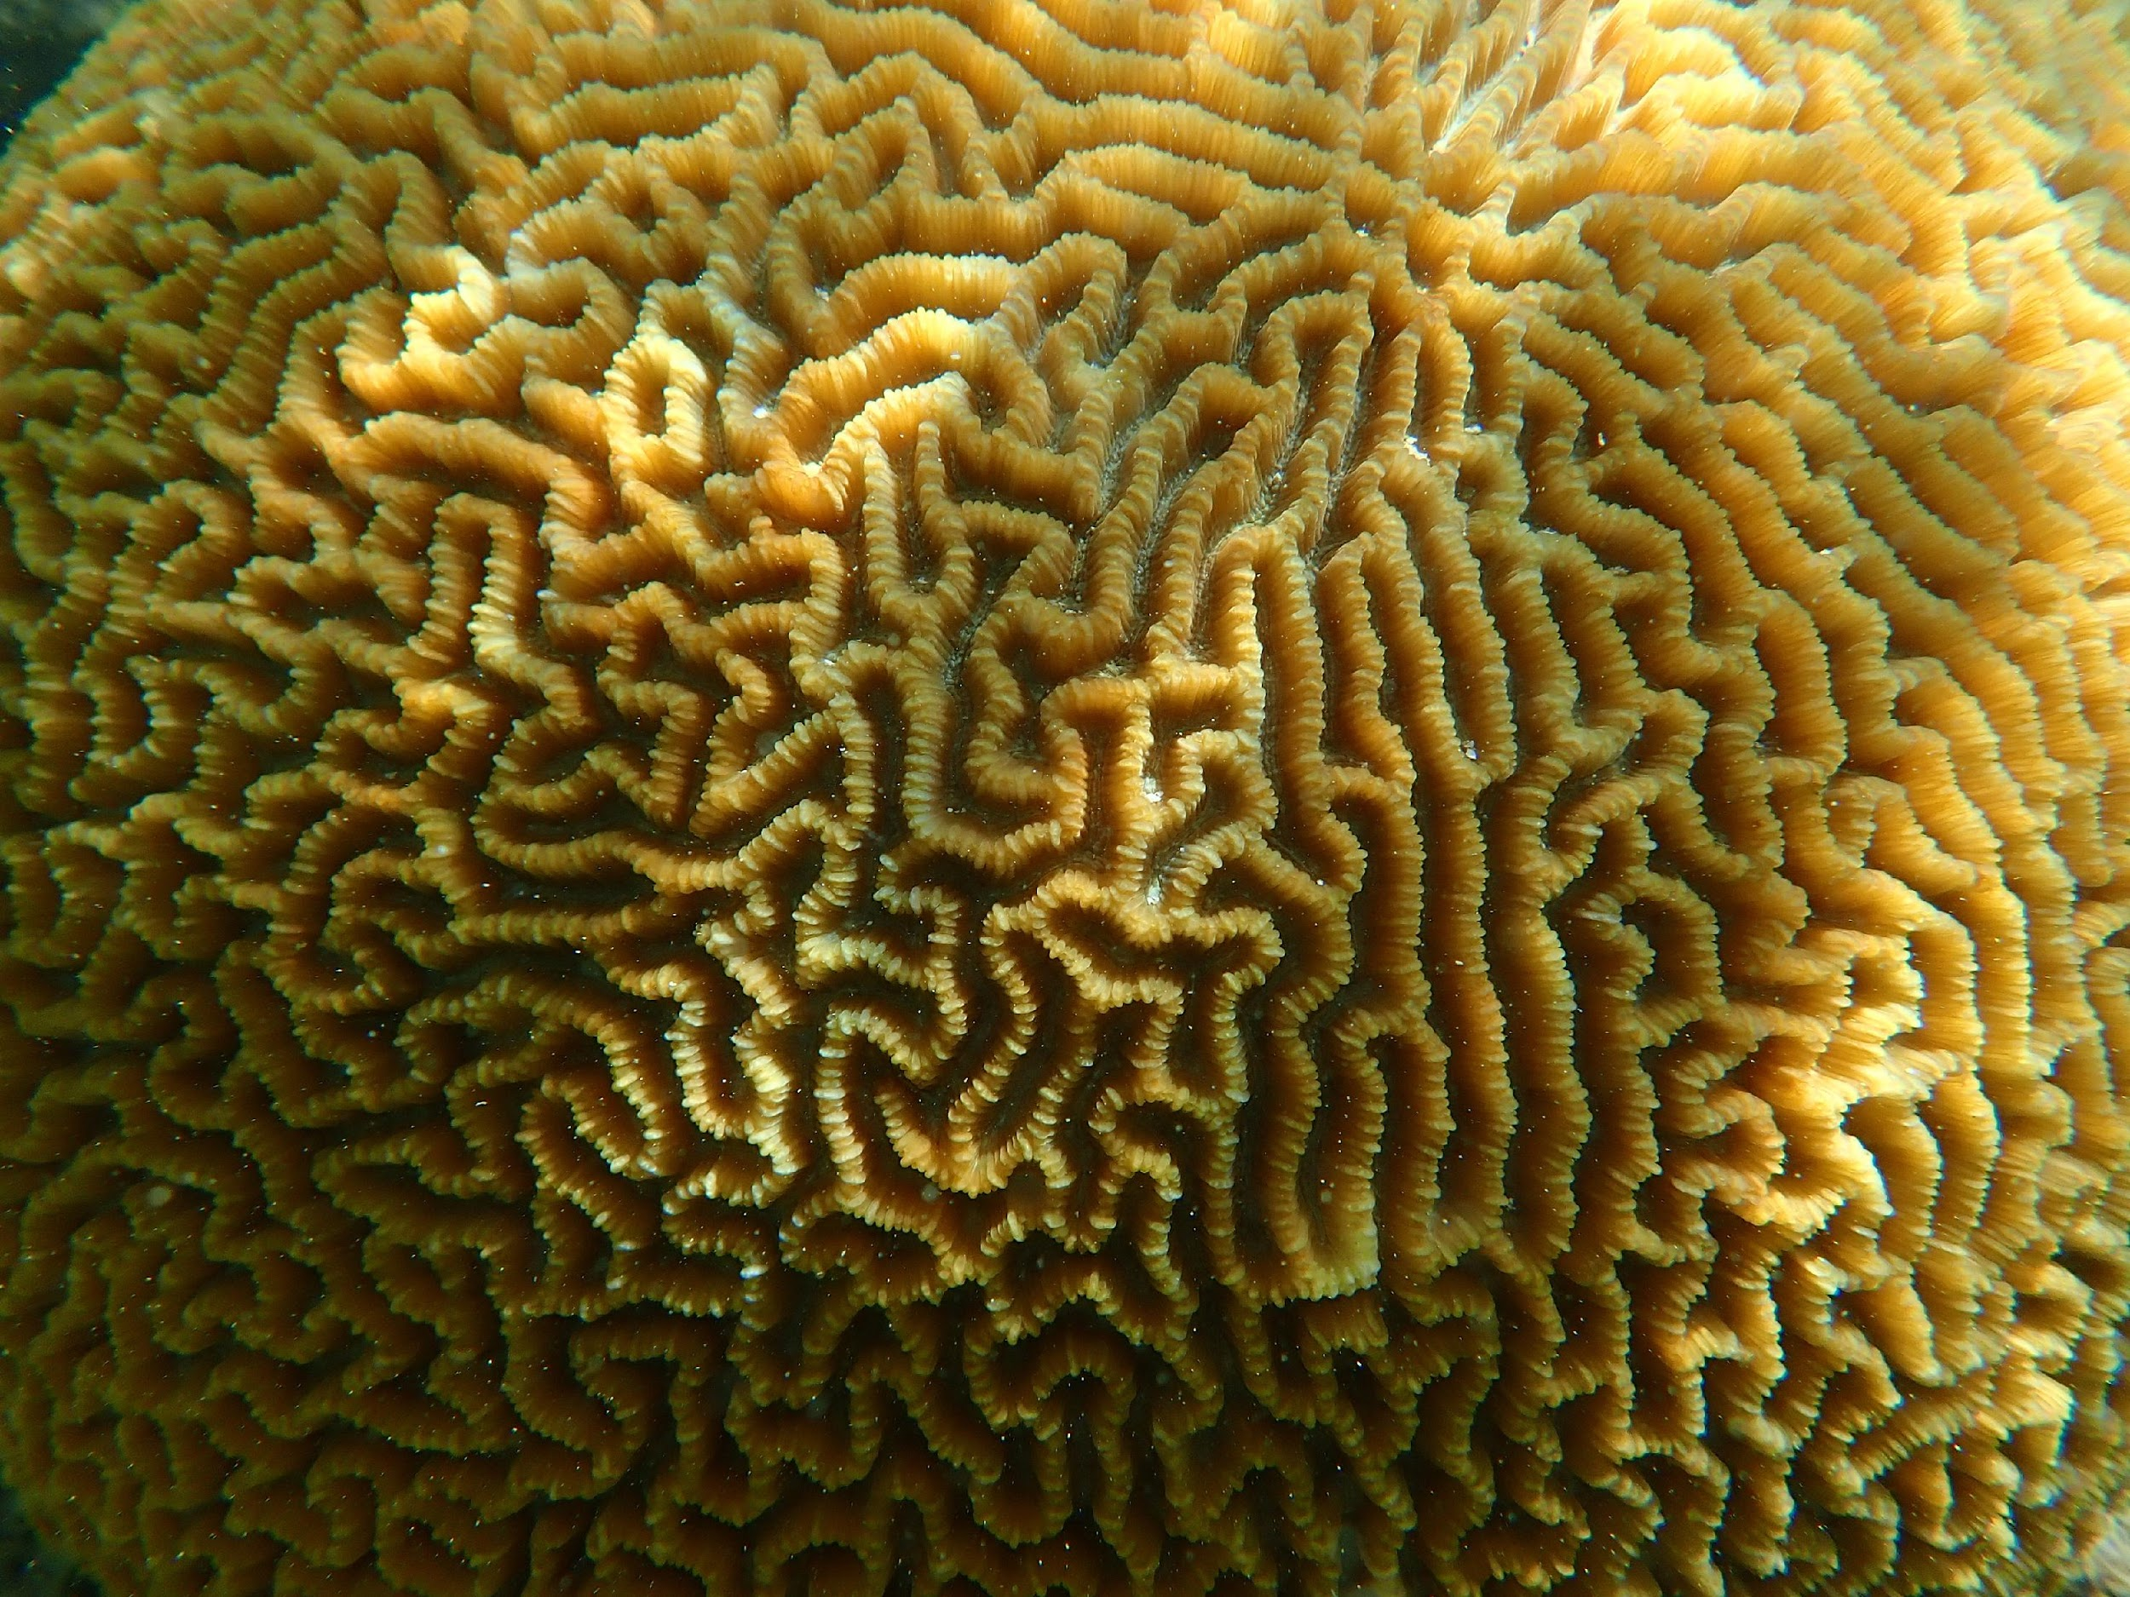


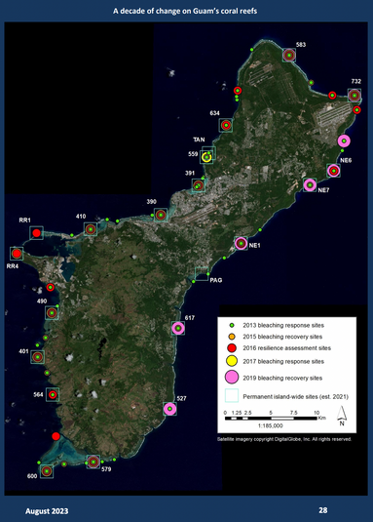

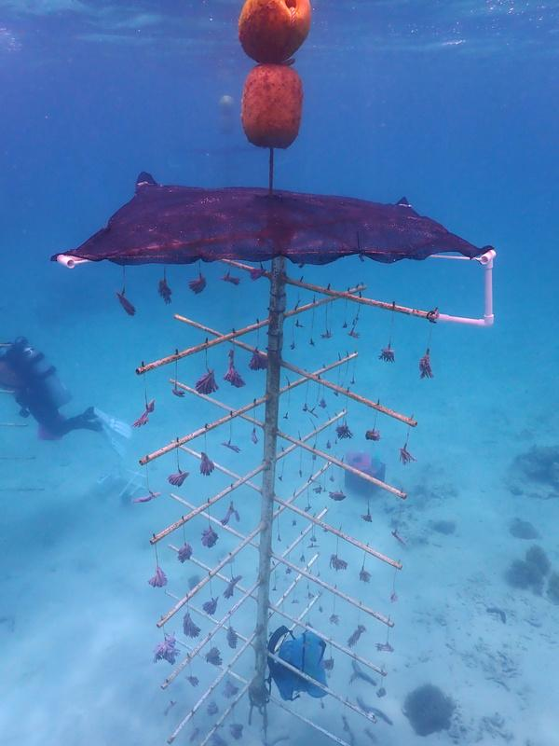
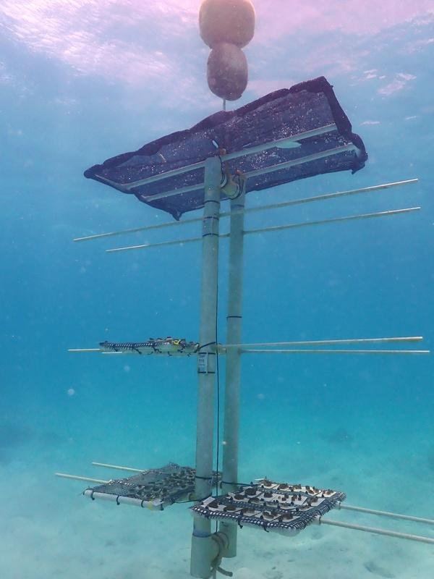

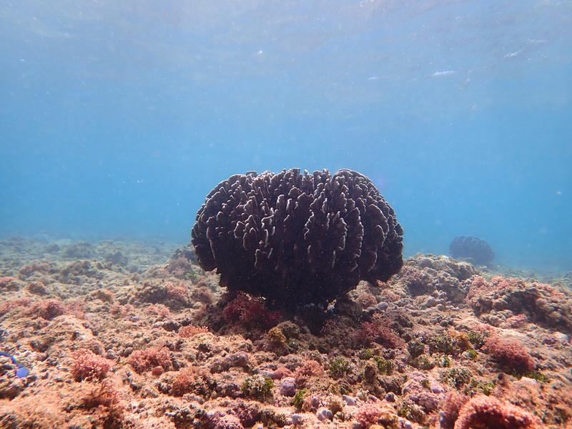
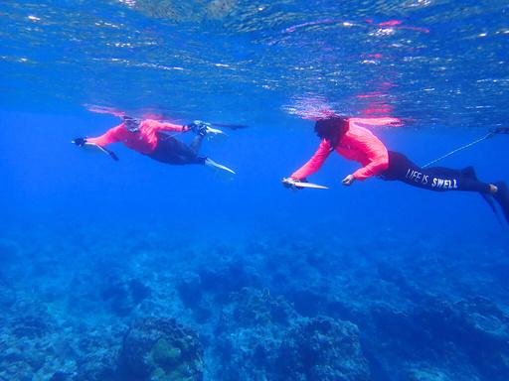
Taking action
Before
During
After
Limiting other stressors
Organizing - GRRIP
Do not step on coral
Use reef-safe sunblock
Do not litter
Anchor boats away from the reef
Reduce off-roading
Compiling data
Installing shade cloths
Report bleaching and reef threats
Identifying resilient corals
Survey!

Slide 9
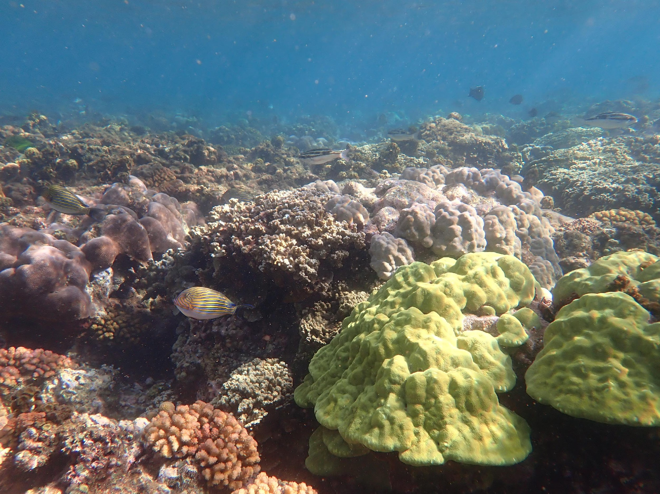


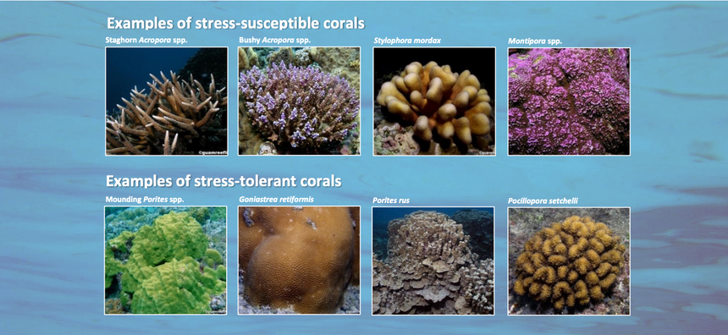
Planning Considerations
Promote projects that reduce erosion
Planting trees, cleaning rivers, restoring watersheds, culling invasive plants and animals
Utilize the Erosion & Sediment Control Field Guide
Planning marine projects around bleaching season
Peak bleaching September-October
Check Guam’s current bleaching status
https://coralreefwatch.noaa.gov/product/vs/gauges/guam.php
Consult biologists about areas with bleaching-sensitive species

Slide 10
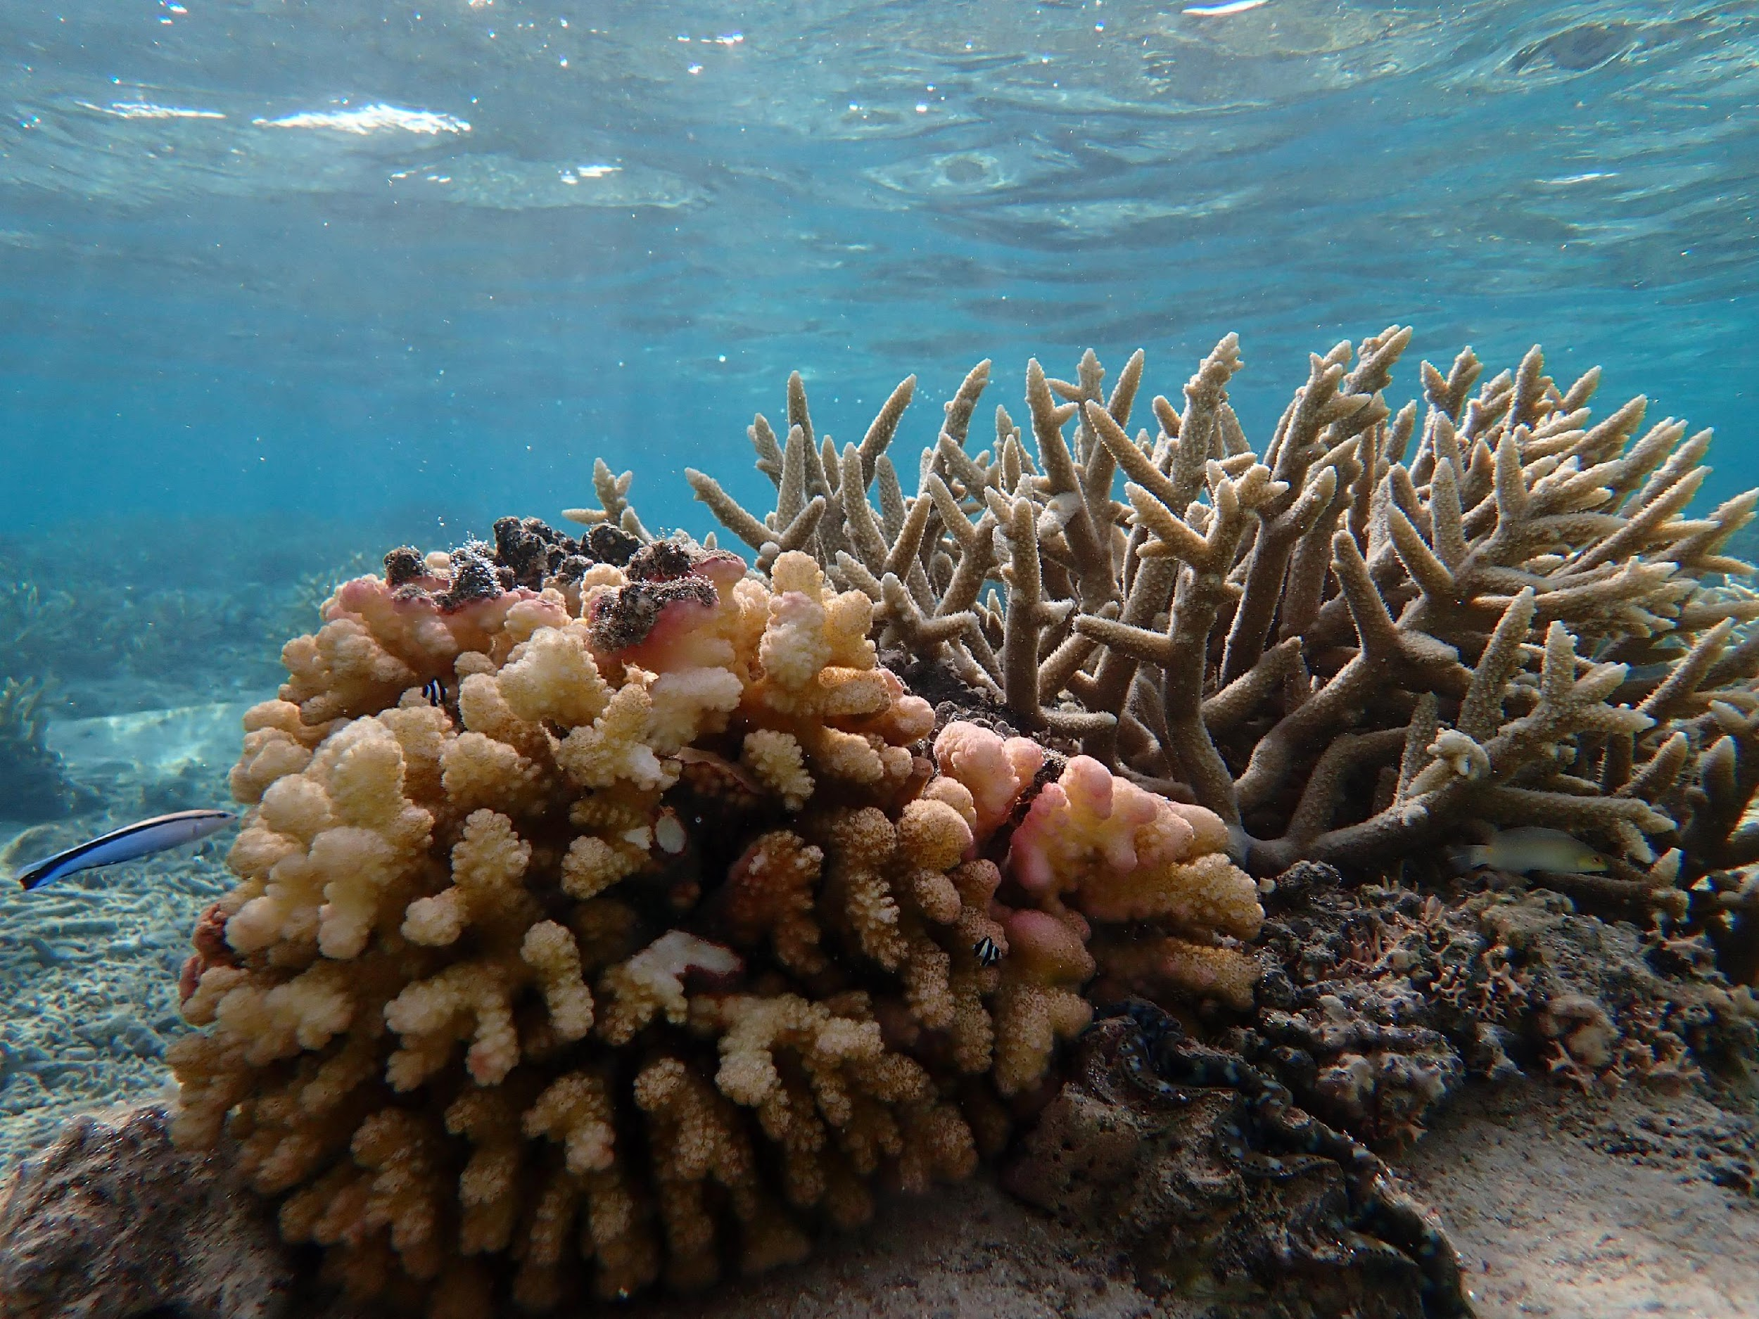





Thank you!
Olivia.banez@doag.guam.gov
www.guamcoralreefs.info
@Guamcoralreefs
@Guam Coral Reef Initiative
Report bleaching or other reef threats through this link:

