Slide 1


INSIGHTS TO ACTION: THE IMPORTANCE OF DATA IN REAL ESTATE

Slide 2

IMPORTANCE OF ACCURATE DATA
Accurate data on title records, property attributes, and market trends are critical for real estate decision-making. Reliable information enables investors to make informed choices, mitigate risks, and capitalize on market opportunities.

Slide 3

DATA STANDARDIZATION
Uniform Data Standards
GIS Integration
Streamlined Data Management
Establishing consistent data formats, structures, and definitions across all real estate data sources to ensure seamless integration and analysis.
Integrating Geographic Information Systems (GIS) to geospatially reference and visualize real estate data, providing a comprehensive and spatial understanding of the market.
Implementing efficient data storage, retrieval, and maintenance processes to optimize data accessibility, accuracy, and reliability for real estate decision-making.
Data Normalization
Data Governance
Transforming and standardizing data from various sources to a common format, ensuring consistency and comparability across different real estate portfolios and markets.
Establishing clear policies, procedures, and roles for data ownership, access, and quality control to maintain the integrity of the real estate data ecosystem.

Slide 4
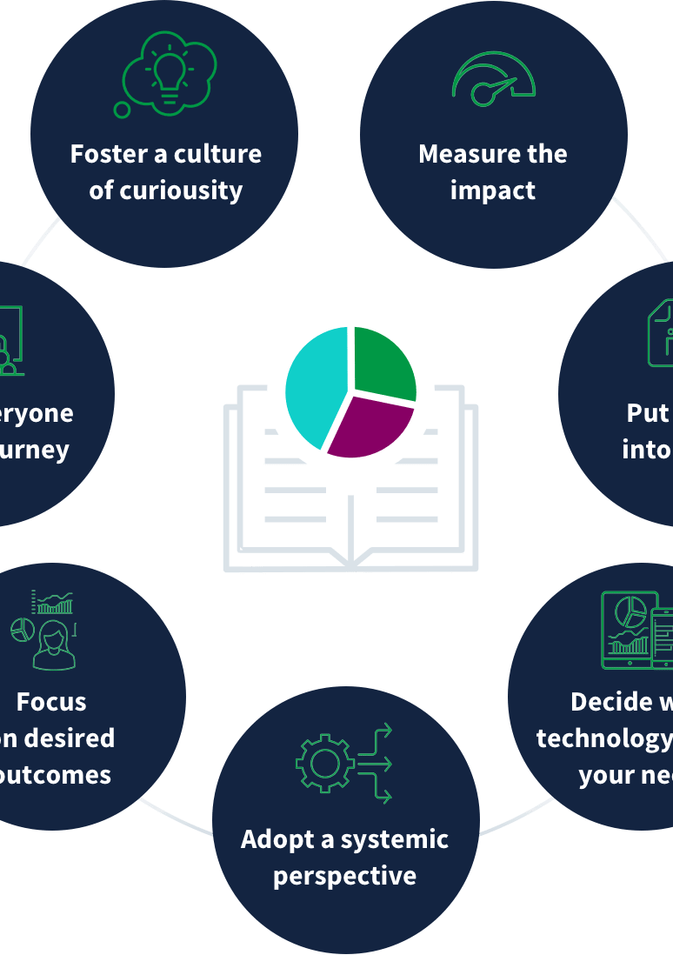
TRAINING AND CAPACITY BUILDING
Effective data utilization in the real estate industry requires a well-trained workforce and informed public. Skilled personnel training programs and public awareness campaigns can significantly improve data literacy, enabling industry professionals and consumers to make informed decisions based on accurate and reliable data.

Slide 5





STEPS TO ENSURE DATA ACCURACY
Establish Data Verification Protocols
Implement Data Reconciliation Processes
Automate Data Validation Checks
Establish Data Governance Policies
Provide Ongoing Data Quality Training
Implement detailed procedures to systematically verify the accuracy and reliability of data sources, such as conducting cross-checks, validating against authoritative references, and implementing data quality audits.
Develop robust processes to cross-reference data from multiple sources, identify and resolve any discrepancies, and ensure a single, consistent, and accurate data repository.
Leverage technology to automatically validate data inputs, flag anomalies, and trigger alerts for potential errors or inconsistencies, enabling real-time data quality monitoring and maintenance.
Create and enforce comprehensive data governance policies that define clear roles, responsibilities, and accountability for data quality, including data ownership, access controls, and change management procedures.
Implement regular training and educational programs for all data users, empowering them to understand the importance of data accuracy and equipping them with the skills to maintain high-quality data standards.

Slide 6





CURRENT GOALS FOR DATA INTEGRATION AND DECISIONING
Understanding Internal Governmental Workflows
Identifying Data Sources
Navigating Data Accessibility
Ensuring Data Integrity
Leveraging Governmental Data
Explore the intricate processes and procedures that govern the collection, management, and dissemination of real estate data within governmental organizations. Gain insights into the challenges and complexities involved in ensuring accurate and timely information.
Recognize the various governmental agencies and departments responsible for collecting, maintaining, and providing real estate data. Understand the different data formats, reporting standards, and access protocols that may be involved.
Examine the policies, regulations, and limitations that can impact the availability and accessibility of real estate data from governmental sources. Discover strategies to effectively navigate these challenges and obtain the necessary information.
Investigate the measures taken by governmental entities to verify the accuracy, completeness, and timeliness of the real estate data they provide. Assess the importance of data quality assurance processes in maintaining reliable information.
Explore the ways in which real estate professionals can effectively utilize the data provided by governmental sources to inform their decision-making, market analysis, and investment strategies. Discuss the benefits and potential limitations of relying on governmental data.

Slide 7

APPLICATIONS IN REAL ESTATE
GIS applications have revolutionized the real estate industry. These applications allow real estate professionals to gather and access property information, photos, and other relevant data directly from the field, streamlining the decision-making process and providing a more comprehensive understanding of the market for stakeholders and consumers alike.

Slide 8
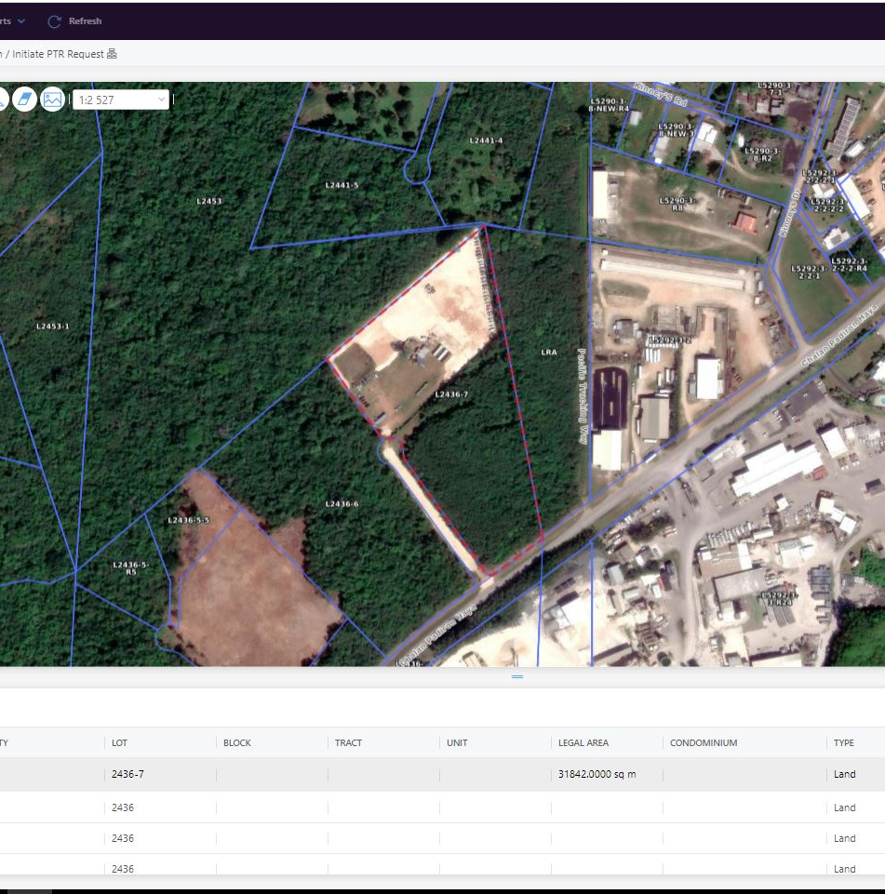
COORDINATE GIS/MAPPING DATA

Slide 9
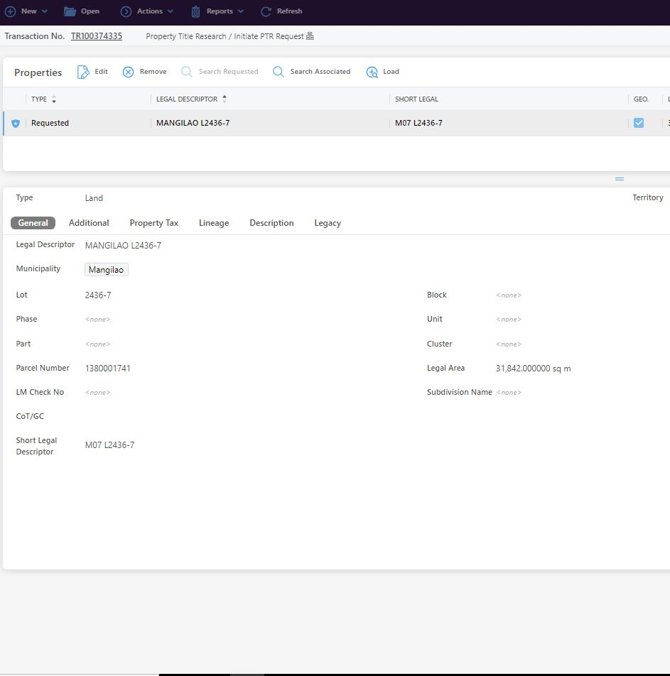
STEP 1:
IDENTIFY LOT TO BE RESEARCHED.

Slide 10
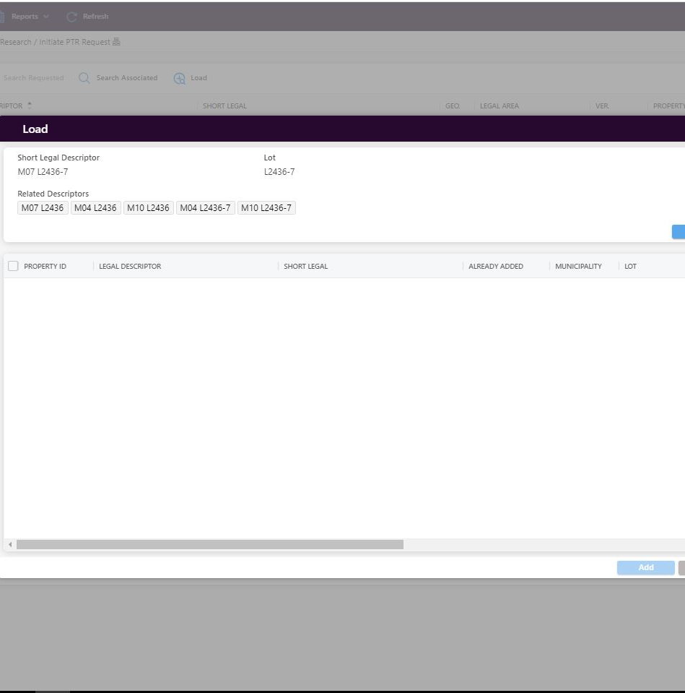
STEP 2:
USE ALGORYTHM TO PULL ASSOCATIATED PARCELS.

Slide 11
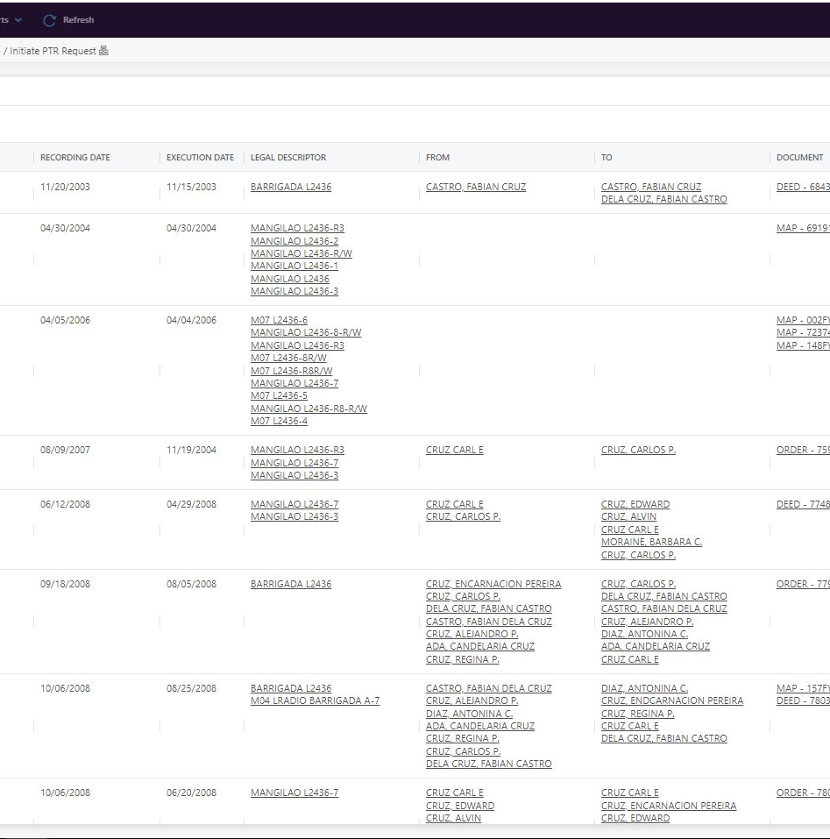
STEP 3:
HIGH LEVEL REVIEW OF SYSTEM CONCLUSIONS.

Slide 12
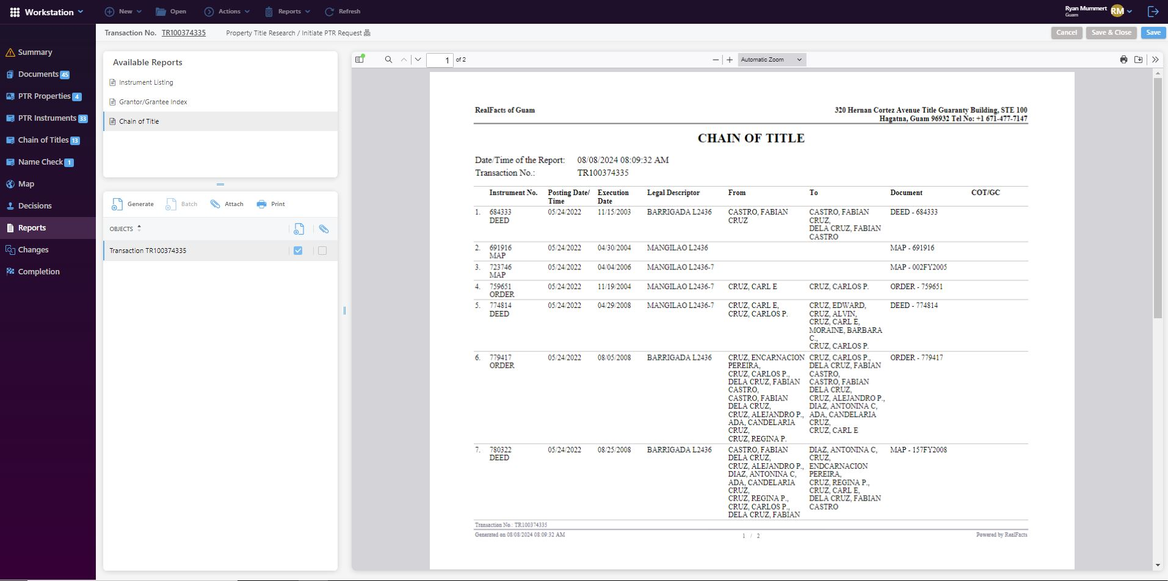
STEP 4:
PROVIDE DELIVERABLE AND APPARATUS FOR REVIEW

Slide 13
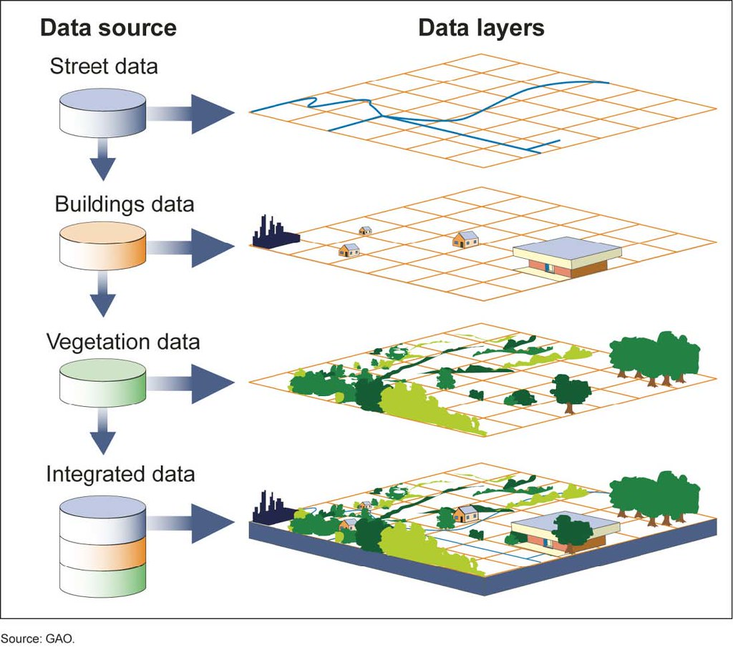
GIS IN REAL ESTATE
Geographic Information Systems (GIS) play a crucial role in the real estate industry by providing powerful tools for mapping, spatial analysis, and land use planning. GIS allows real estate professionals to leverage the power of location-based data to make informed decisions, optimize property management, and enhance investment strategies.

Slide 14

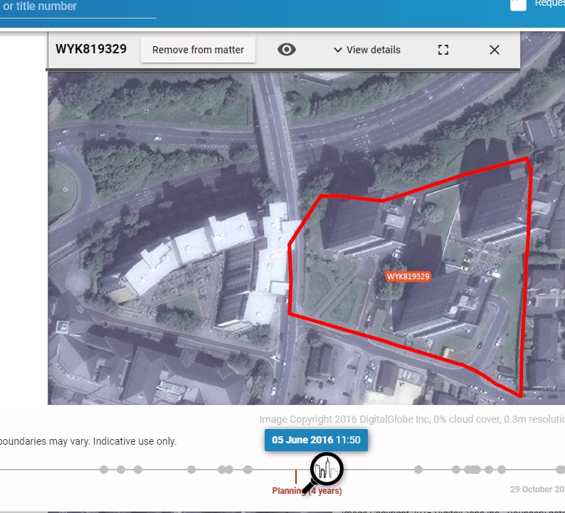

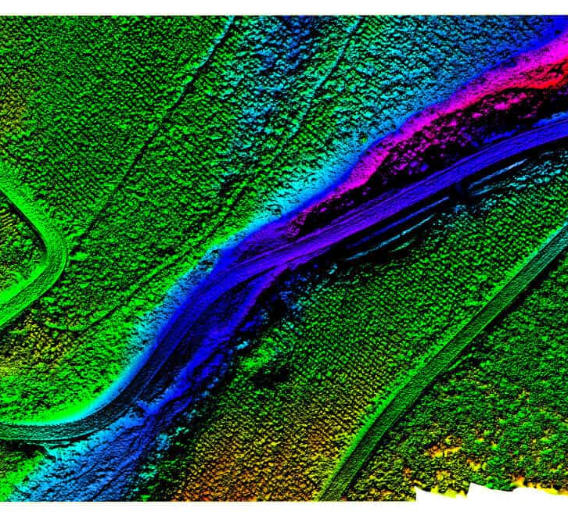
TECHNOLOGY IMPLEMENTED IN GIS SERVICES
High-Resolution Satellite Imagery
LiDAR Point Cloud Data
Multispectral Imagery
Capture highly detailed and geographically precise images of properties and land parcels from space, enabling comprehensive analysis of the built environment.
Utilize advanced LiDAR technology to generate dense 3D point cloud data, providing accurate measurements and terrain mapping for property assessments and development planning.
Leverage multispectral satellite data to identify vegetation, water bodies, and other land cover features that can impact property value and development potential.

Slide 15
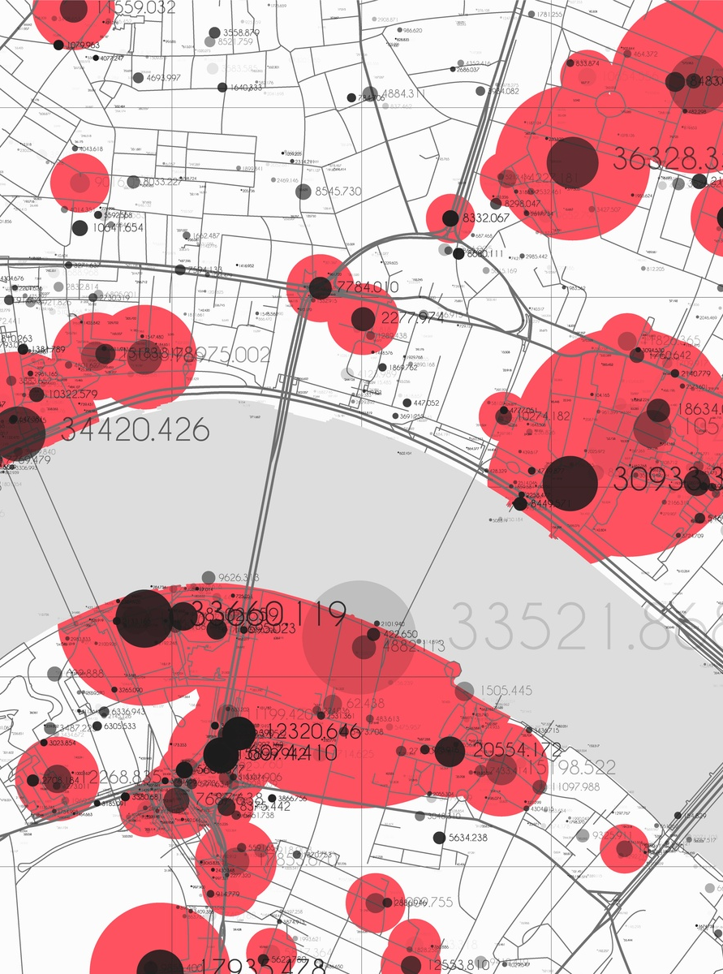
BIG DATA ANALYTICS IN REAL ESTATE
Big data analytics in real estate can provide valuable insights into market trends and risk assessment, enabling real estate professionals to make more informed decisions. By leveraging advanced data analysis techniques, such as predictive modeling and machine learning, real estate organizations can gain a deeper understanding of market dynamics, identify potential risks, and make strategic investments that align with the current and future needs of the industry.

Slide 16
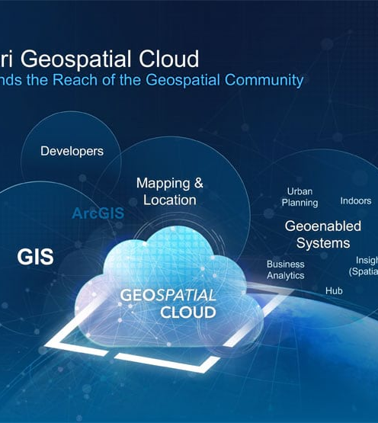
CLOUD-BASED GIS PLATFORMS
Cloud-based Geographic Information Systems (GIS) platforms provide real-time access to geospatial data, enabling efficient real estate data management. These scalable solutions allow real estate professionals to quickly access and analyze critical information, streamlining decision-making processes.

Slide 17

IMPORTANCE OF PUBLIC-PRIVATE COOPERATION
Accurate data is crucial for informed decision-making in the real estate industry. Public-private collaboration can enhance data accuracy and utilization through data sharing and policy support. By combining resources and expertise, public agencies and private organizations can develop comprehensive data sets and streamlined processes to better serve the needs of the real estate market.

Slide 18
“Through innovation and technology, our vision is to enable sustainable development, facilitate informed decision-making, and contribute to the prosperity and resilience of our community.”

Slide 19

POTENTIAL OUTCOMES FROM IMPROVING DATA COLLECTION, QUALITY, AND CAPACITY*:
Uncollected and/or Delinquent Property Taxes ($10.5 Million)
Improving data quality can help identify and collect unpaid property taxes, boosting government revenue.
Unbilled/Unidentified Property Owners ($2.8 Million)
Accurate data can ensure all property owners are billed and identified, leading to increased tax collection.
Unpaid Escaped Assessments ($2.3 Million)
Improved data quality can help identify properties that have escaped proper tax assessment, allowing for collection of owed taxes.
Unbilled and Unassessed Chamorro Land Trust Real Property Inventory ($1.9 Million)
Accurate data on Chamorro Land Trust properties can ensure all are properly billed and assessed for taxation.
Untaxed Multi-Family Dwelling Properties ($862,000.00)
Improved data can help identify multi-family properties that are not being properly taxed, increasing revenue.
New Residential Home Construction and Additions to Existing Units ($2.6 Million)
Accurate data on new construction and home additions can ensure these properties are assessed and taxed appropriately.

Slide 20

ADVANCED TECHNOLOGY IMPLEMENTATION
Blockchain technology offers a secure and transparent way to record and track real estate transactions, ensuring data accuracy and tamper-proof record-keeping. Automated data collection from various sources, such as property records and sensor data, can further enhance the reliability and timeliness of the information available to real estate professionals.

Slide 21





CONCLUSION
Data-Driven Decision-Making
Data Standardization
Accurate real estate data enables informed decision-making, leading to optimal resource allocation and sustainable growth.
Establishing industry-wide data standards and protocols ensures consistency, interoperability, and reliability of real estate data.
Technology Implementation
Public-Private Collaboration
Continued investment in innovative technologies, such as data analytics and automation, can enhance data accuracy and reliability.
Strengthening partnerships between government agencies and private real estate organizations can foster data sharing and improve data quality.
By prioritizing accurate data, implementing cutting-edge technologies, standardizing data practices, and fostering public-private cooperation, the real estate industry can unlock the full potential of data-driven decision-making and drive sustainable growth.

